Slide 1
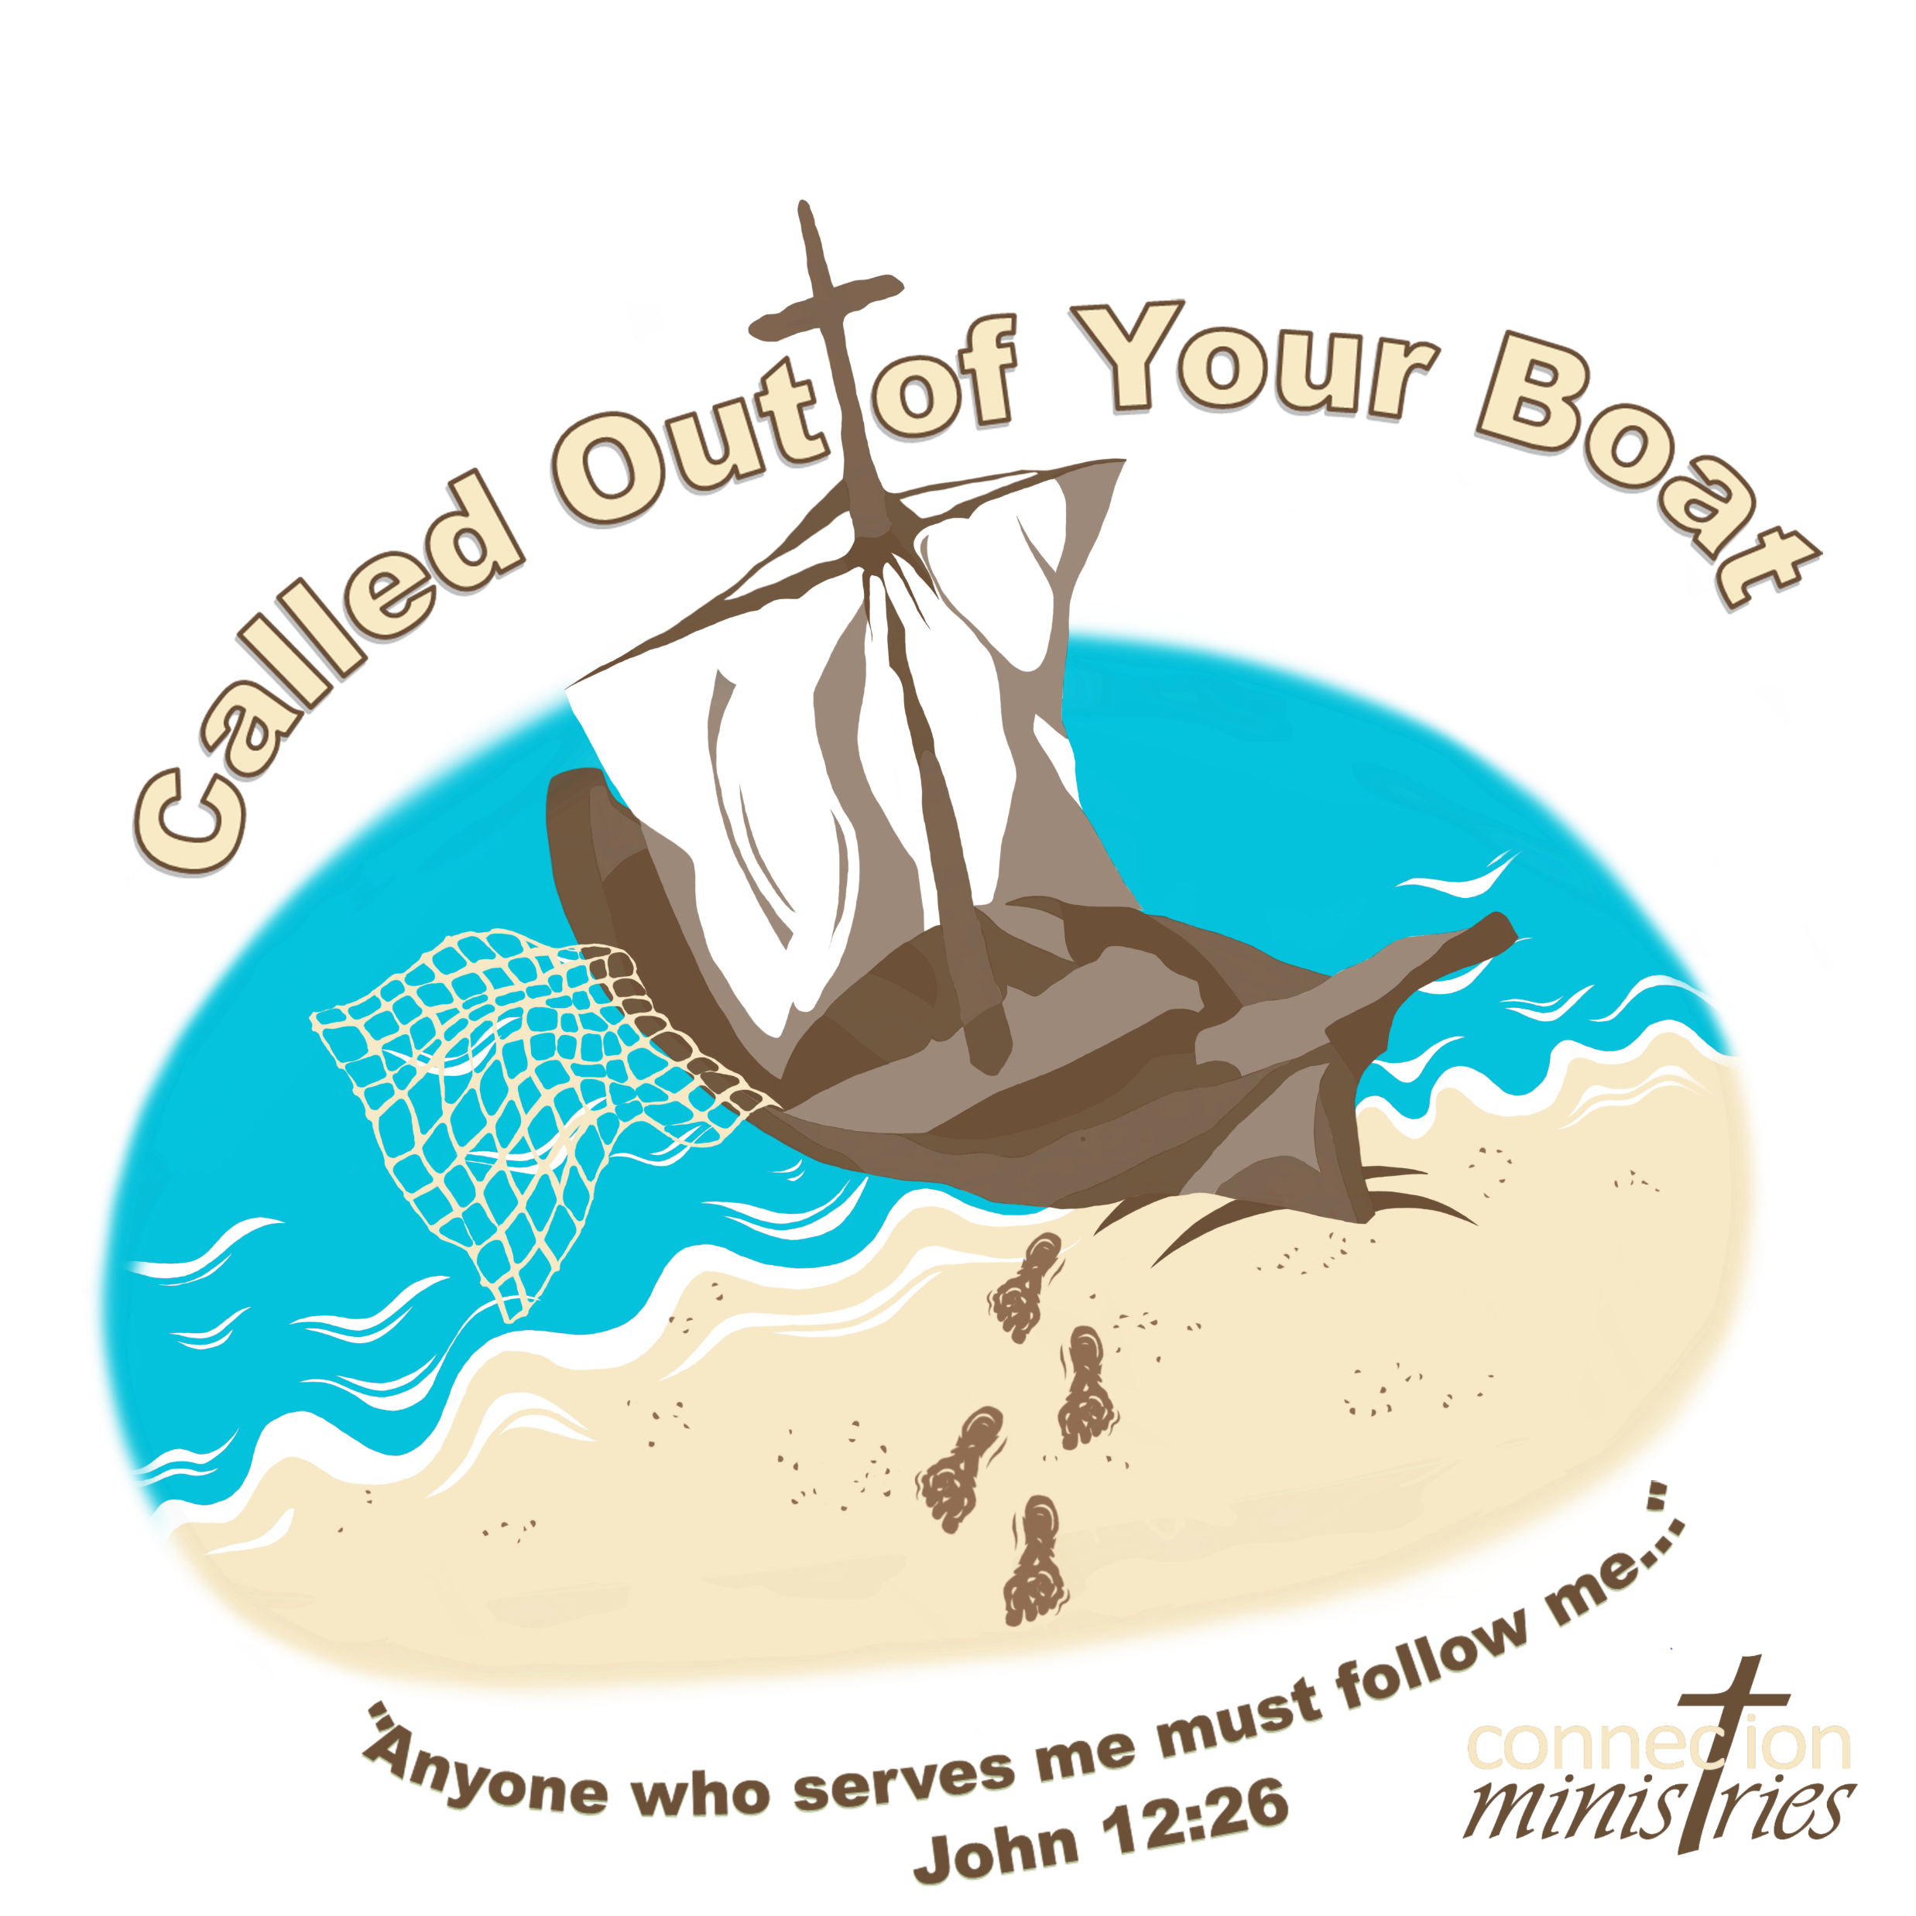

Slide 2
Day 1
Called to Follow
Jesus calls Peter to be a fisher of men
(John 1, Luke 5:1-11)

Slide 3
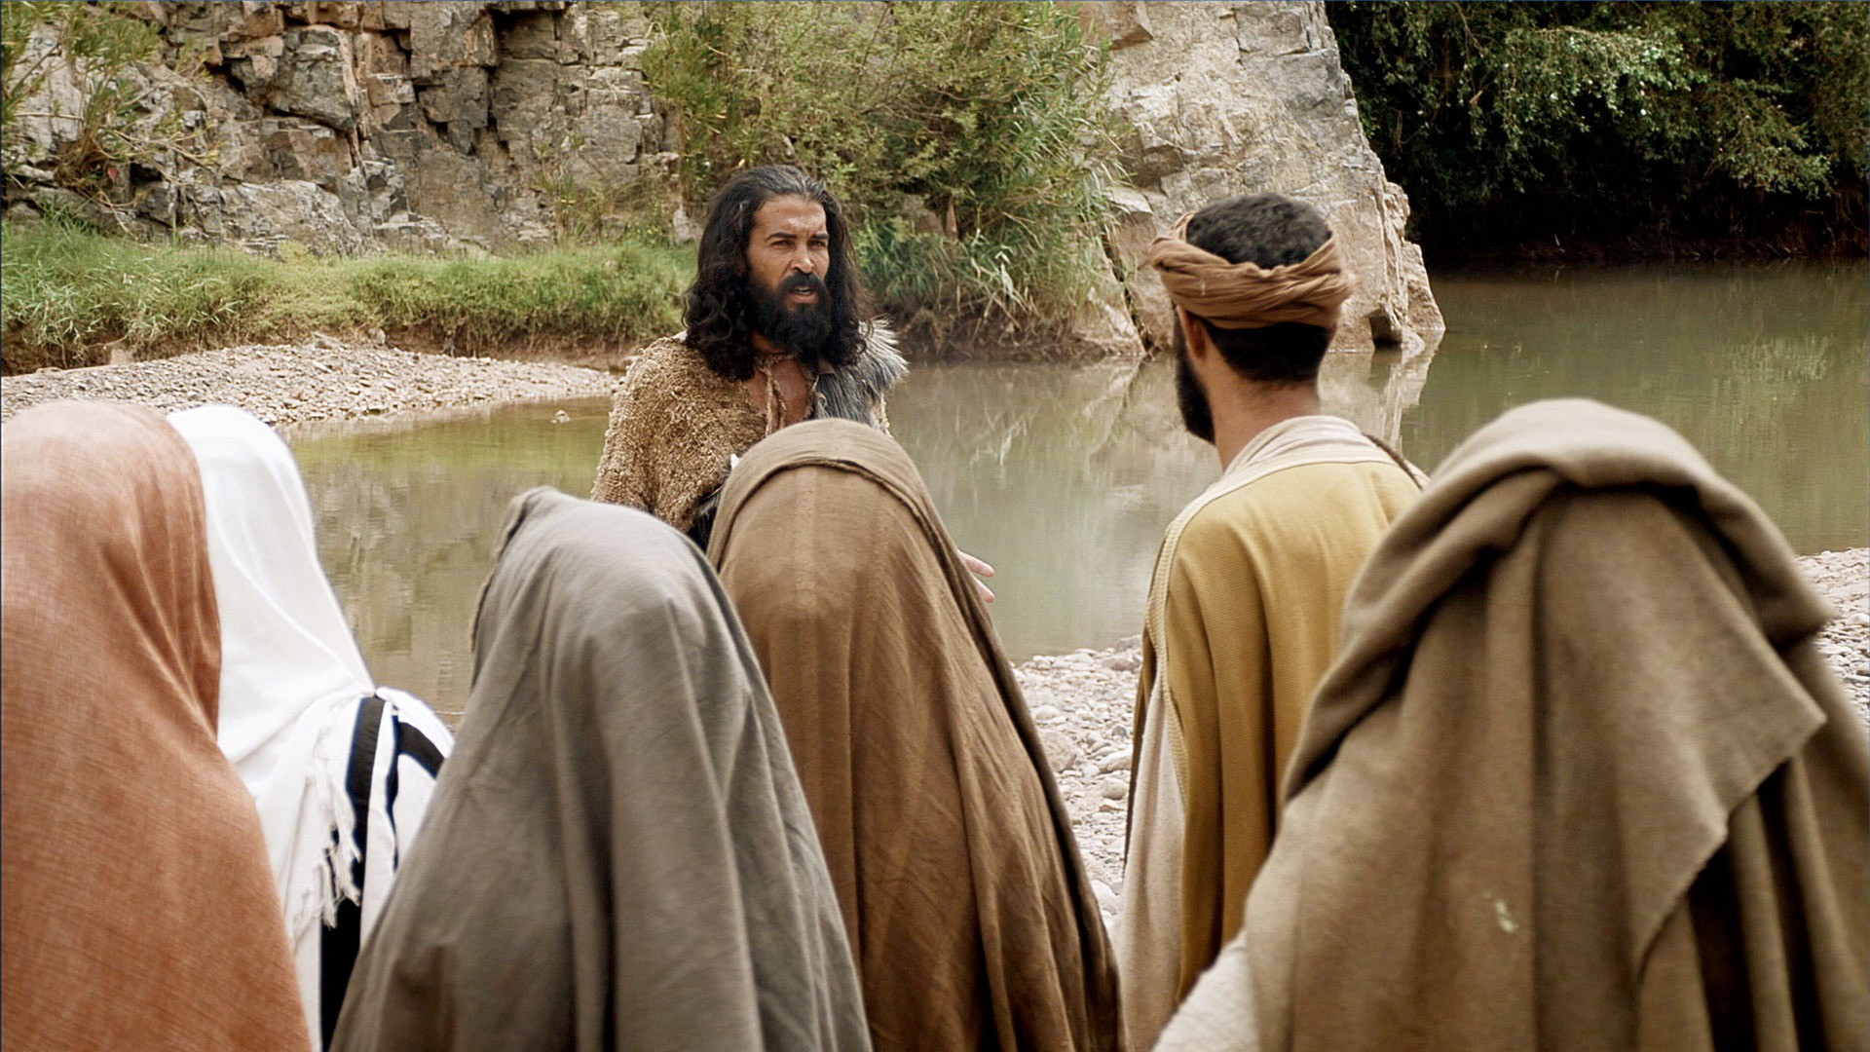
Andrew and another disciple were following John the Baptist. One day they heard John refer to Jesus as the “Lamb of God.” At that time, they started following Jesus.

Slide 4
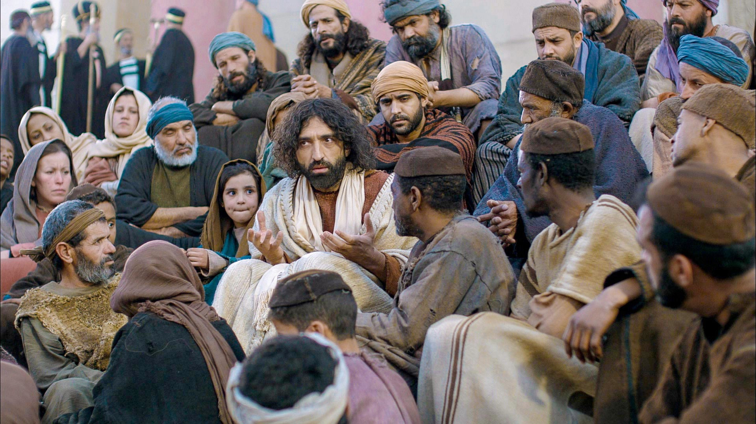
The story continues in Luke 5 where Jesus is preaching the Word of God in the synagogues of Judea.
Crowds of People were pressing around Him.

Slide 5
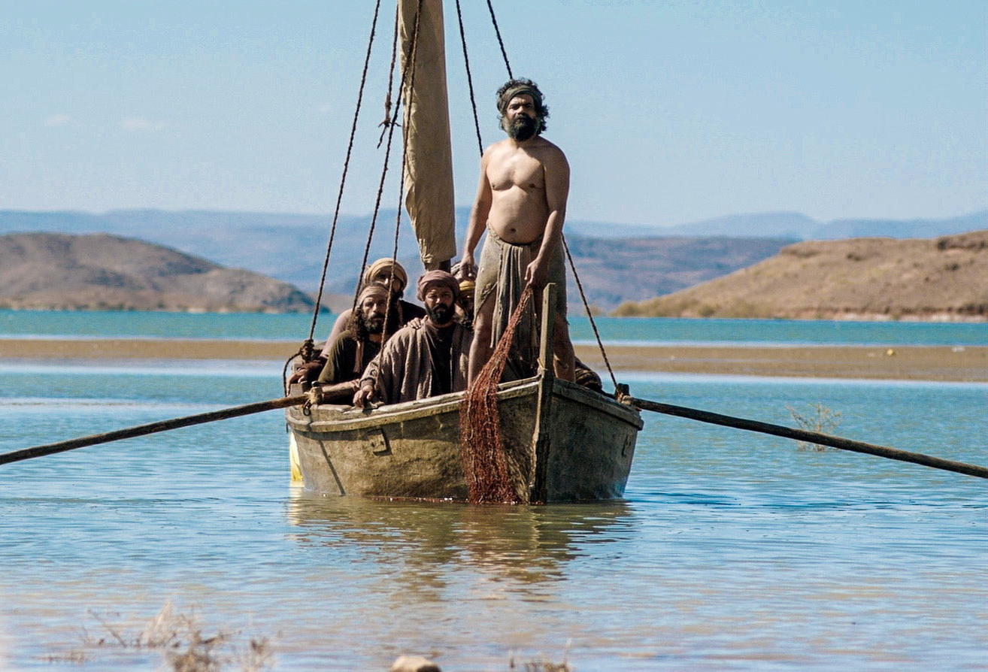
AAAAA
Andrew and Peter were fisherman in the area where Jesus was teaching.

Slide 6
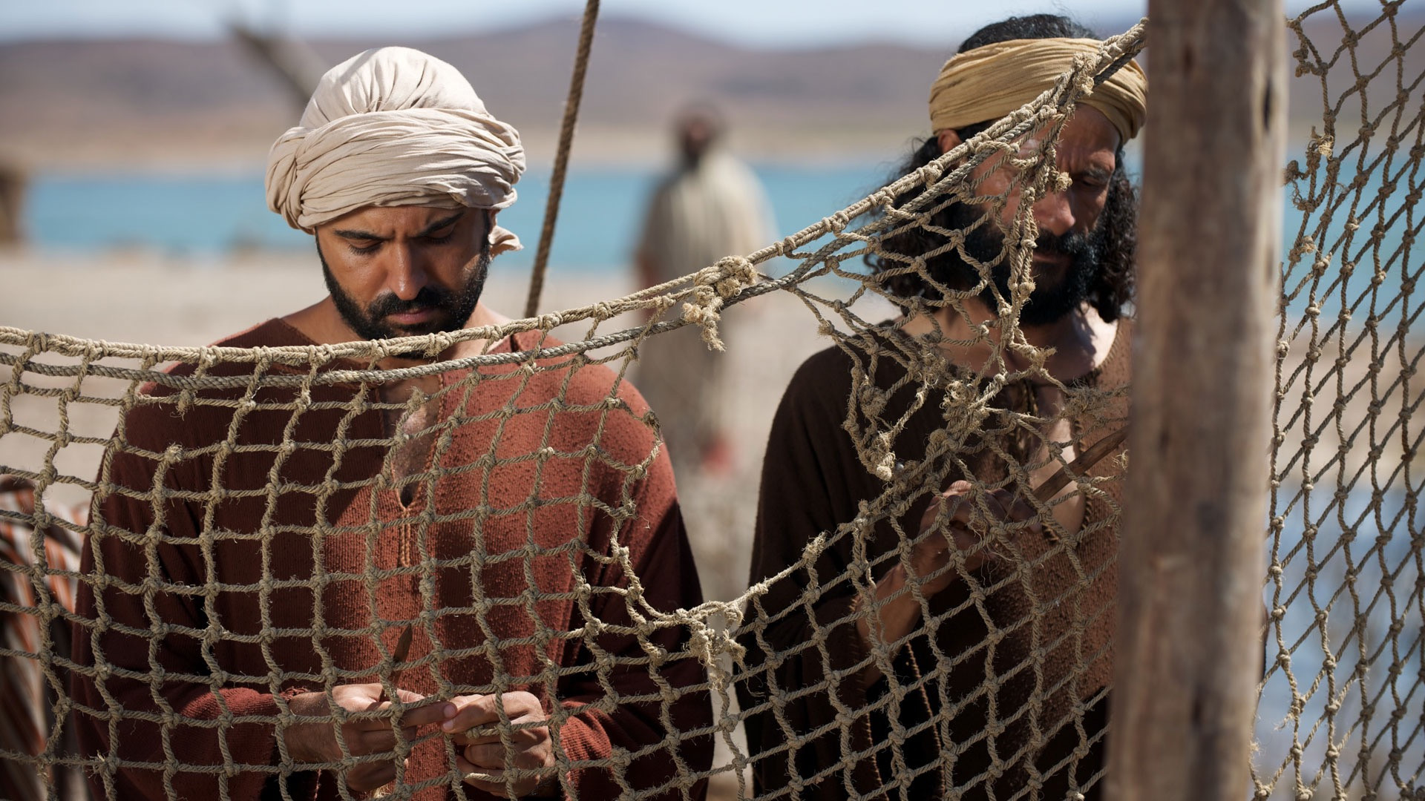
They had been fishing all night but caught nothing. They were cleaning their nets.

Slide 7
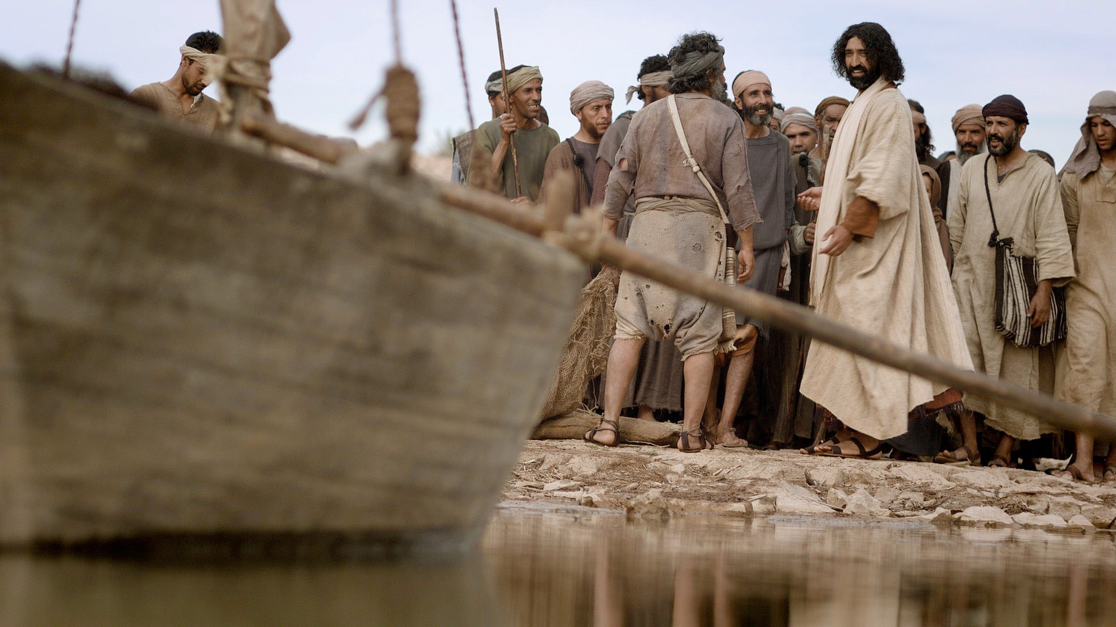
Jesus saw their boats near the shore and decided to get in one of the boats which belonged to Peter.

Slide 8
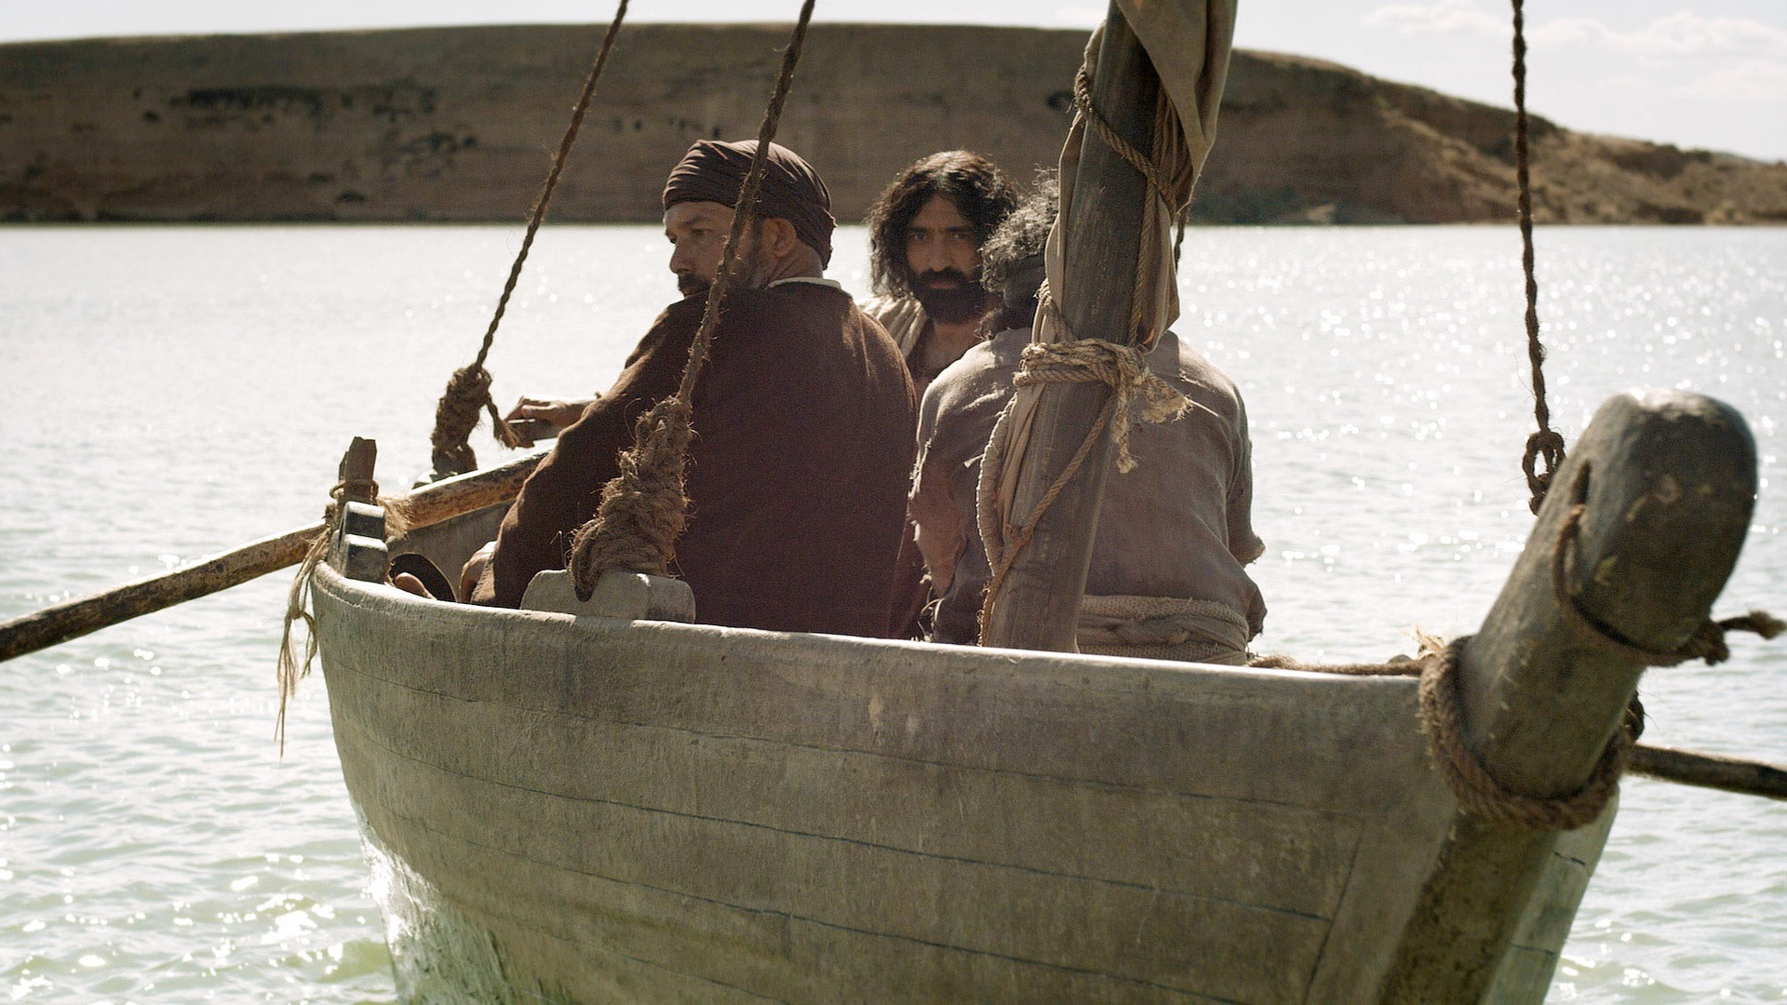
He asked Peter to take the boat out a little from the shore so the people could hear him better.

Slide 9
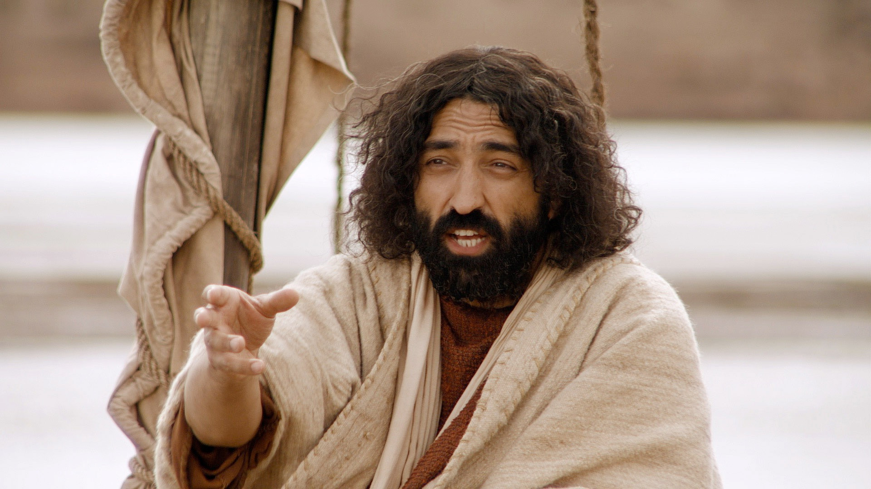
When he finished speaking, He turned to Peter and said, “Go out into the deep water. Let down the nets so you can catch some fish.”

Slide 10
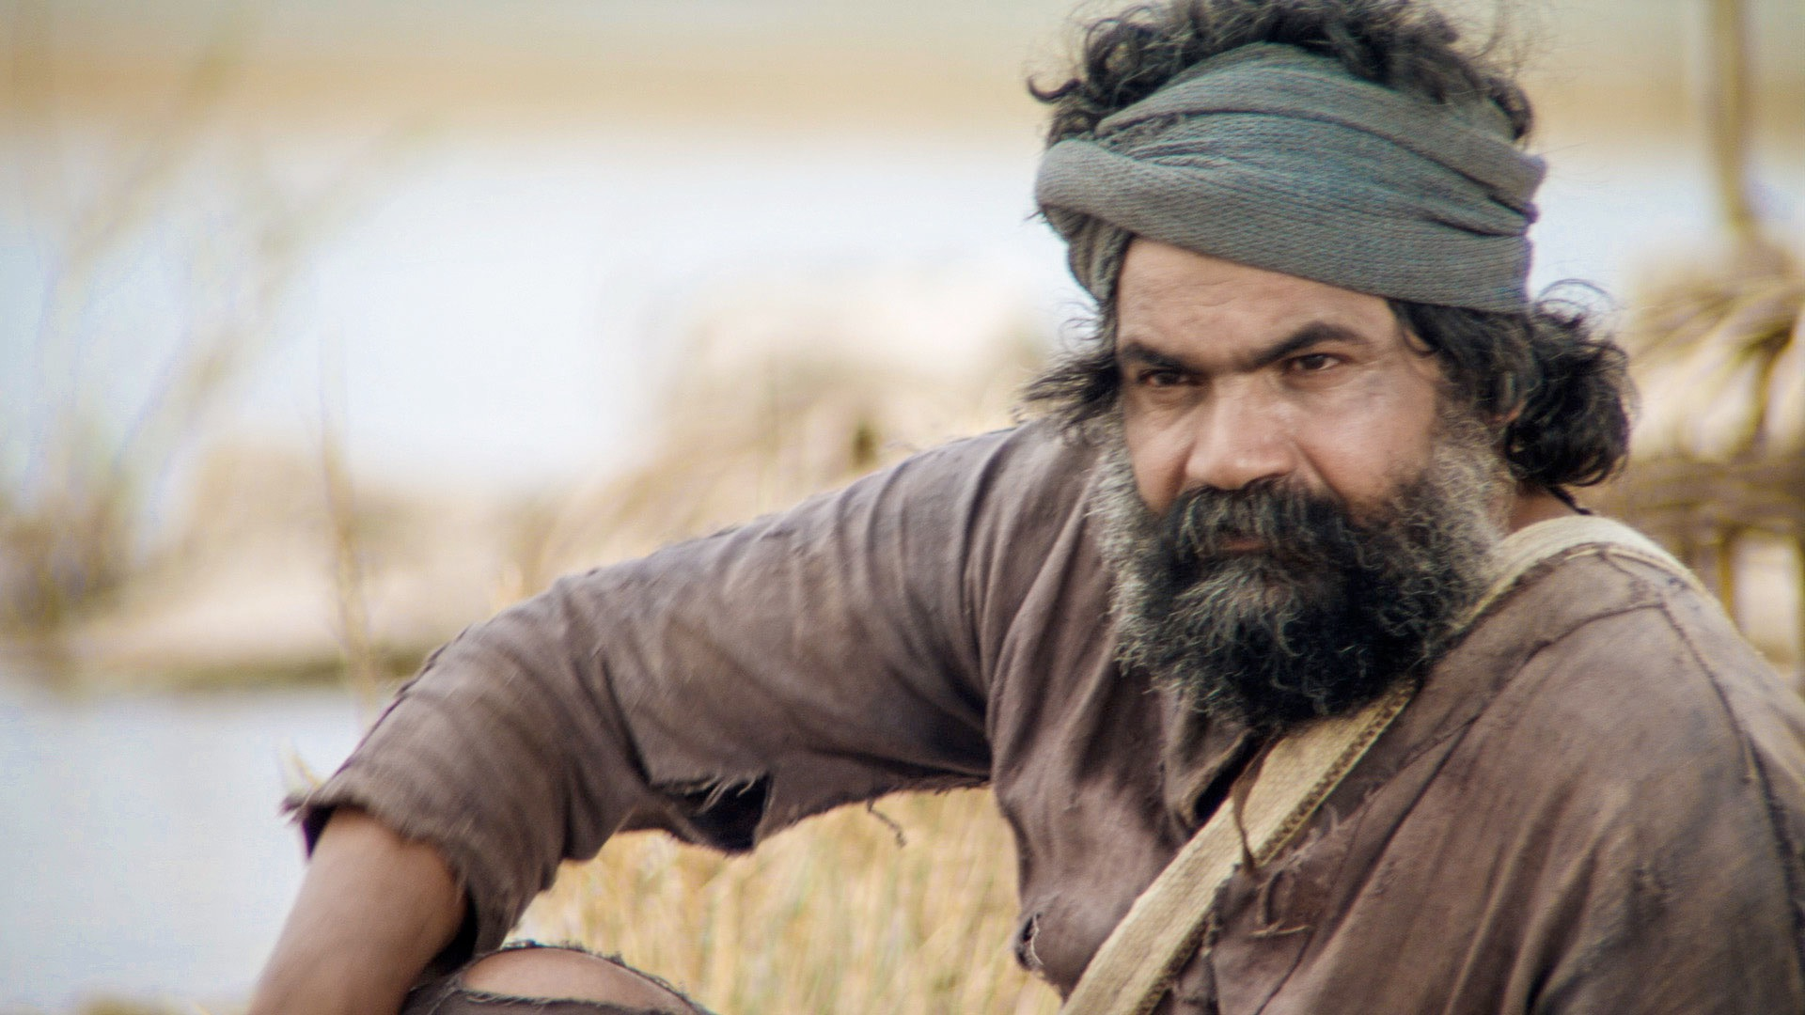
You can hear Peter’s frustration when he answered, “Master, we’ve worked hard all night and haven’t caught anything.”

Slide 11
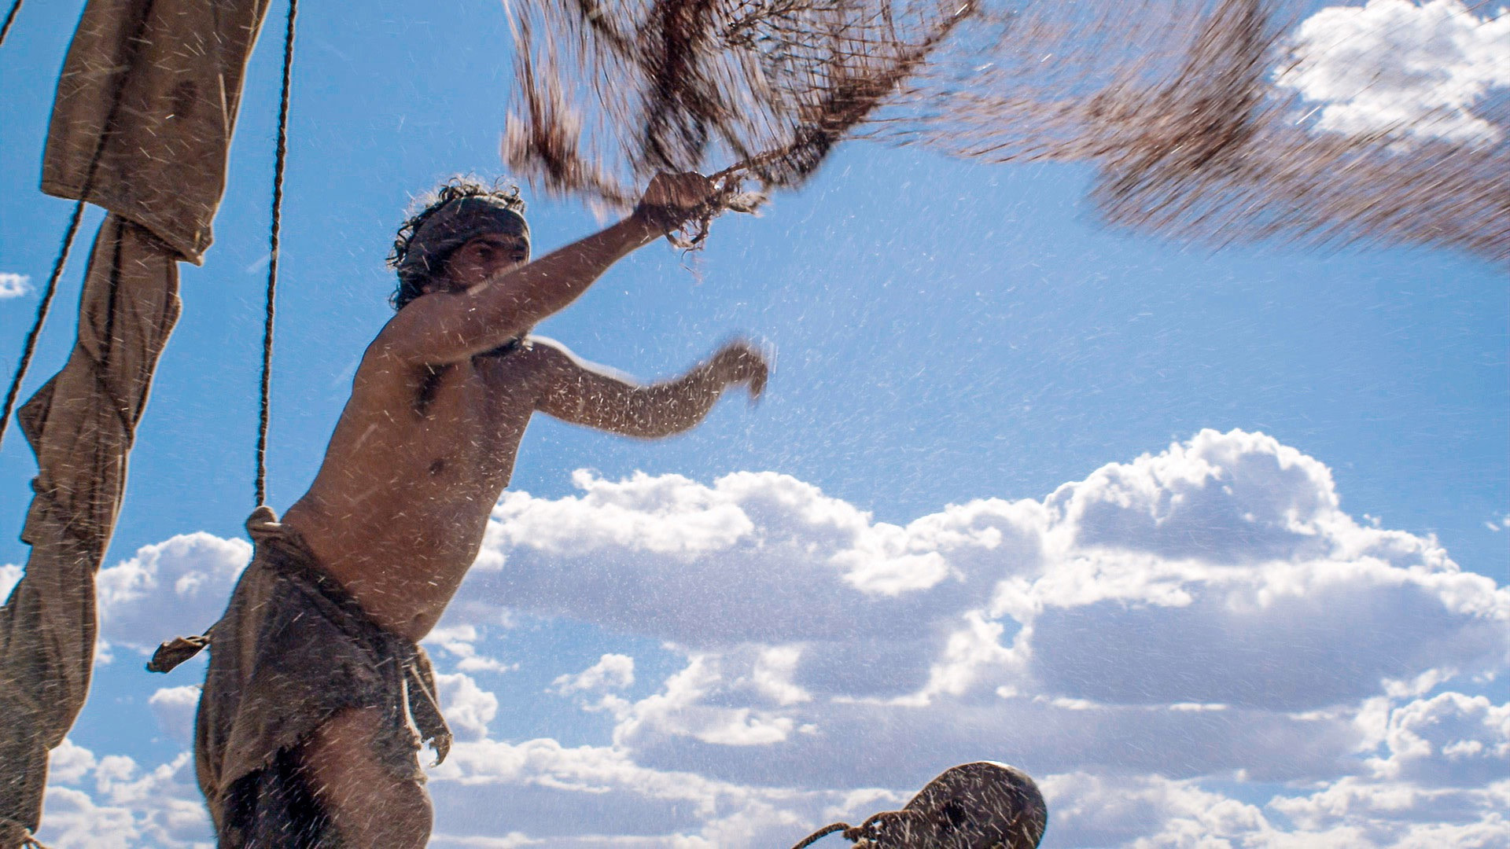
“Because you say so, I will let down the nets.”

Slide 12
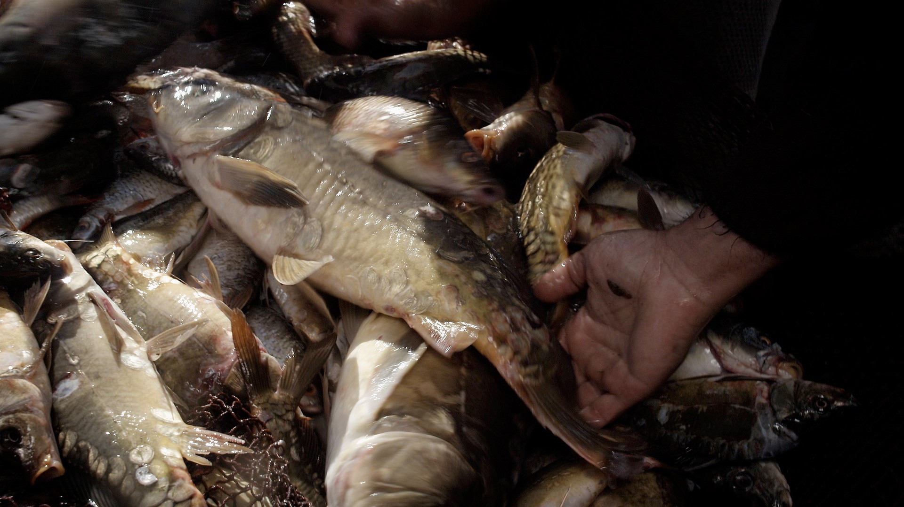
As soon as they let down their nets, they caught a huge number of fish! So many that their nets were at the point of breaking.

Slide 13
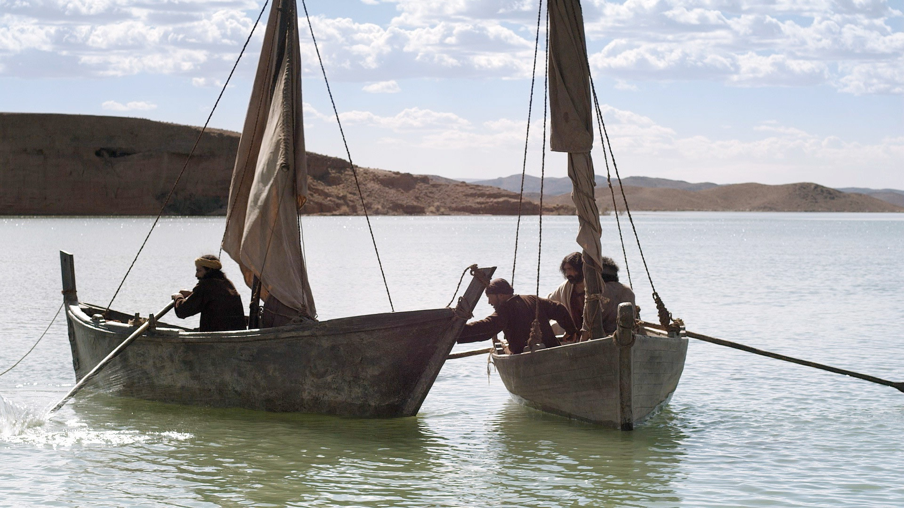
They signaled their partners James and John who were in another boat to help them. They all worked together to pull in the boat load of fish.

Slide 14
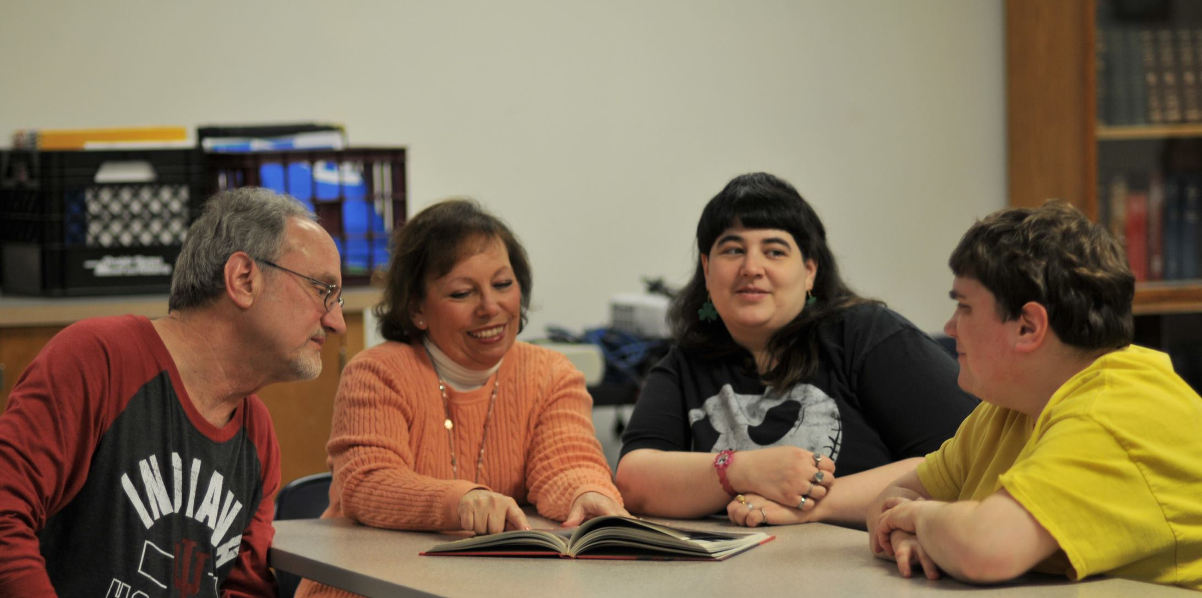
Some of us can teach…

Slide 15
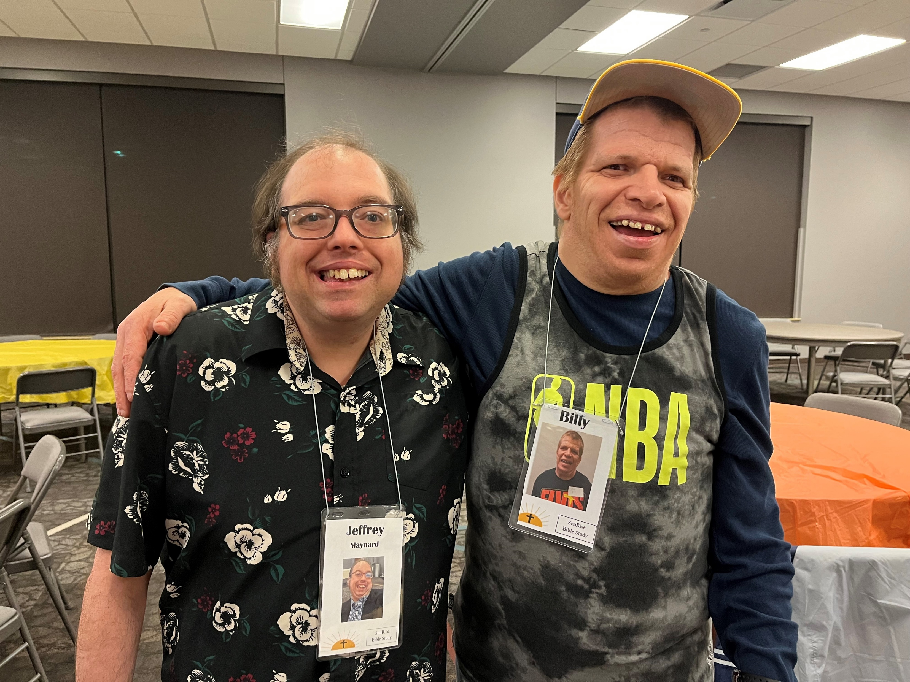
…or tell a friend about Jesus.

Slide 16
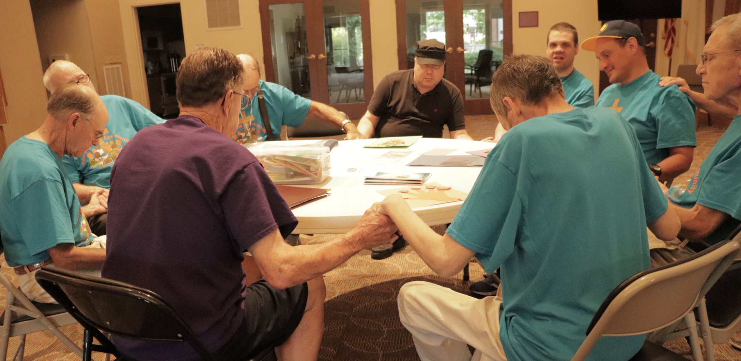
We can stop and pray with a friend,
or anyone in need.

Slide 17
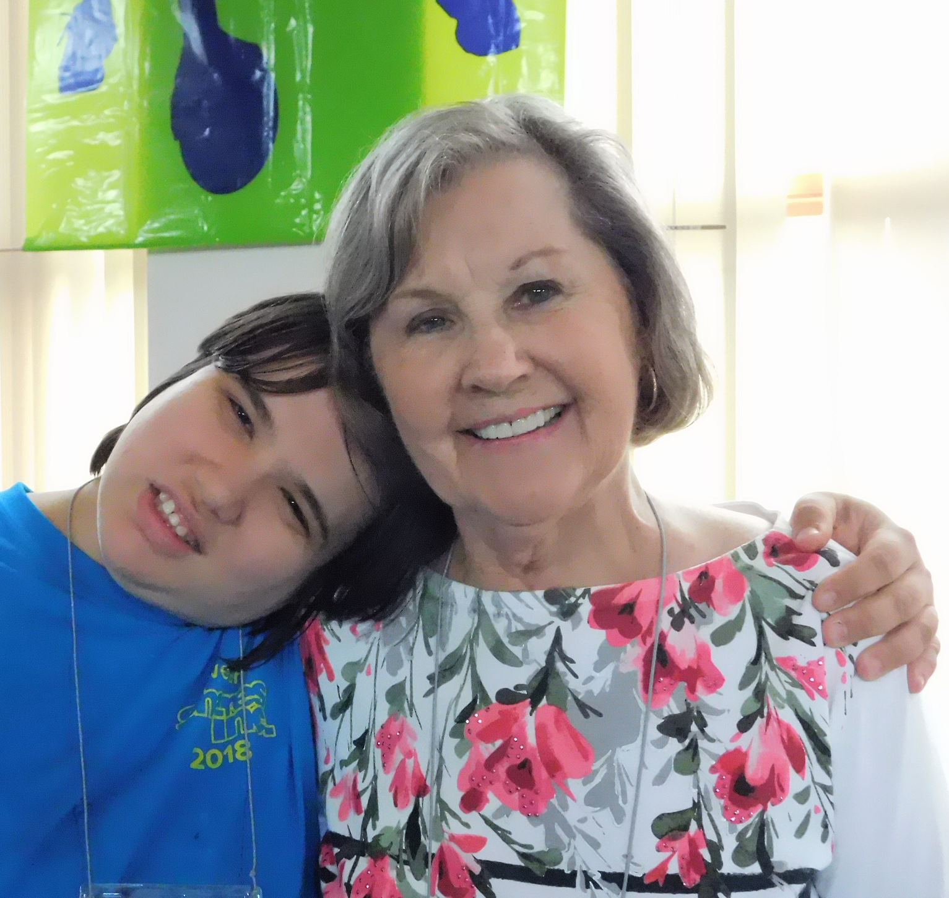
We can encourage others who are hurting or sad.

Slide 18
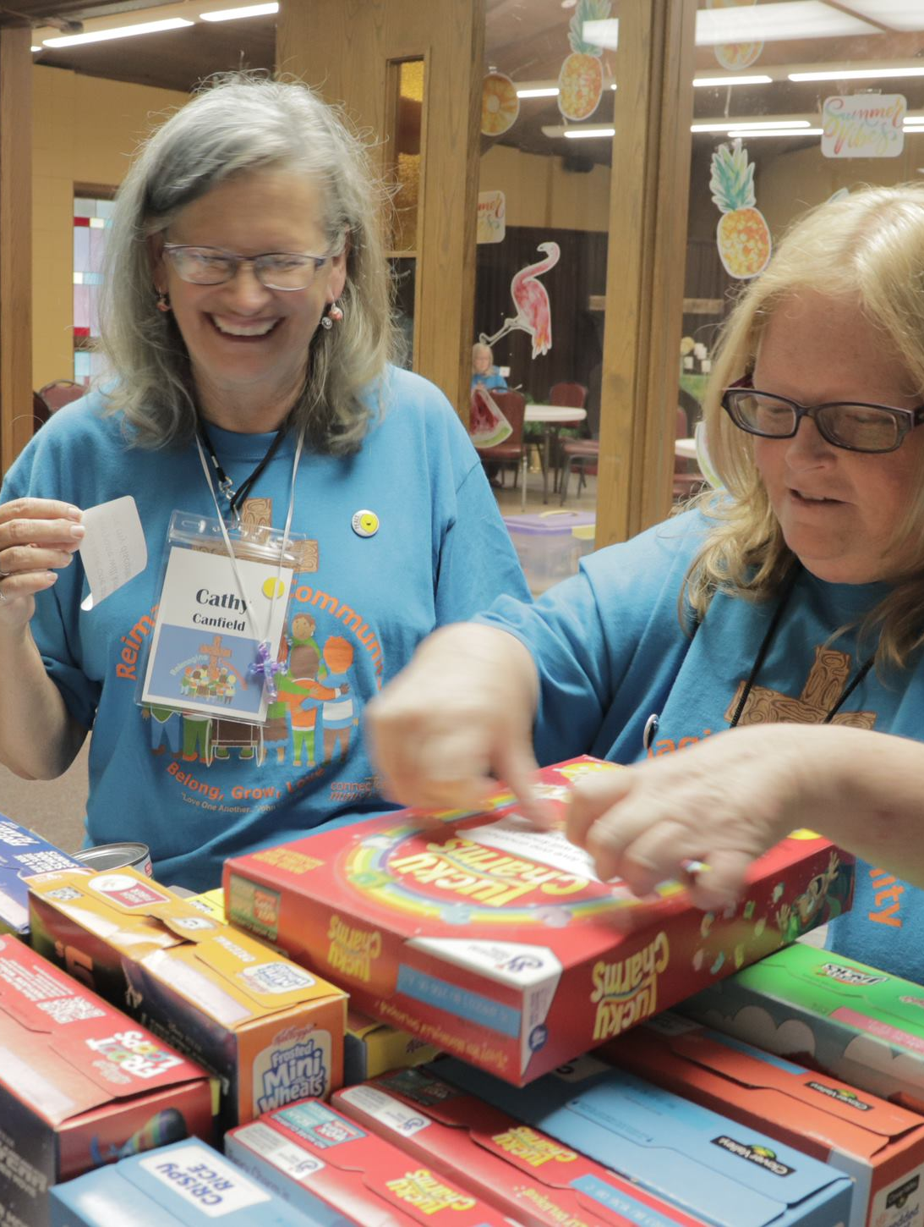
We can give to people who are in need
…or be generous with our time and money.

Slide 19
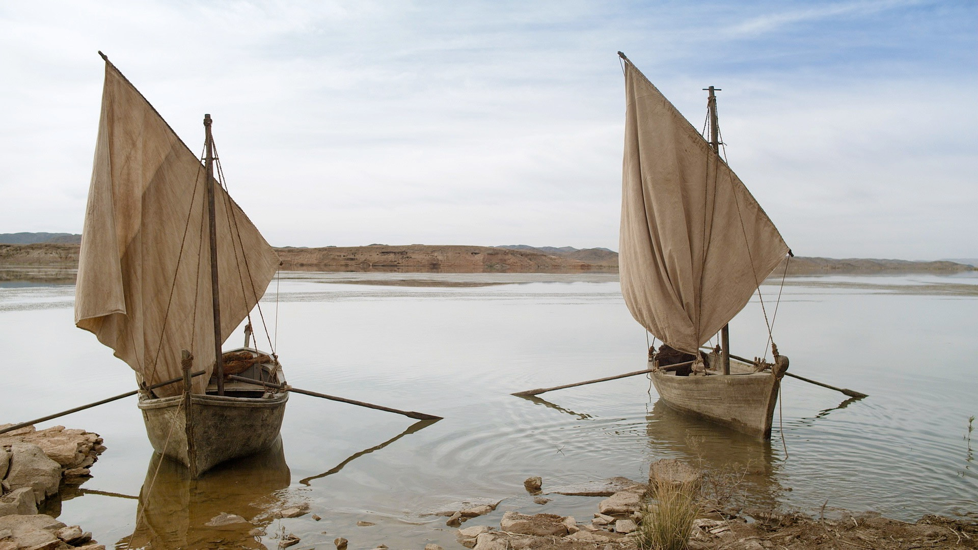
What are we willing to leave behind to follow Jesus? Peter left his fishing boat to follow Jesus.

Slide 20
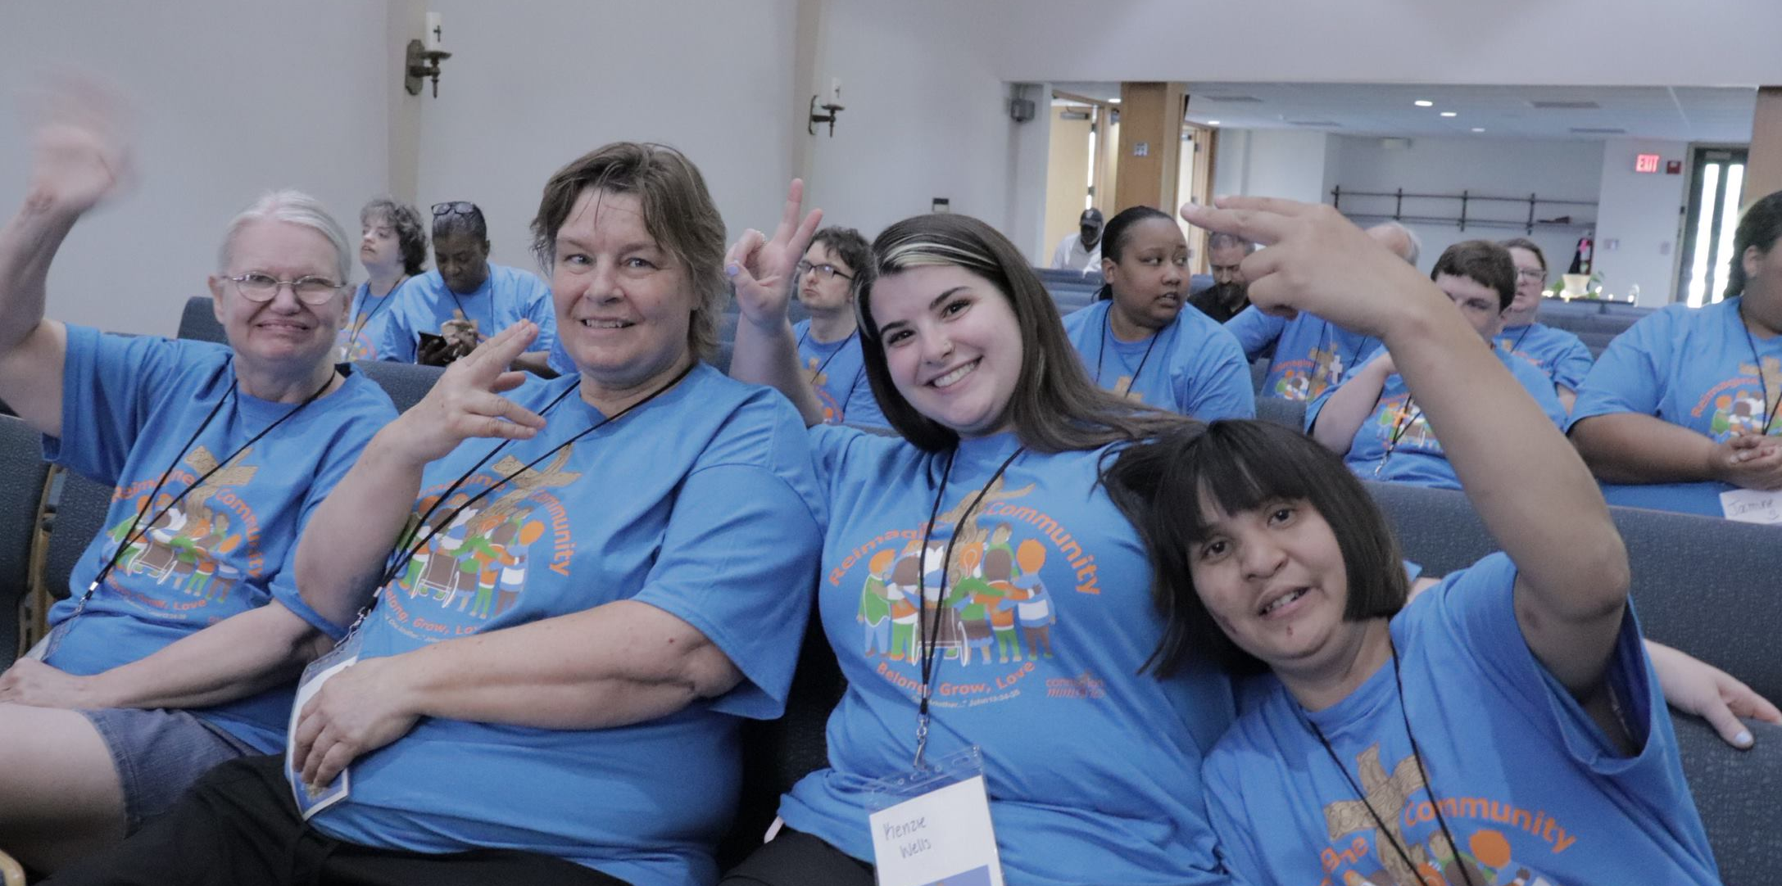
We could skip watching TV and go to Friendship Group.

Slide 21
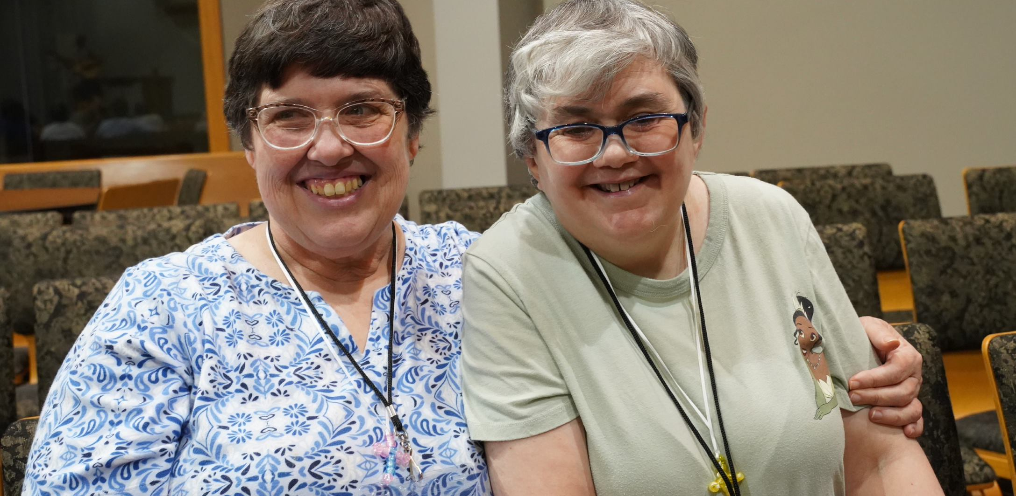
Give up a nap so you could help someone
with a chore.

Slide 22
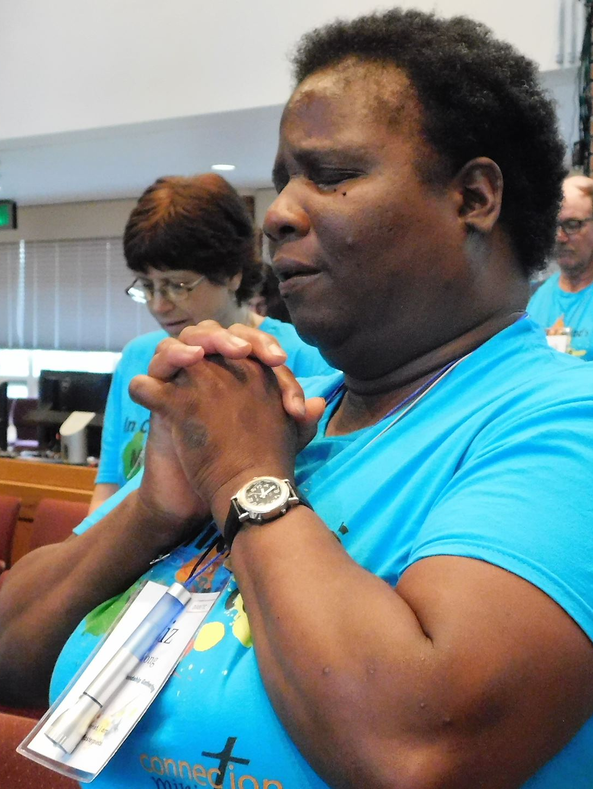
We can ask Jesus for courage
and pray with someone.

Slide 23

