Slide 1
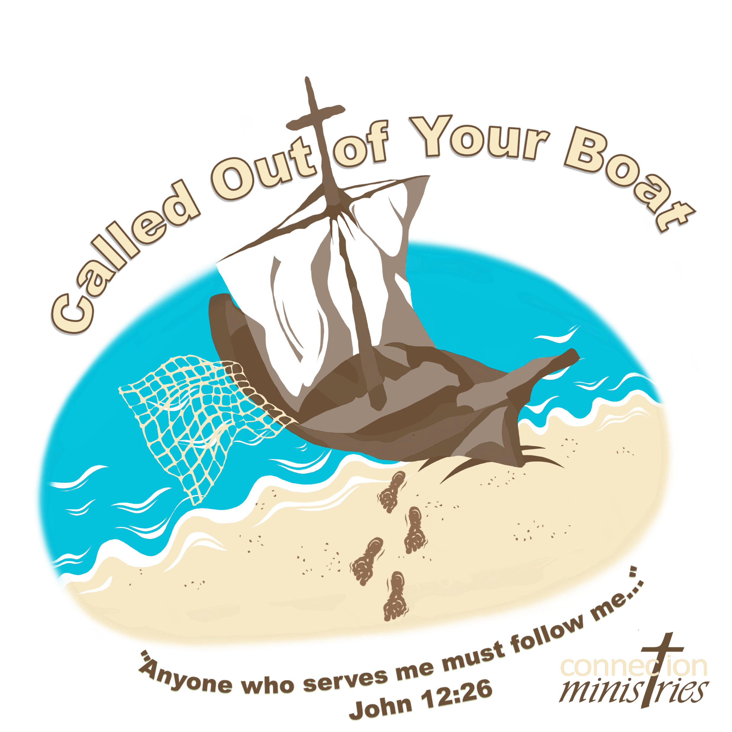

Slide 2
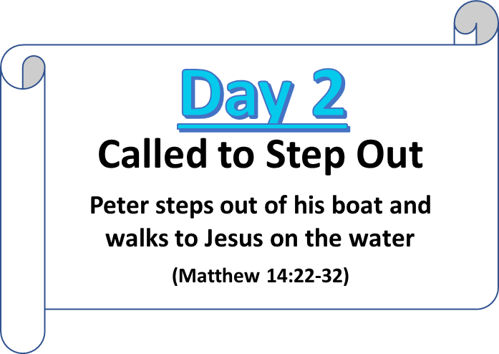

Slide 3
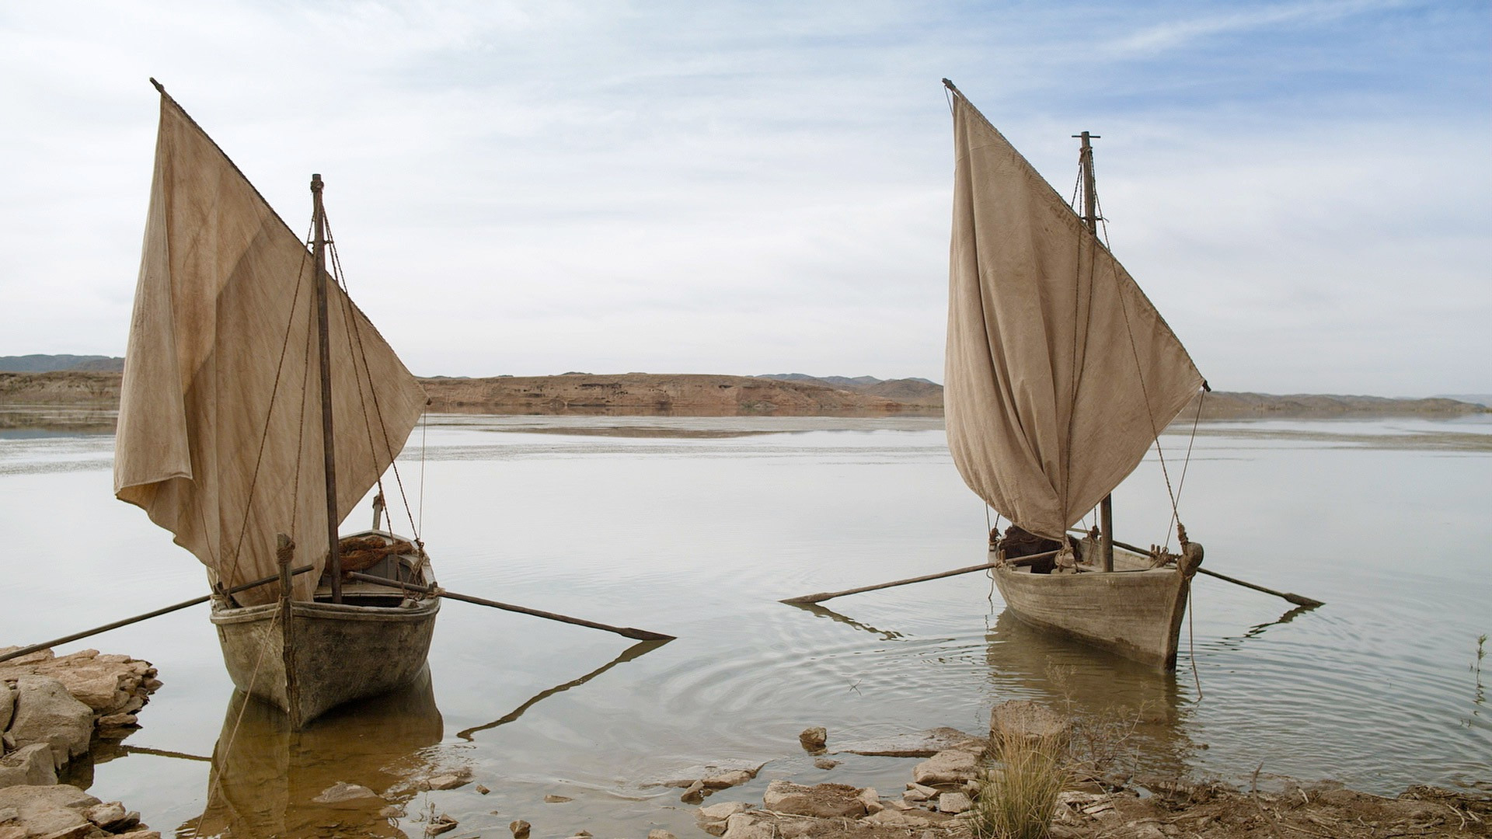
On day 1, Jesus called Peter out of his boat from being a simple fisherman to become a fisher of men.

Slide 4
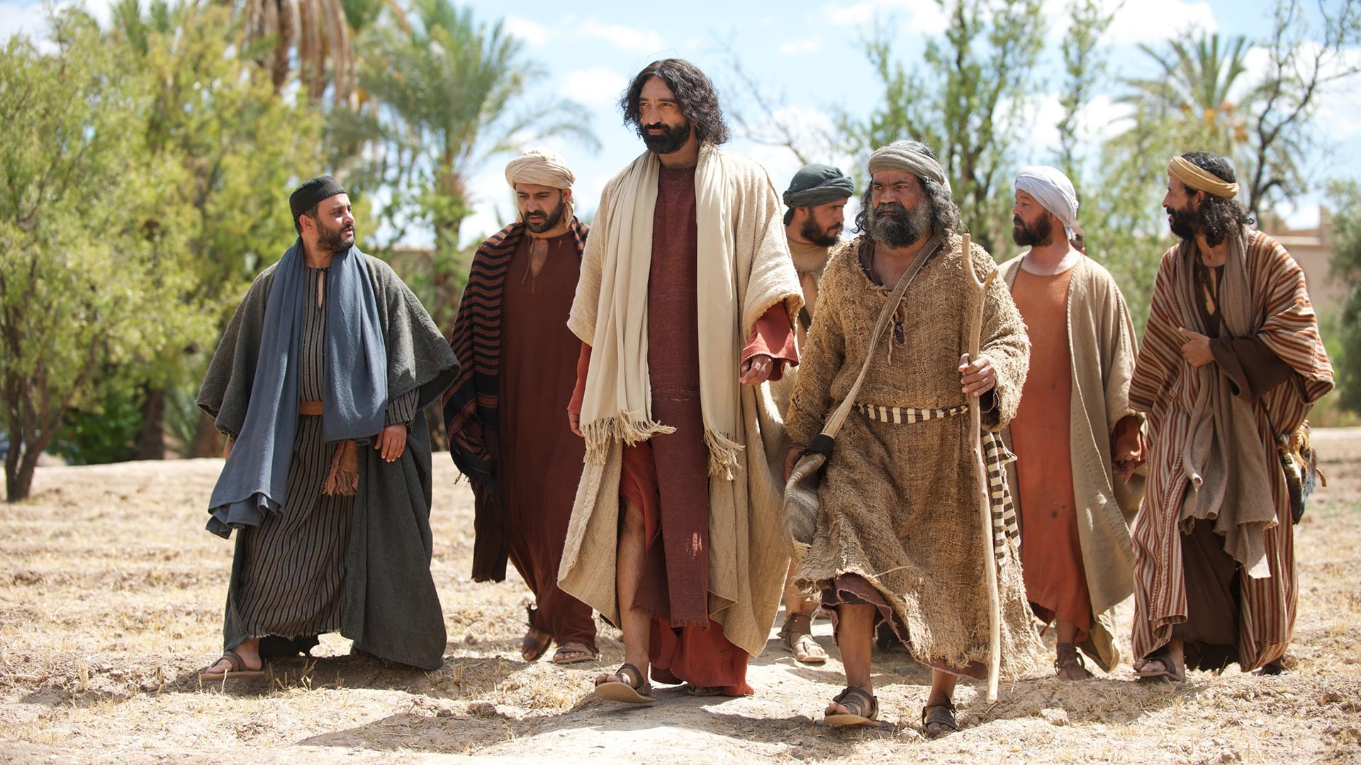
By faith, Peter answered the call and left everything behind to follow Jesus.

Slide 5
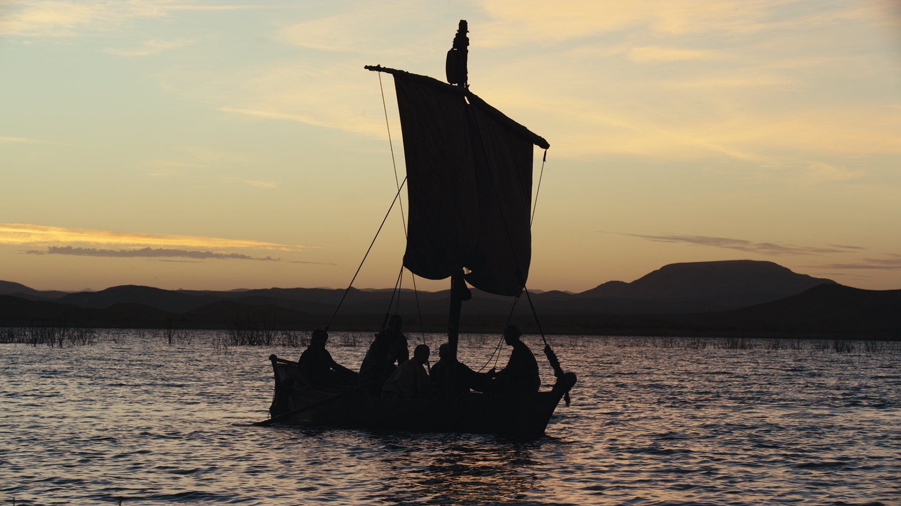
Jesus made the disciples get into the boat after a couple long days of teaching and healing people. He had them go on ahead of him to the other side of the Sea of Galilee.

Slide 6
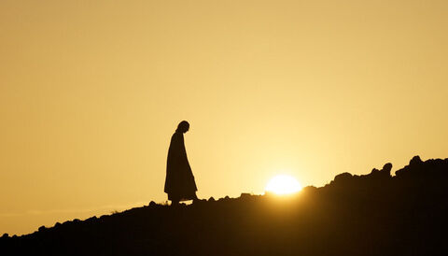
Jesus went up on a mountainside by Himself to pray. He needed to be alone with His Father.

Slide 7
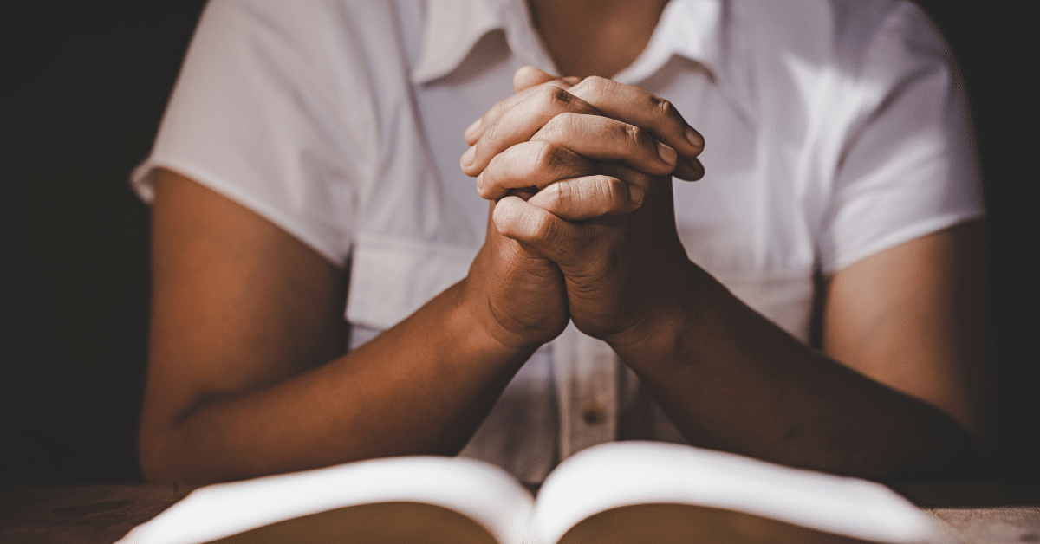
Prayer is a way we can talk to God

Slide 8
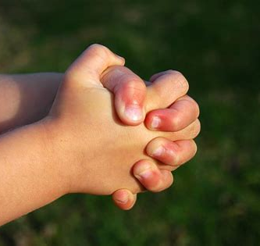
We can find a place to be alone with God without other distractions.

Slide 9
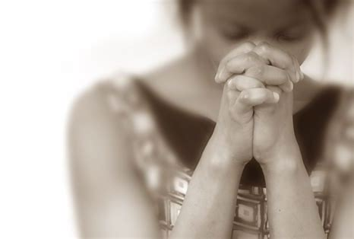
We can talk to Him about our day
and what He wants to do in our lives.

Slide 10
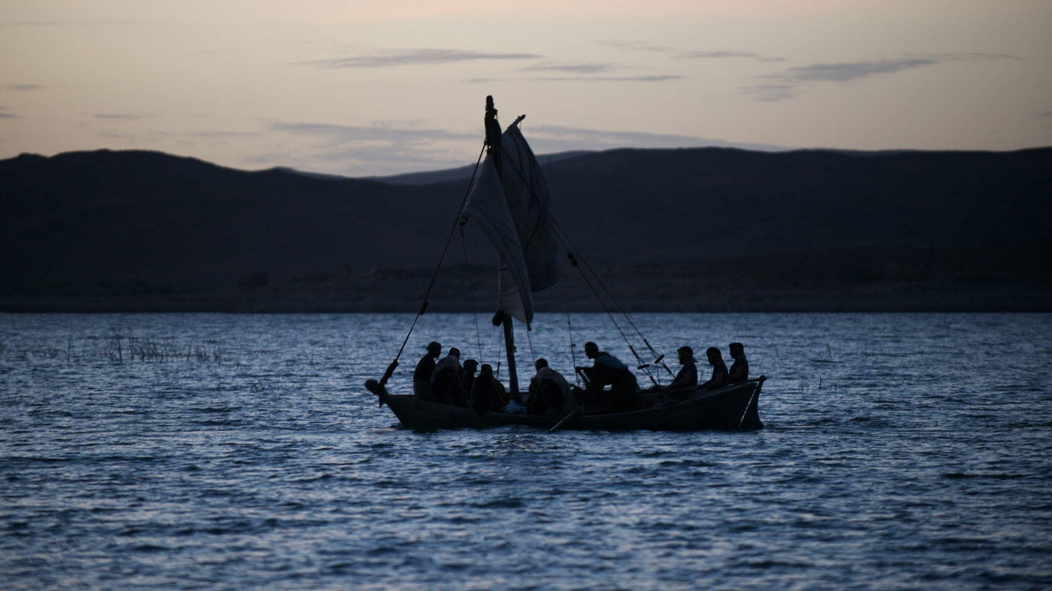
The boat was already a long way from land when Jesus came down from the mountain.

Slide 11
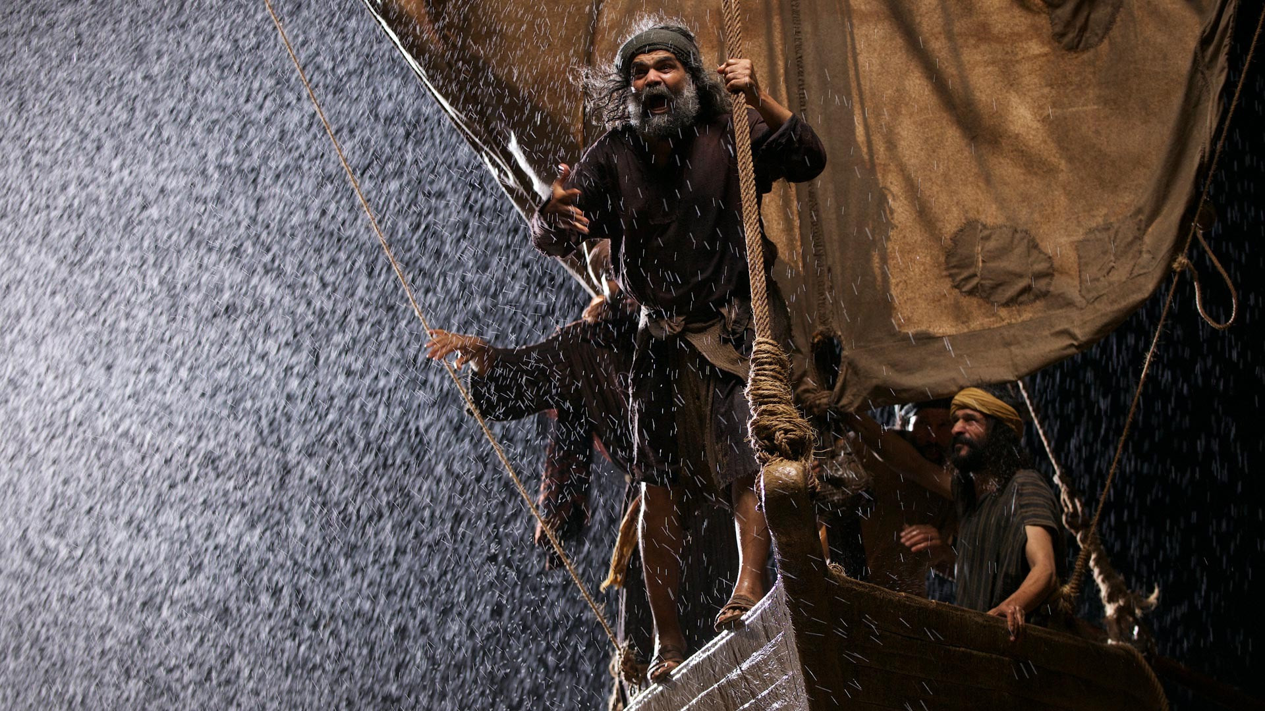
Suddenly a great storm arose, and the disciples were being pounded by the waves.

Slide 12
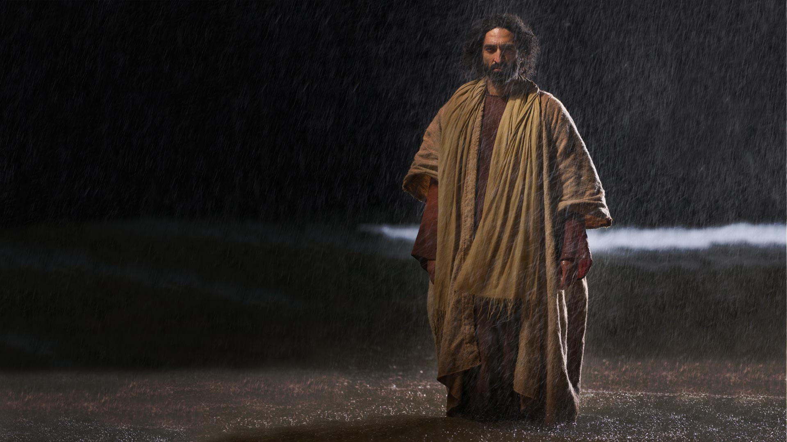
Shortly before dawn Jesus went out to them walking on the water. The disciples saw Him and were terrified. “It’s a ghost!” they said.

Slide 13
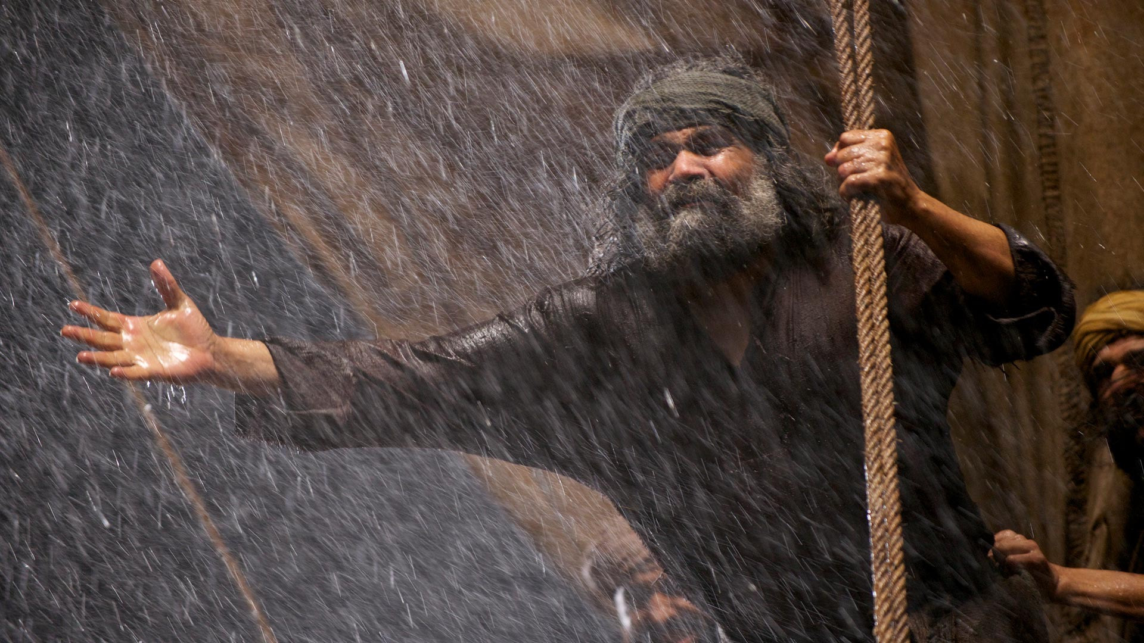
“Lord is it You?” Peter asked. “If it is call to me to come to You on the water.”

Slide 14
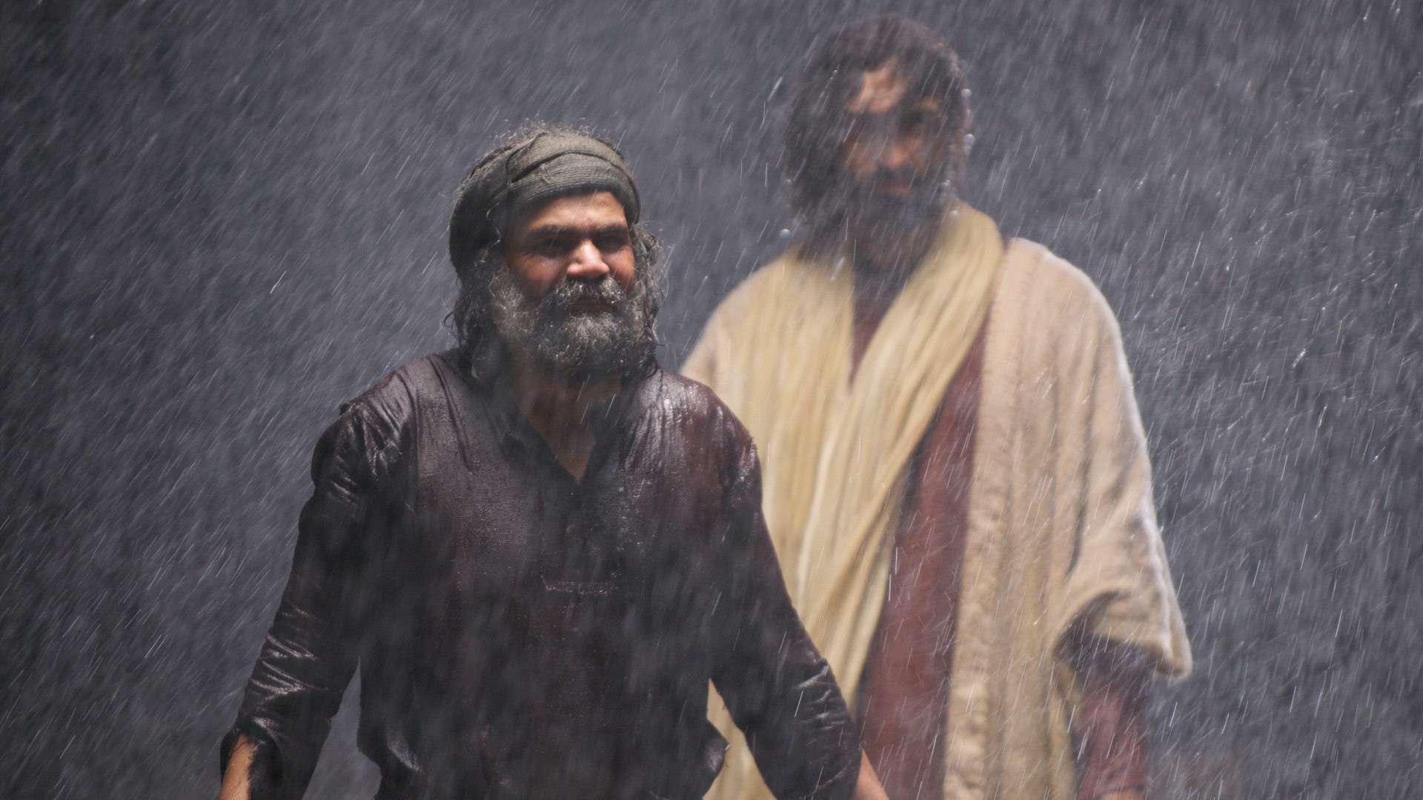
“Come.” Jesus said. And Peter stepped out of the boat and walked on the water to Jesus.

Slide 15
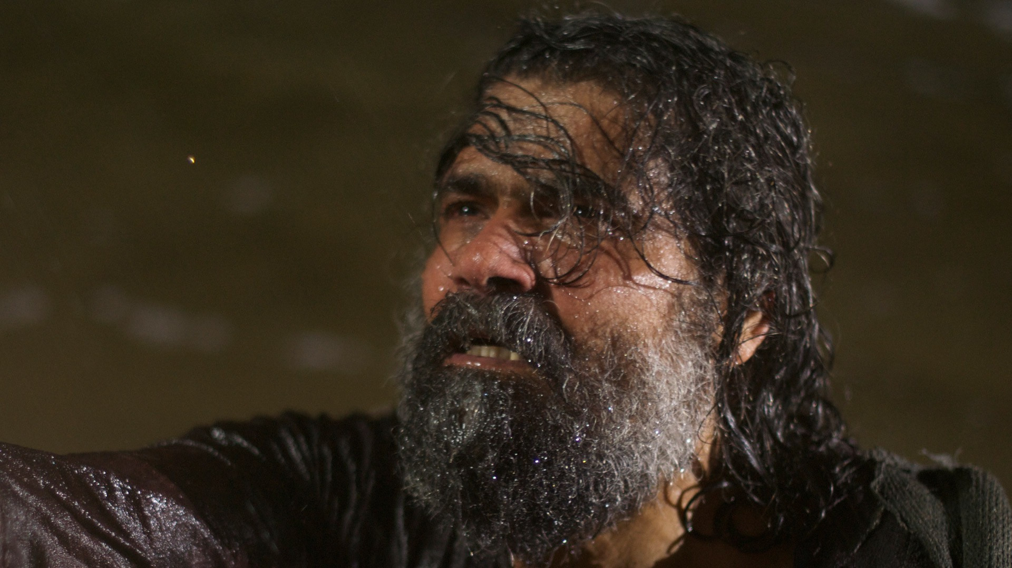
When Peter saw the wind and waves, he was afraid and began to sink.

Slide 16
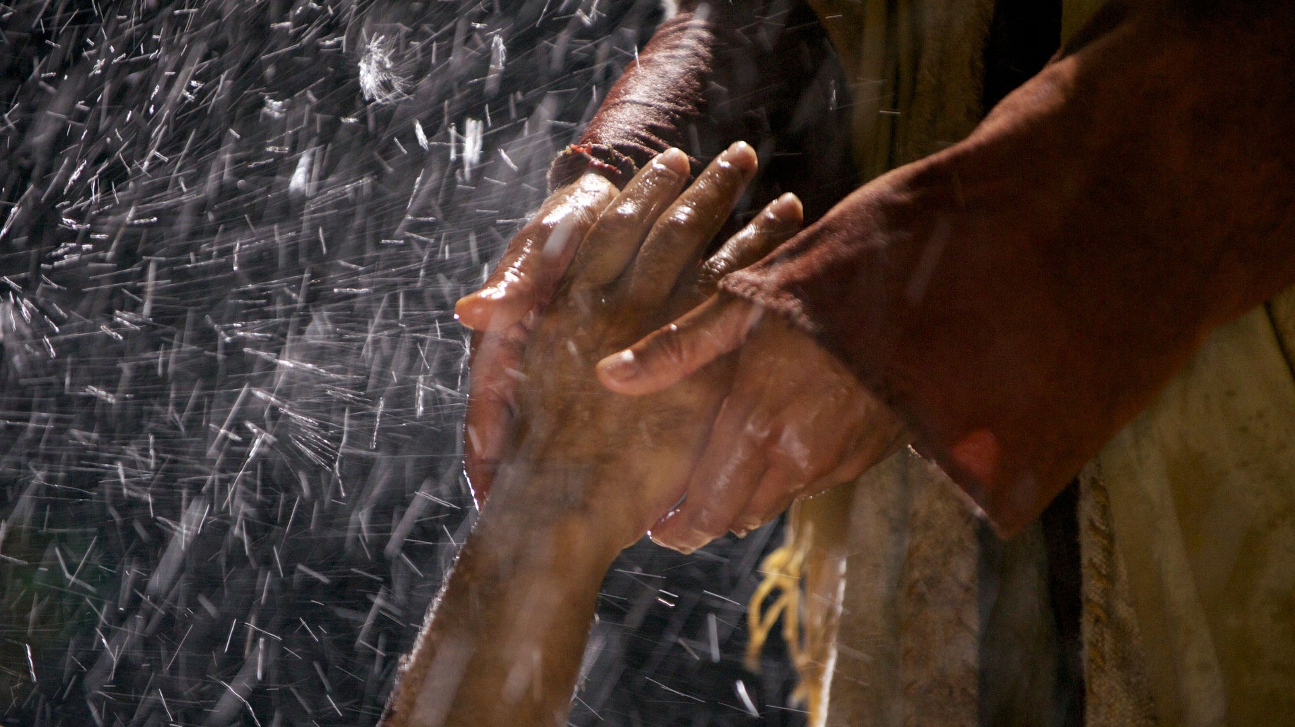
He cried out, “Lord, save me!”

Slide 17
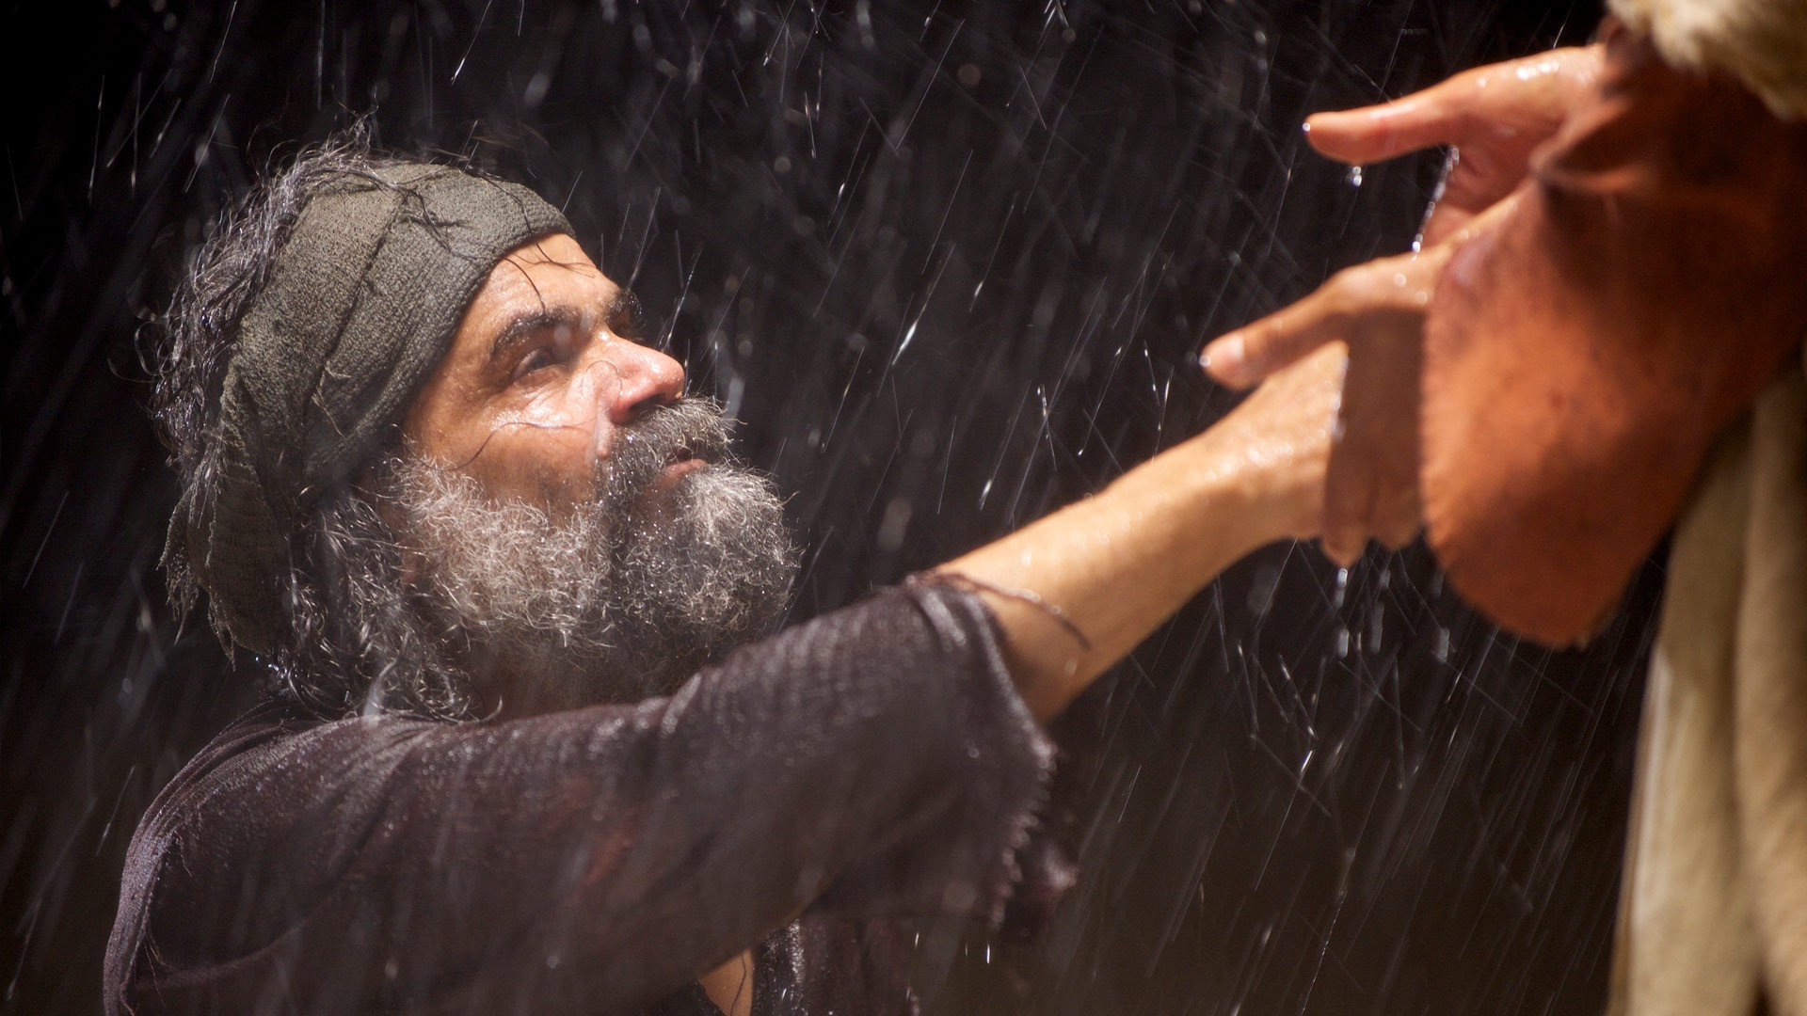
Right away Jesus reached out His hand and caught him. “Your faith is so small He said, why did you doubt me?”

Slide 18

We can read what He tells us in His word, the Bible.

Slide 19
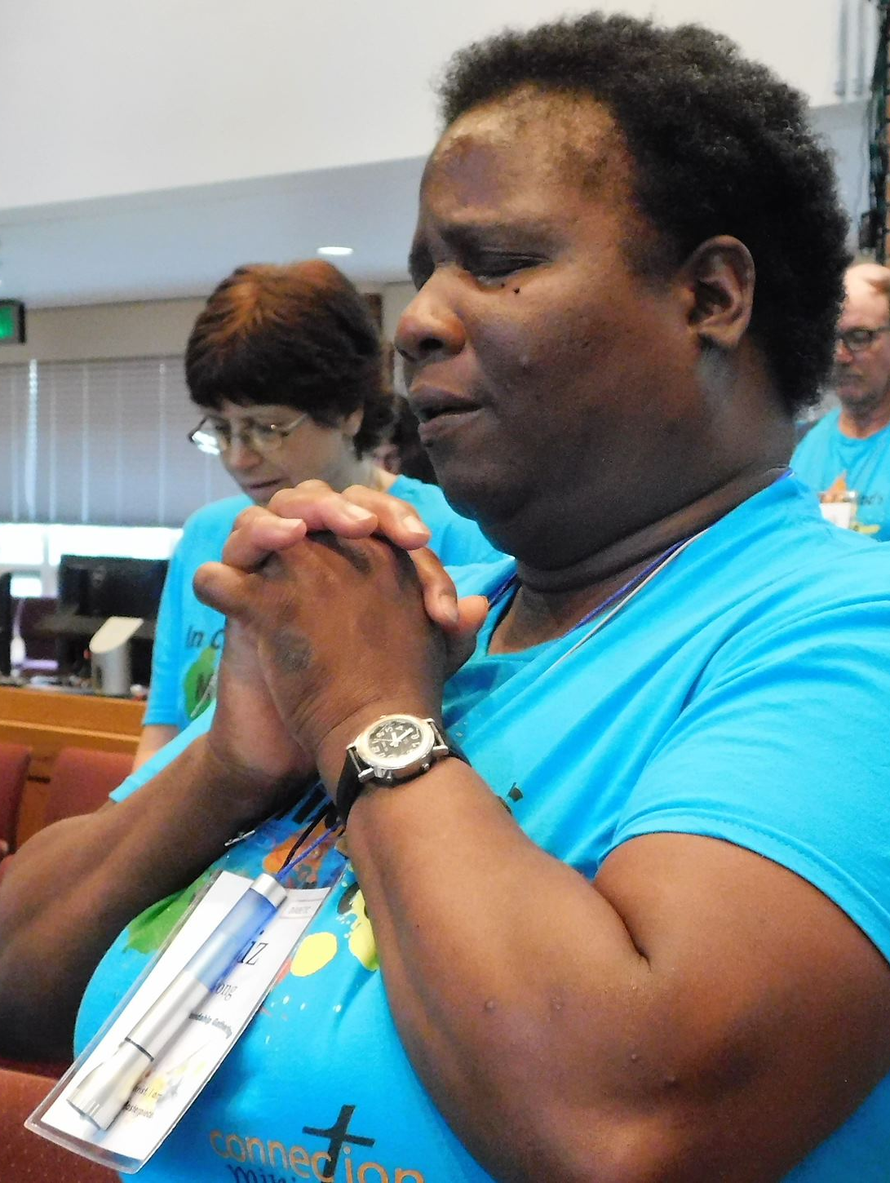
We can pray to Him when we feel worried or fearful.

Slide 20

We can ask the Holy Spirit to help us be brave.

Slide 21

We can go to church and listen to what God says through our Pastors and teachers.

Slide 22
When Peter was sinking, Jesus was Peter’s life preserver. He pulled Peter out of the water. Jesus is also our life preserver.

Slide 23
The Bible says, when they climbed into the boat the wind died down. Then those in the boat worshiped Jesus. They said, “You really are the Son of God!”

Slide 24
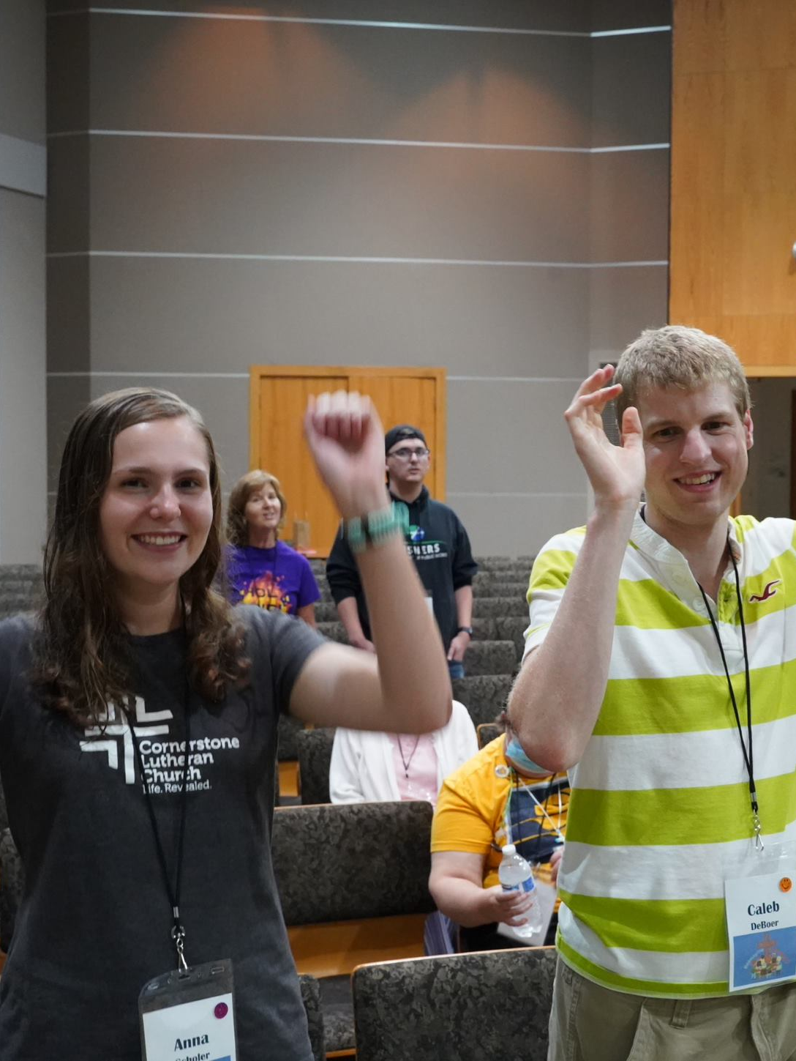
We can worship Jesus by singing to Him…

Slide 25
Praying to Him…

Slide 26
…or reading our Bible.

Slide 27

