Slide 1
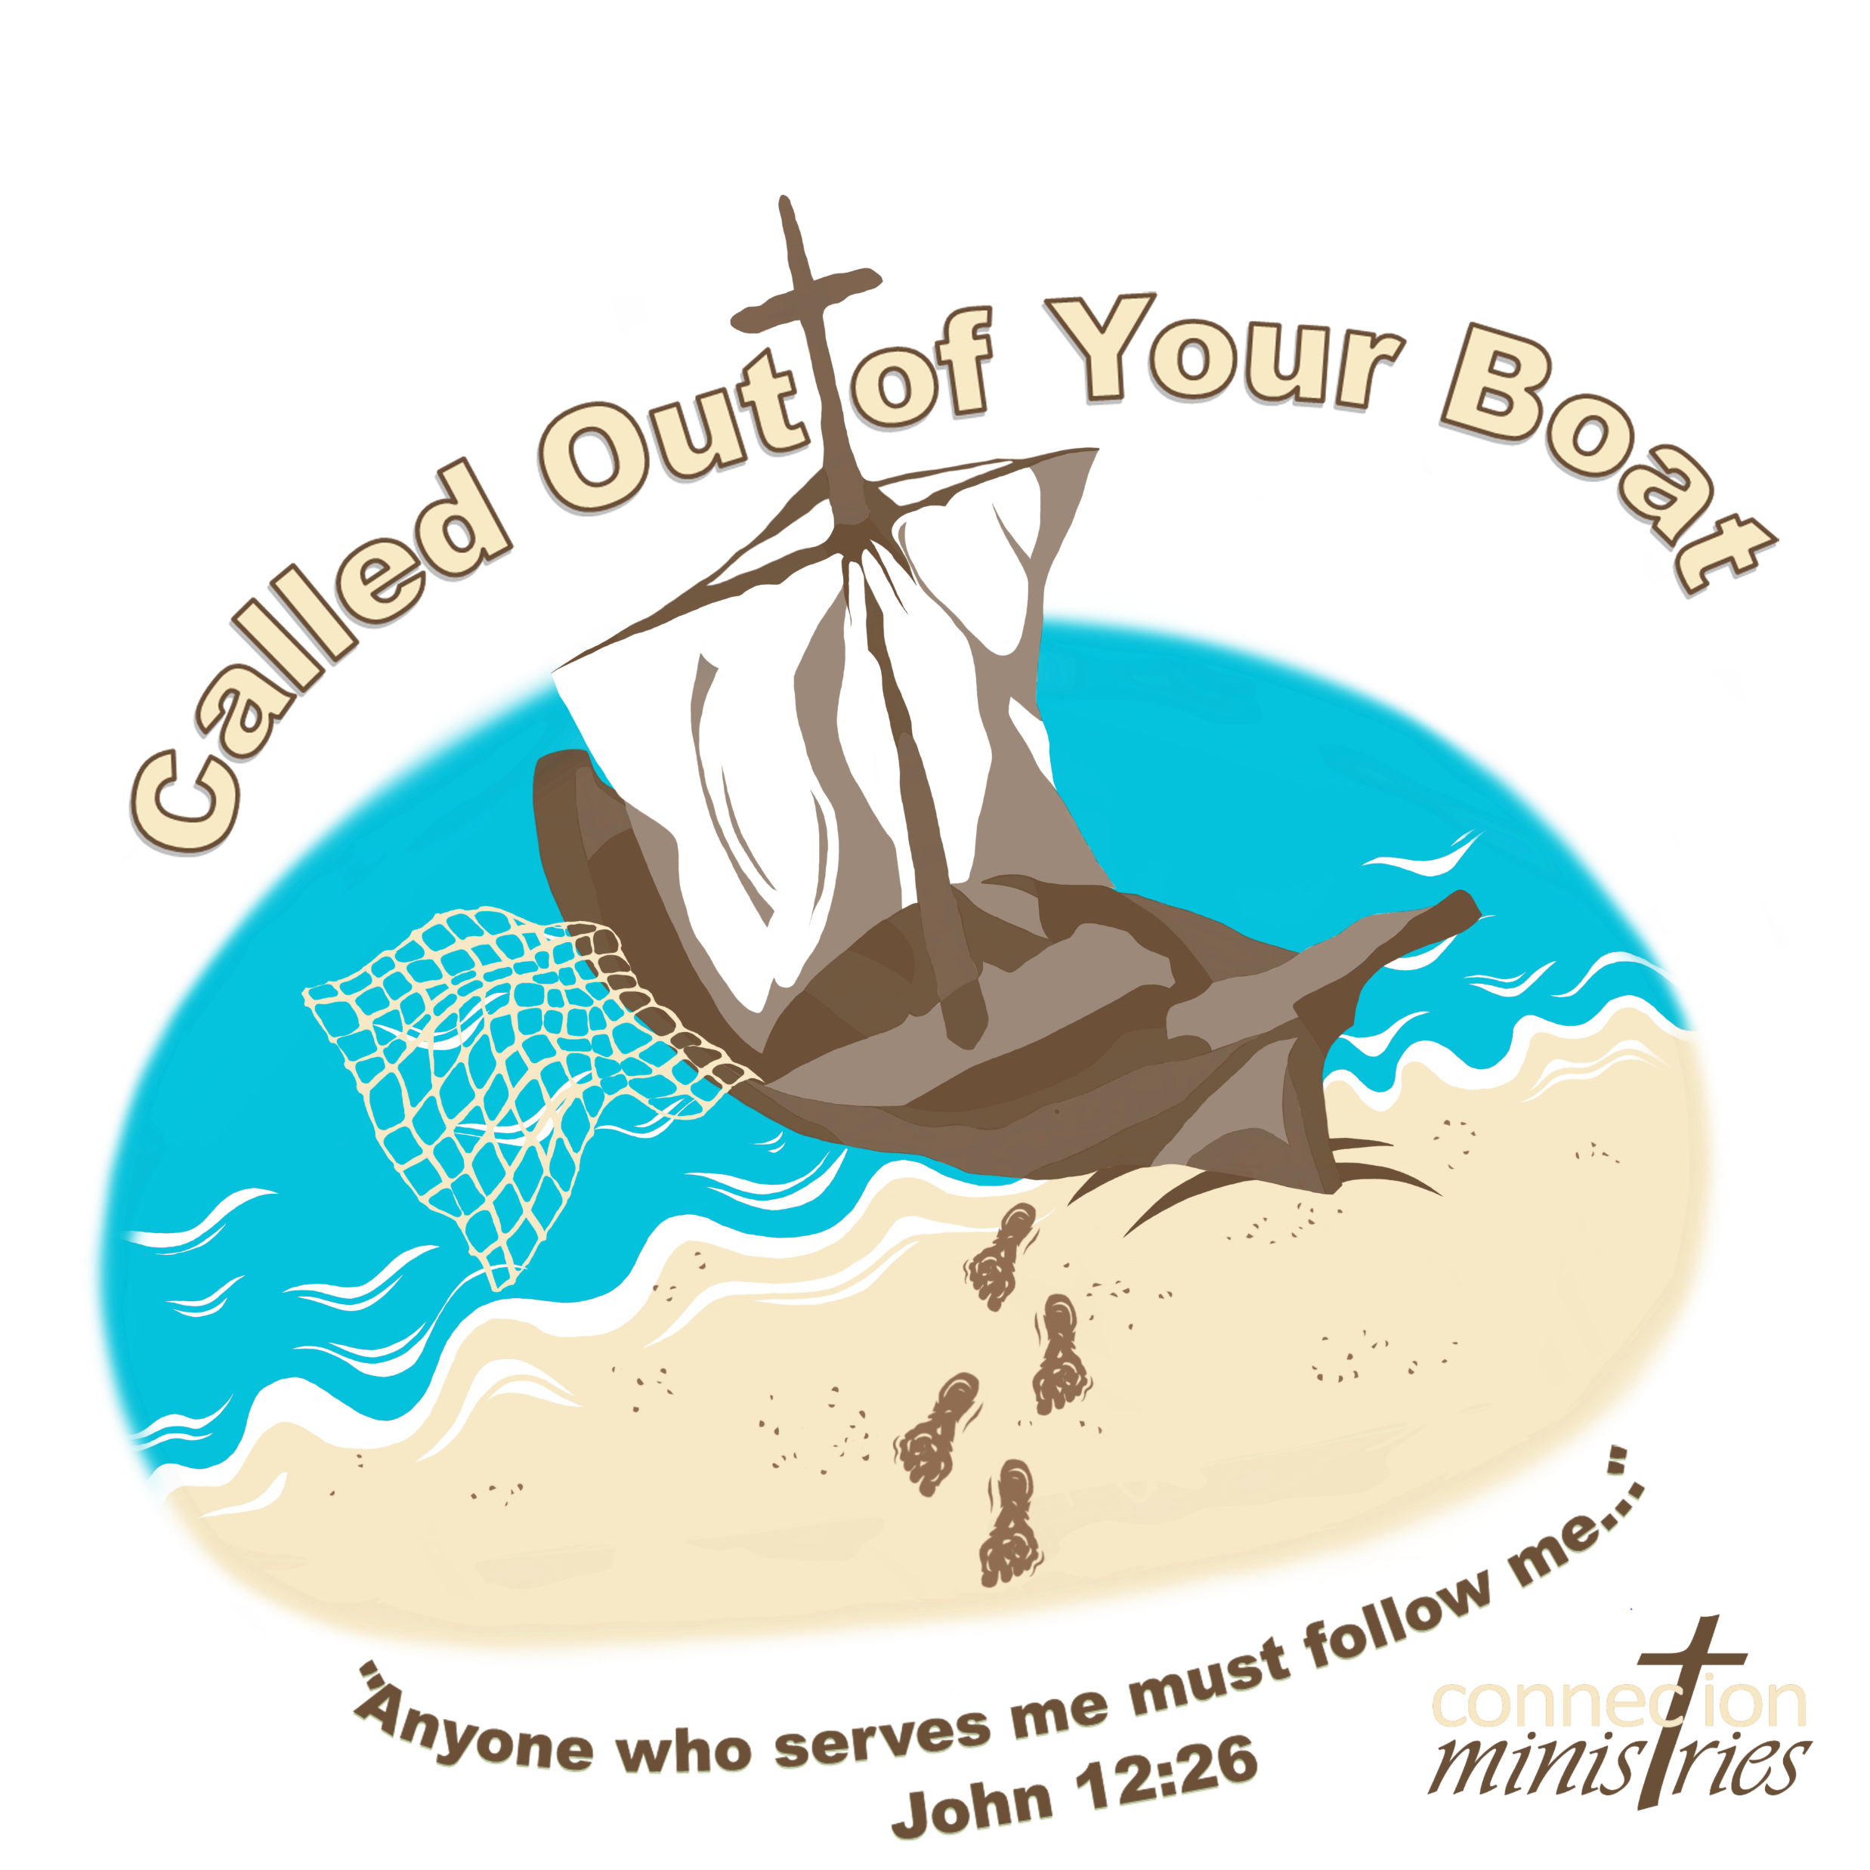

Slide 2
Day 3
Called to Jump Out
Peter jumps out of his boat to
get to Jesus as fast as he can
(John 21:1-17)

Slide 3
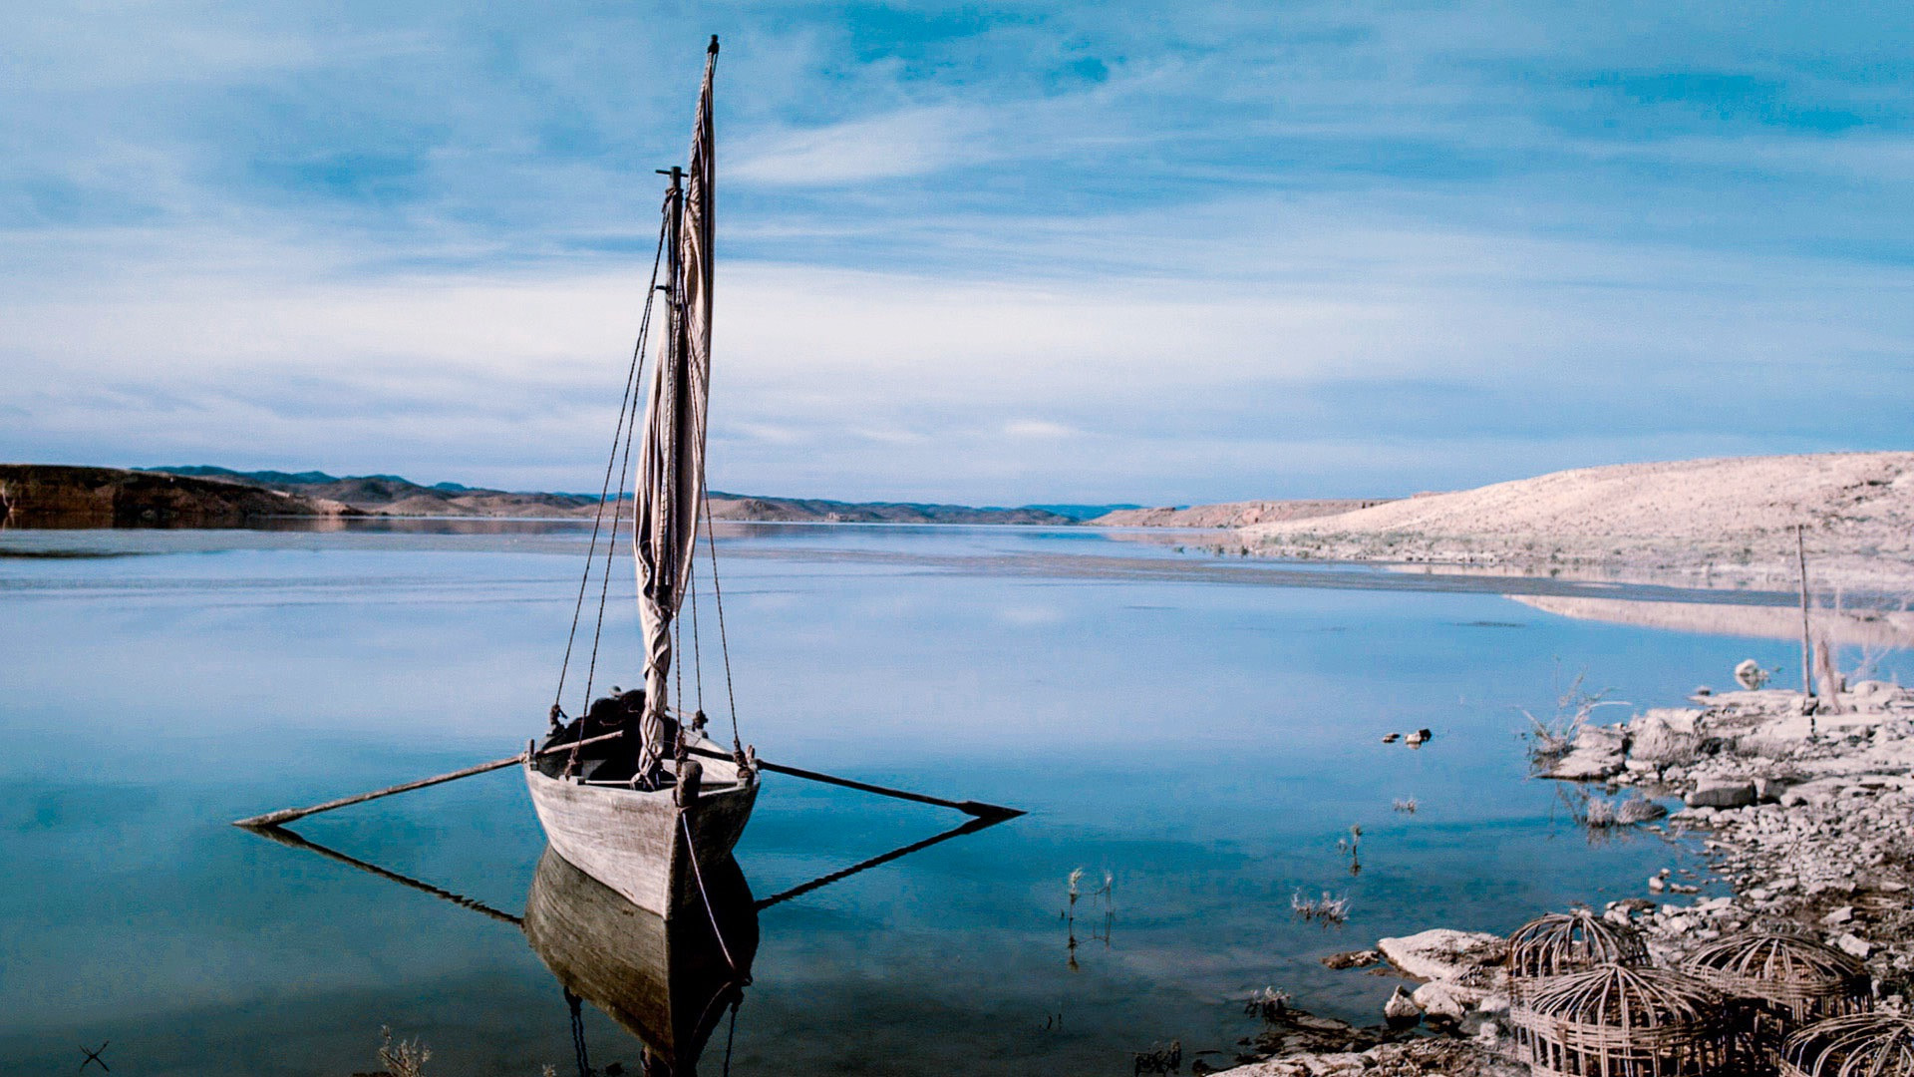
Peter and several of the disciples were together at the Sea of Galilee. They didn’t know what to do.

Slide 4
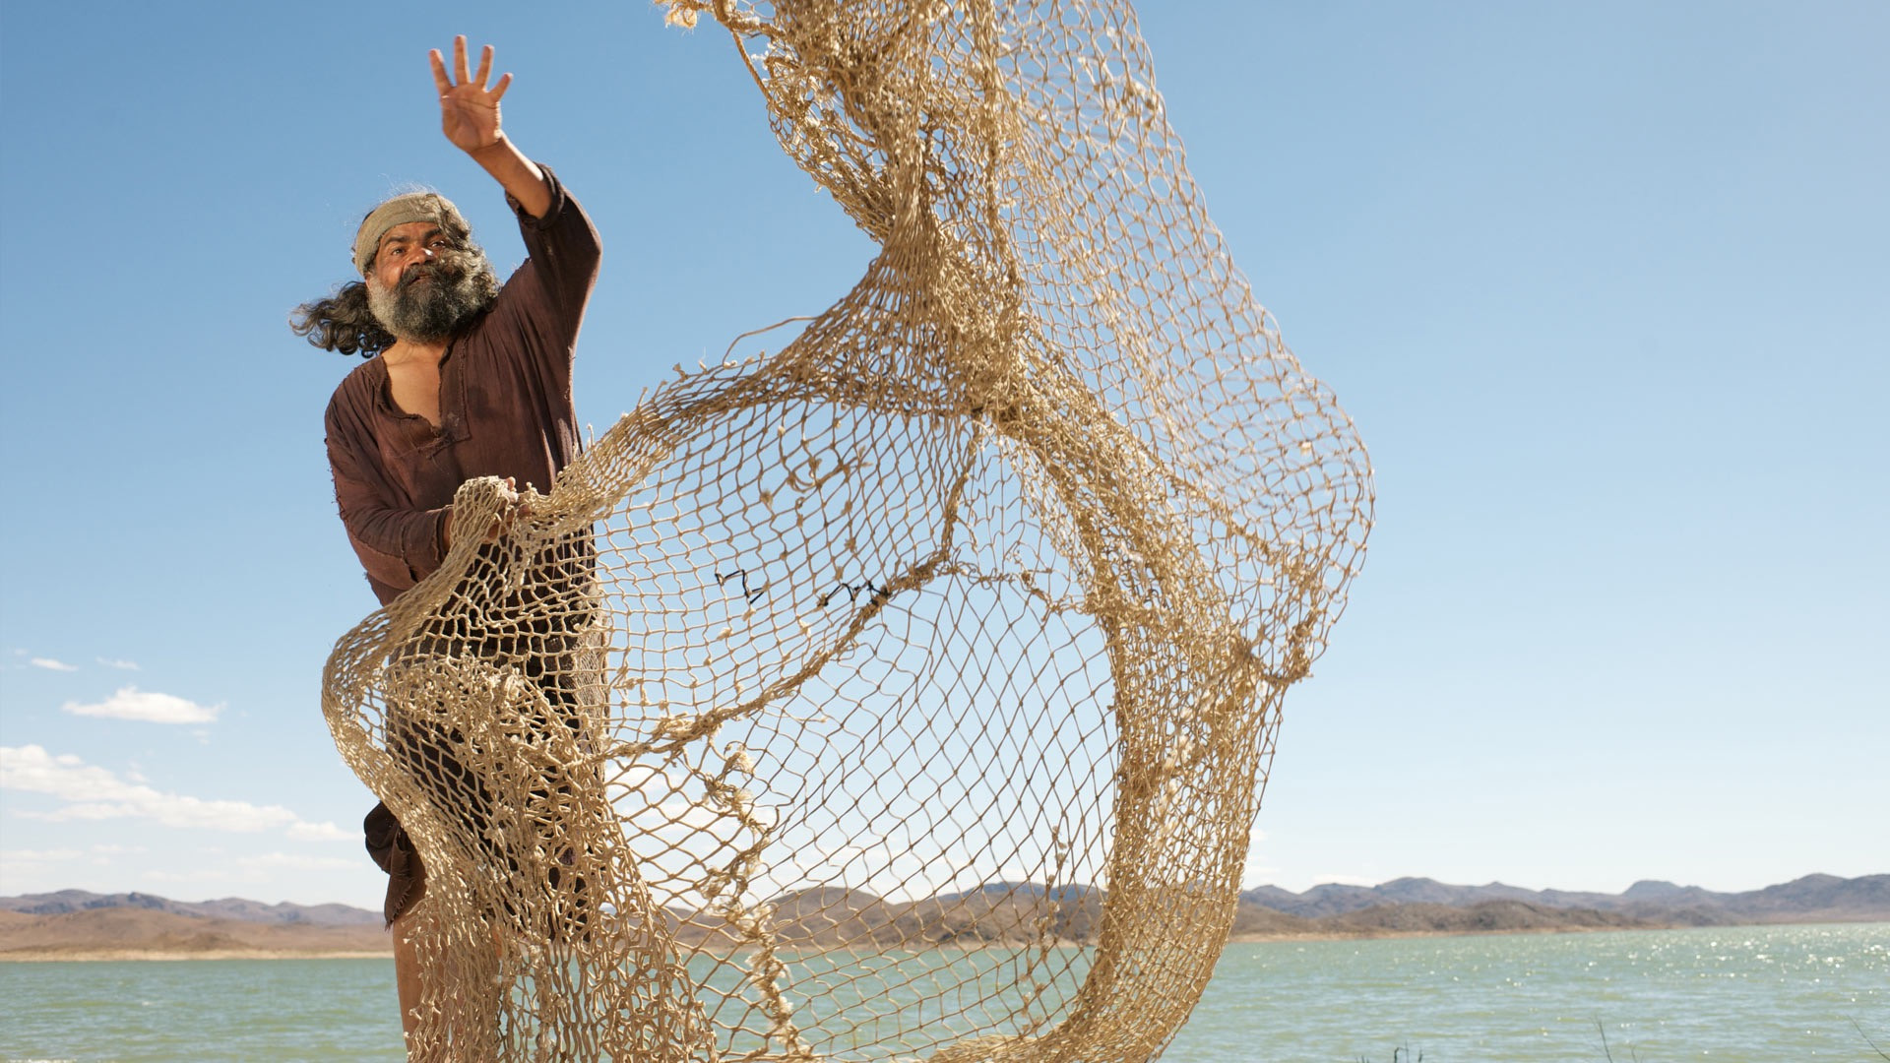
Peter said to the others that he was going fishing. Back to what he knew best. Back to what was comfortable – fishing.

Slide 5
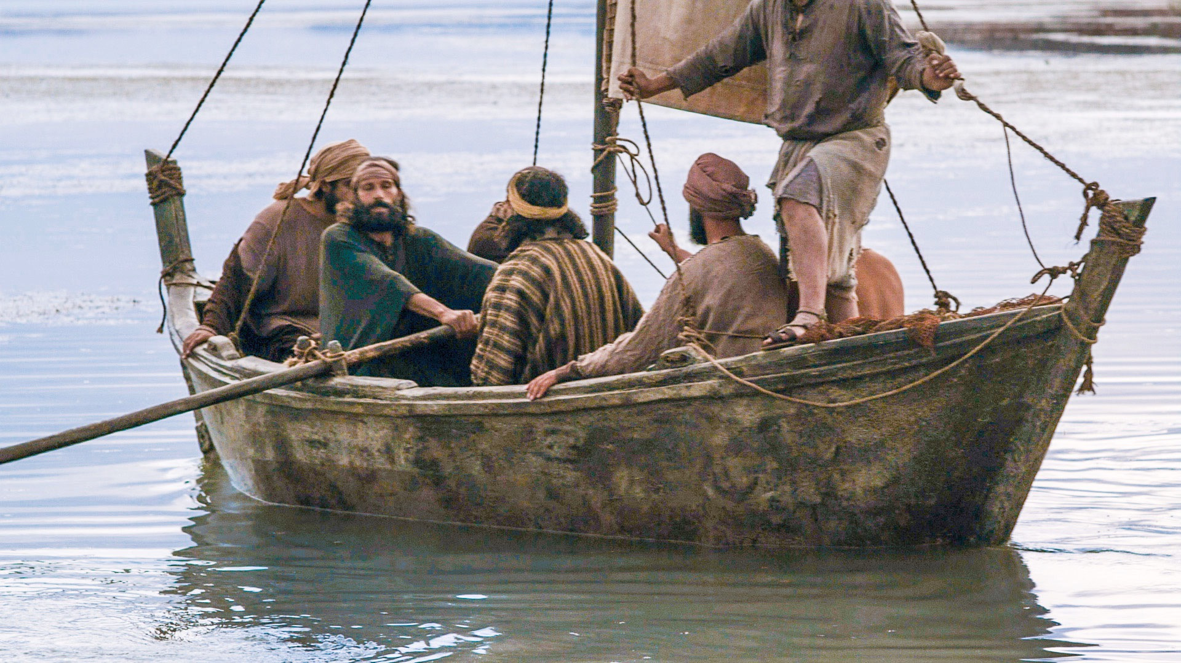
The other disciples thought that was a good idea and decided to join him.

Slide 6
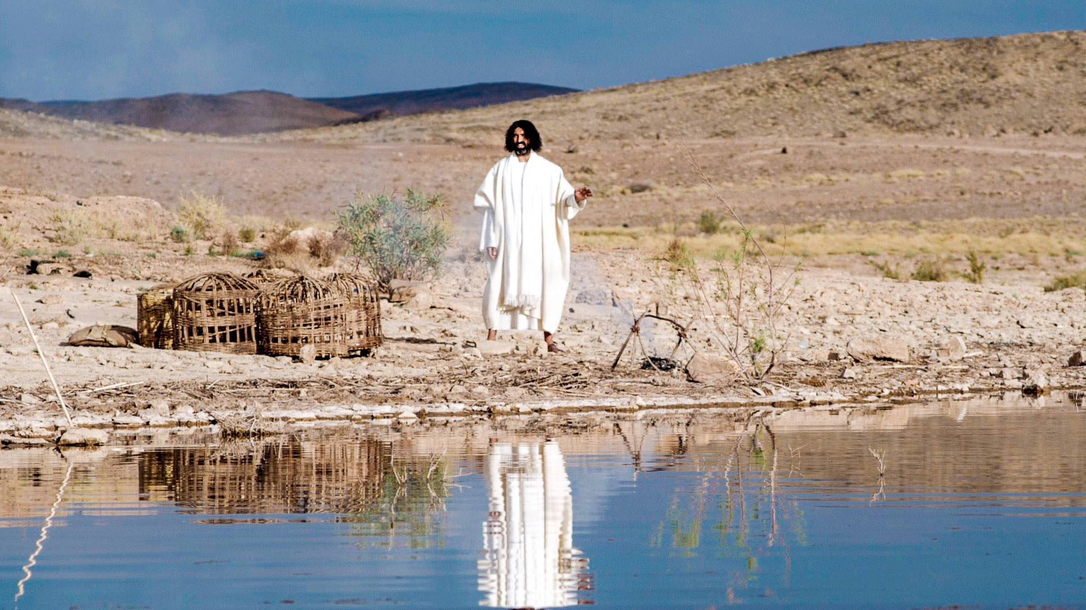
Early in the morning Jesus stood on the shore.

Slide 7
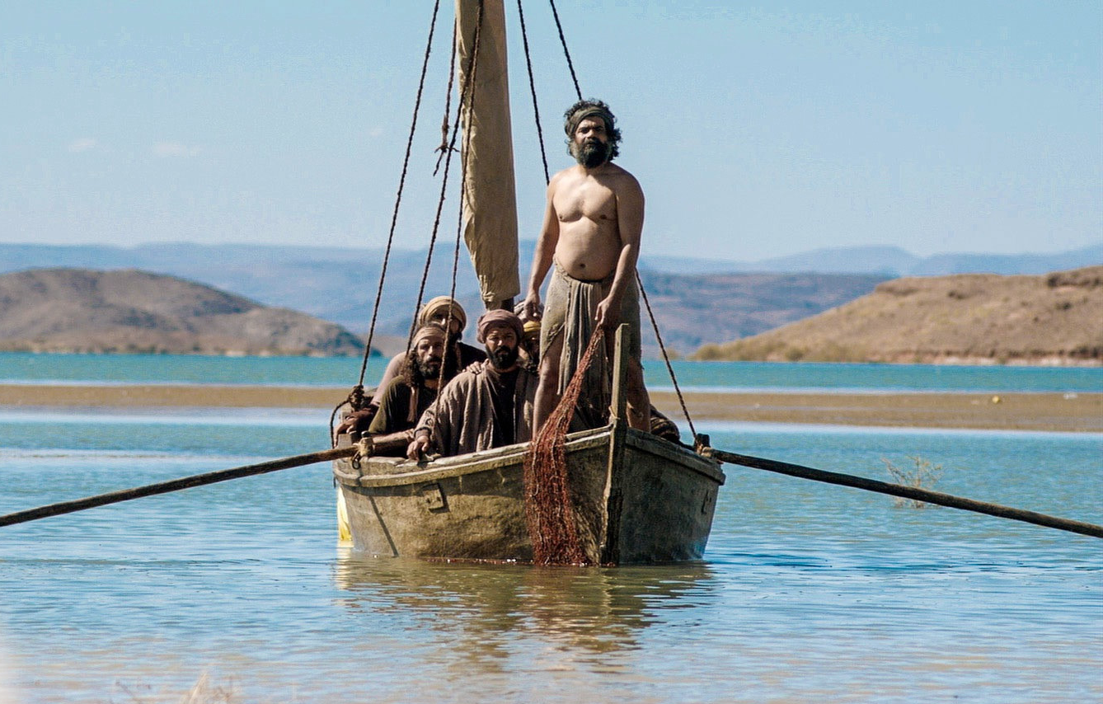
The disciples didn’t realize it was Jesus.

Slide 8
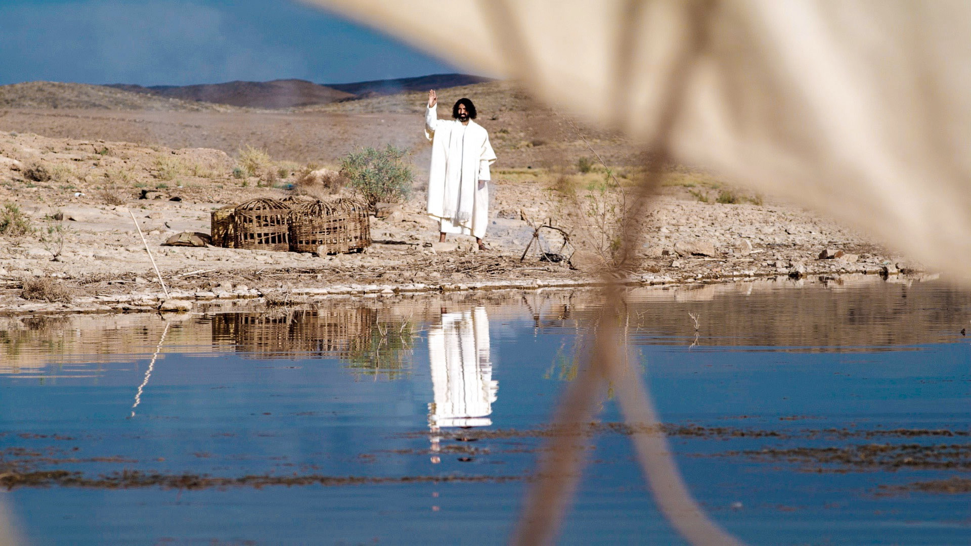
He called out to them, “Friends, don’t you have any fish?” “No” they said. Jesus told them to throw their nets to the
right side of the boat, there you will find some fish.

Slide 9
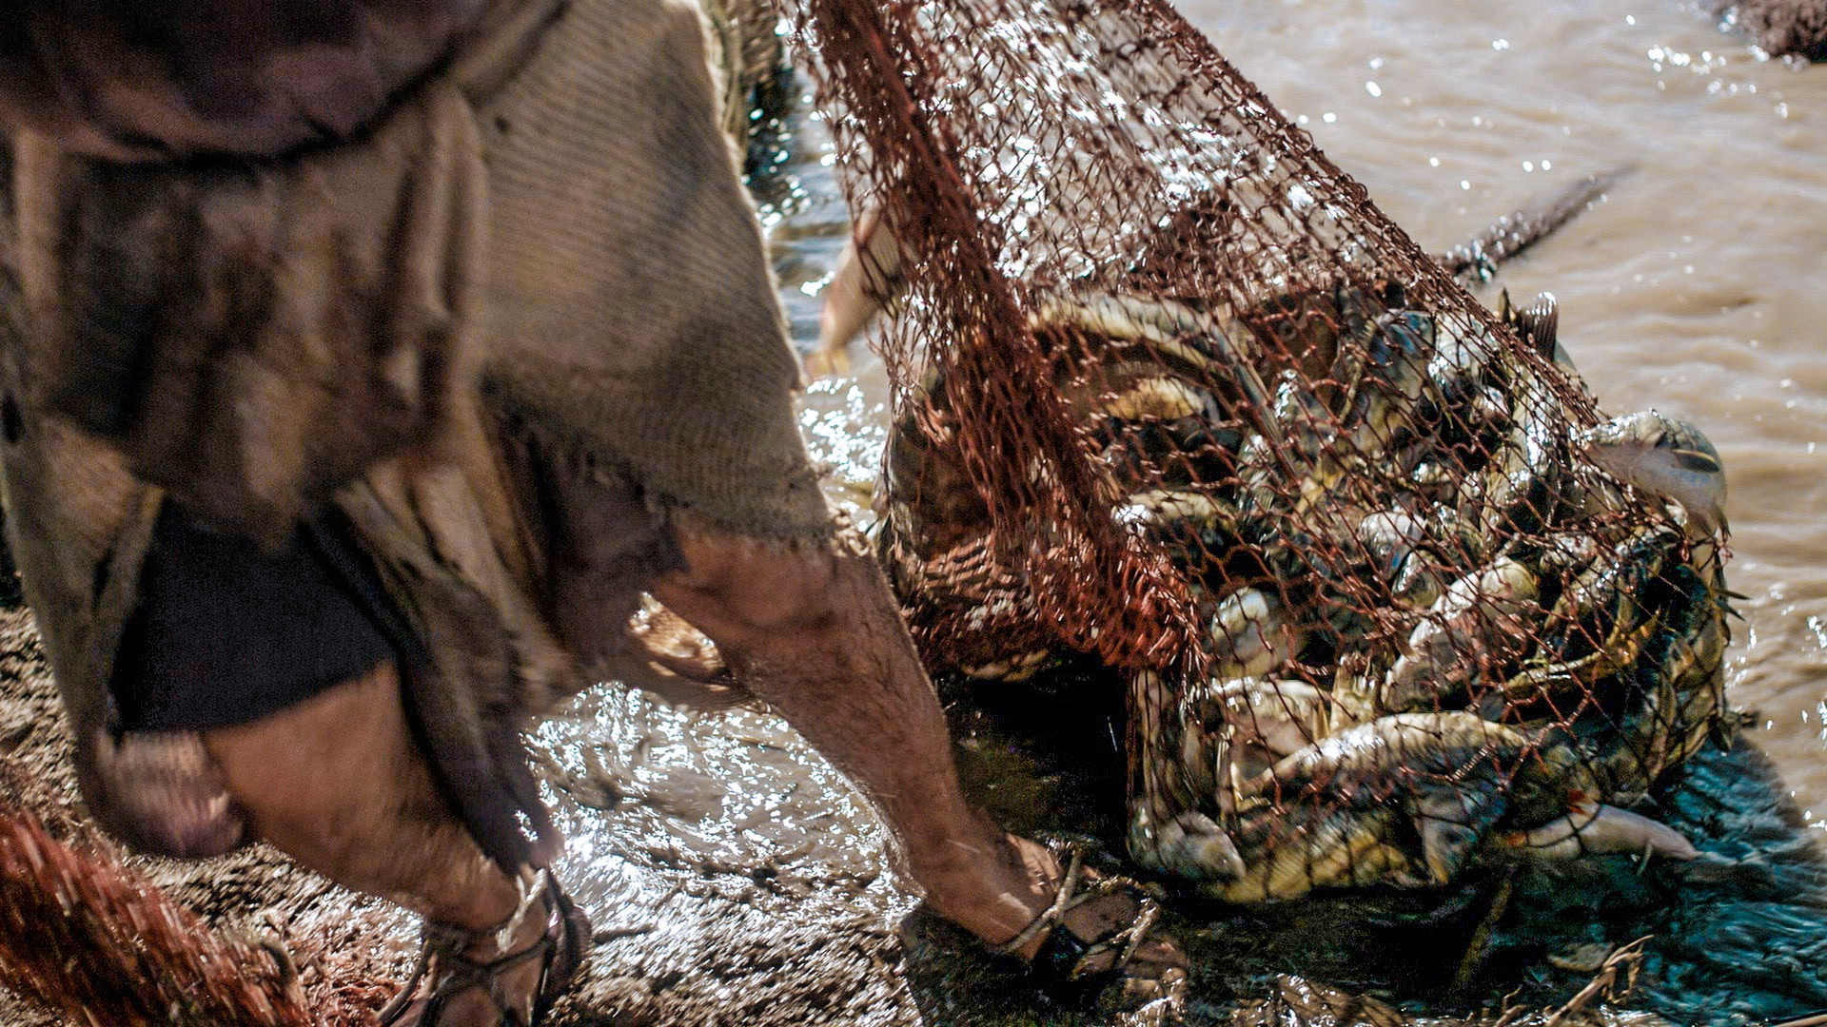
When they did what Jesus told them they could not pull the net into the boat because there were so many fish!

Slide 10
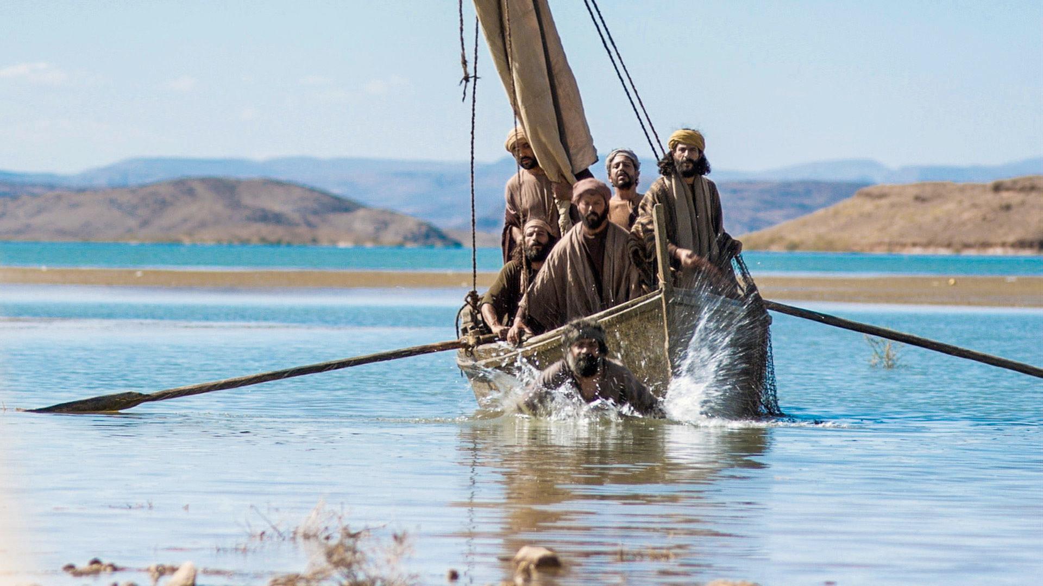
As soon as Peter heard the other disciple say, “It is the Lord!” He jumped out of the boat and swam to Jesus.

Slide 11
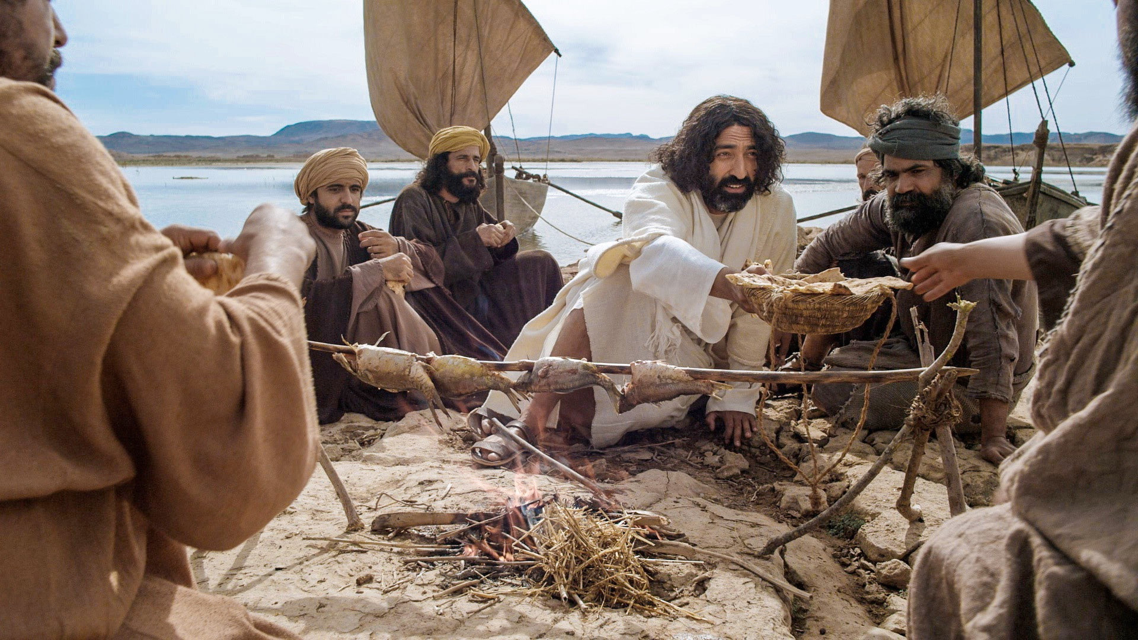
Jesus had a fire on the shore with fish already cooking. He was making breakfast for them.

Slide 12
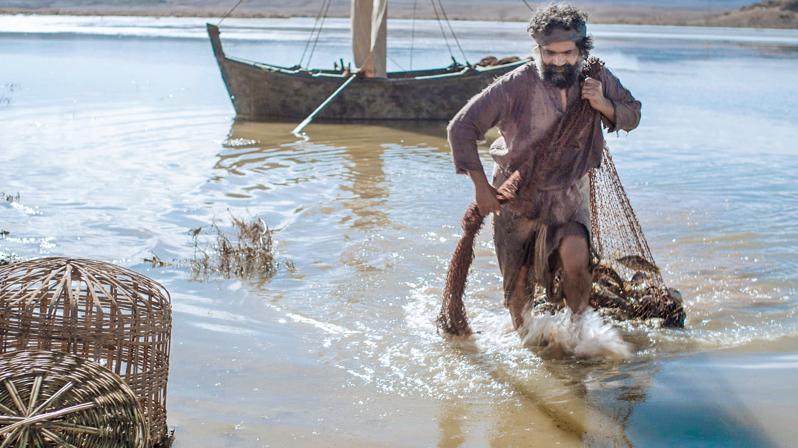
Jesus told them to bring the fish they had caught to Him. Peter climbed back in the boat and helped the other disciples haul in the great catch of fish.

Slide 13
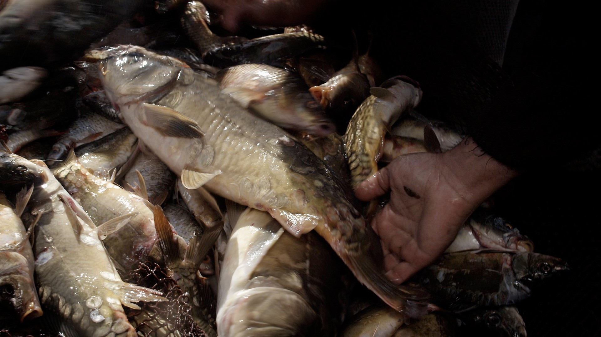
They had caught 153 fish and again their
nets didn’t break!

Slide 14
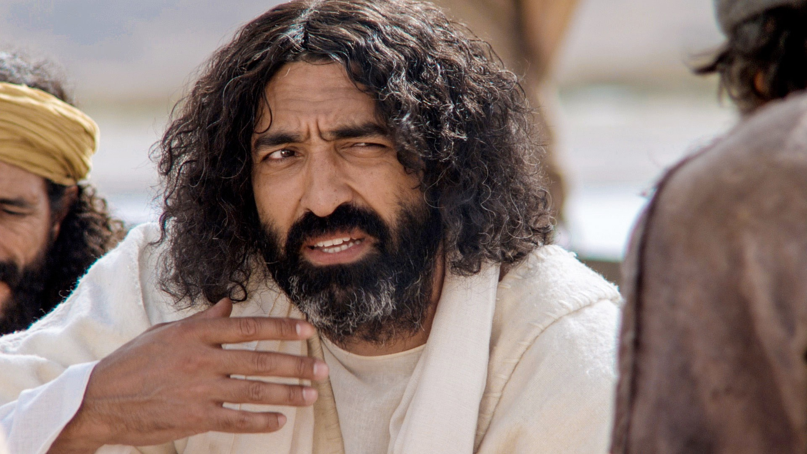
After Jesus and the disciples had finished eating Jesus looked at Peter and asked, “Do you love Me, more that these?”

Slide 15
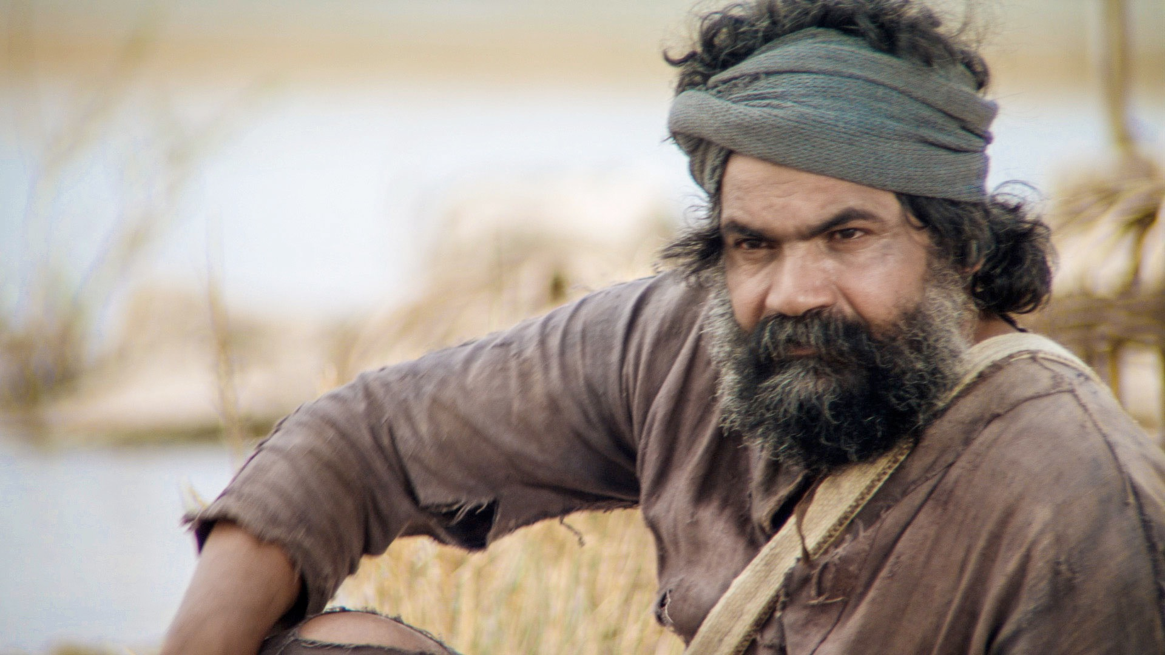
Peter answered, “Yes Lord, you know that I love you.” Jesus said, “Feed my lambs.”

Slide 16
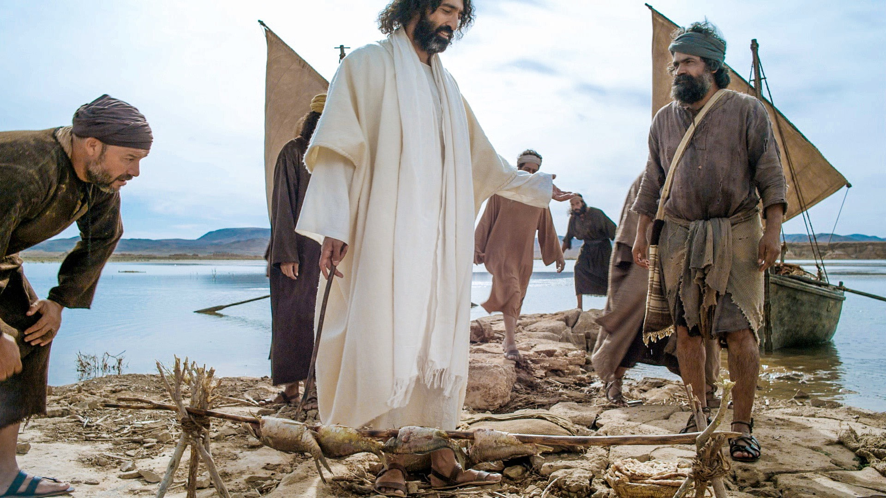
Jesus spoke to him a third time. He asked,
“Simon, son of John, do you love Me?”

Slide 17
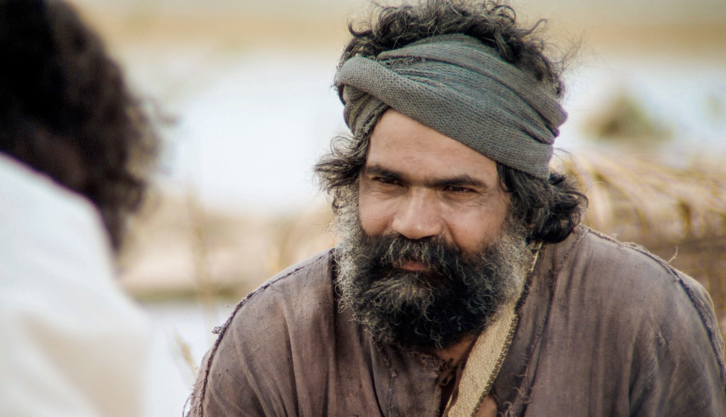
Peter answered, “Lord, You know all things,
You know that I love You.”

Slide 18
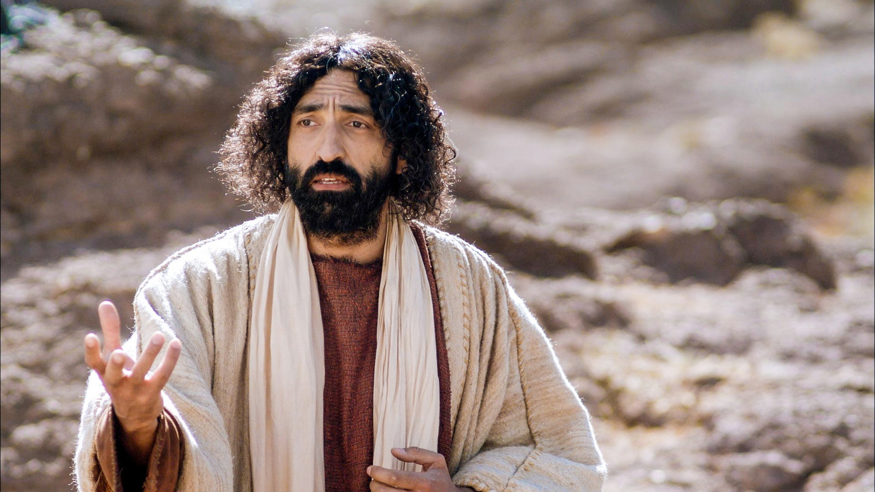
Jesus said, “Feed My sheep.”

Slide 19
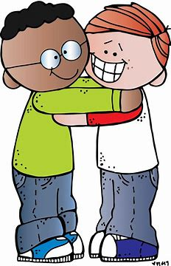
He may be calling you to love your roommate …
when they are unlovable.

Slide 20
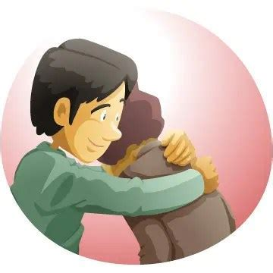
…or forgiving a friend who has hurt you, because Jesus has forgiven you.

Slide 21
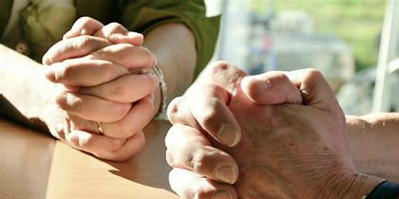
Maybe He calls you to stop and pray with someone.

Slide 22

Or maybe He wants you to invite someone to Friendship Group.

Slide 23
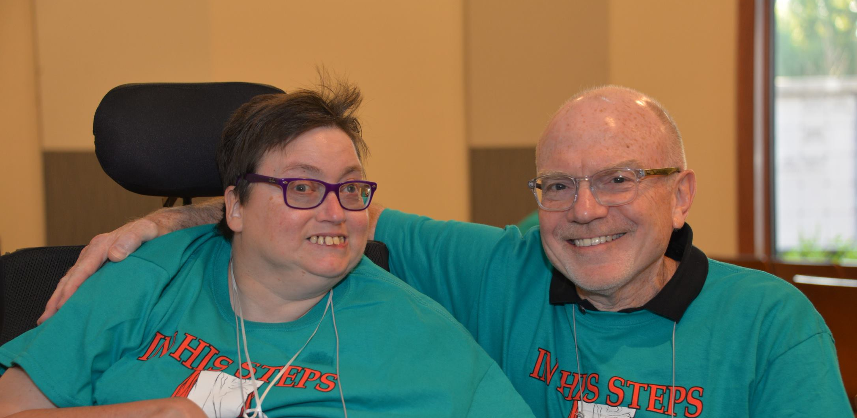
Maybe God has given you the gift of encouragement. You can show someone they are loved…

Slide 24
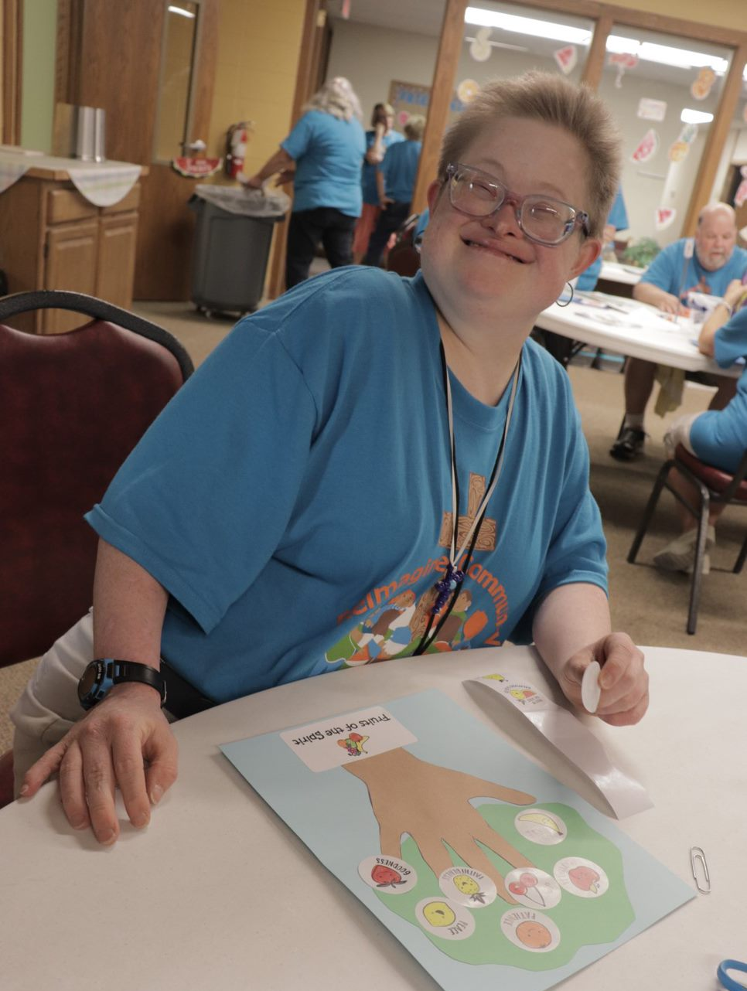
…by giving them a hug or a smile!

Slide 25
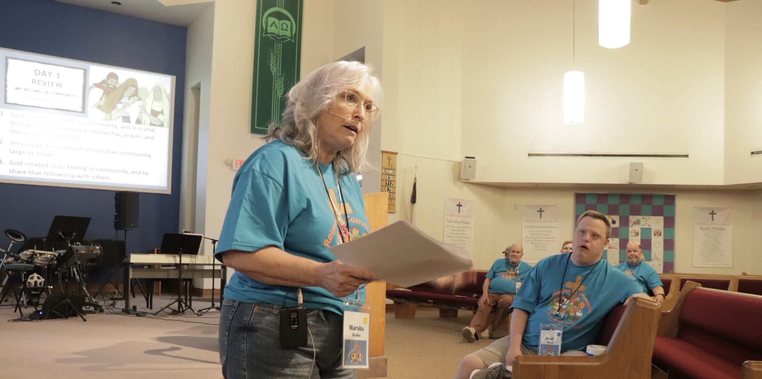
Maybe you have the
gift of teaching.

Slide 26
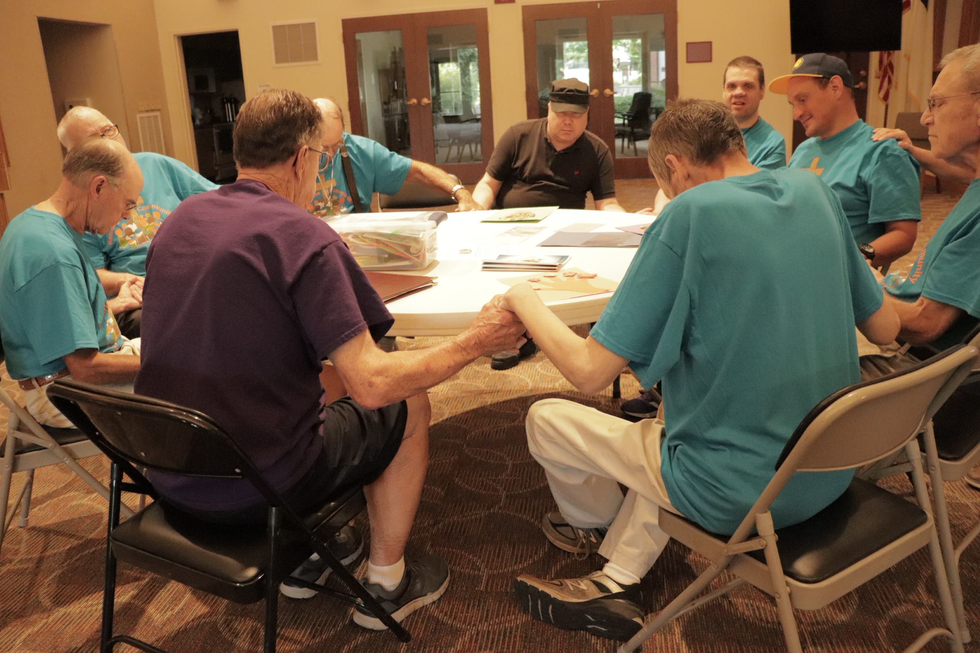
We can pray with a friend when they are hurting.

Slide 27
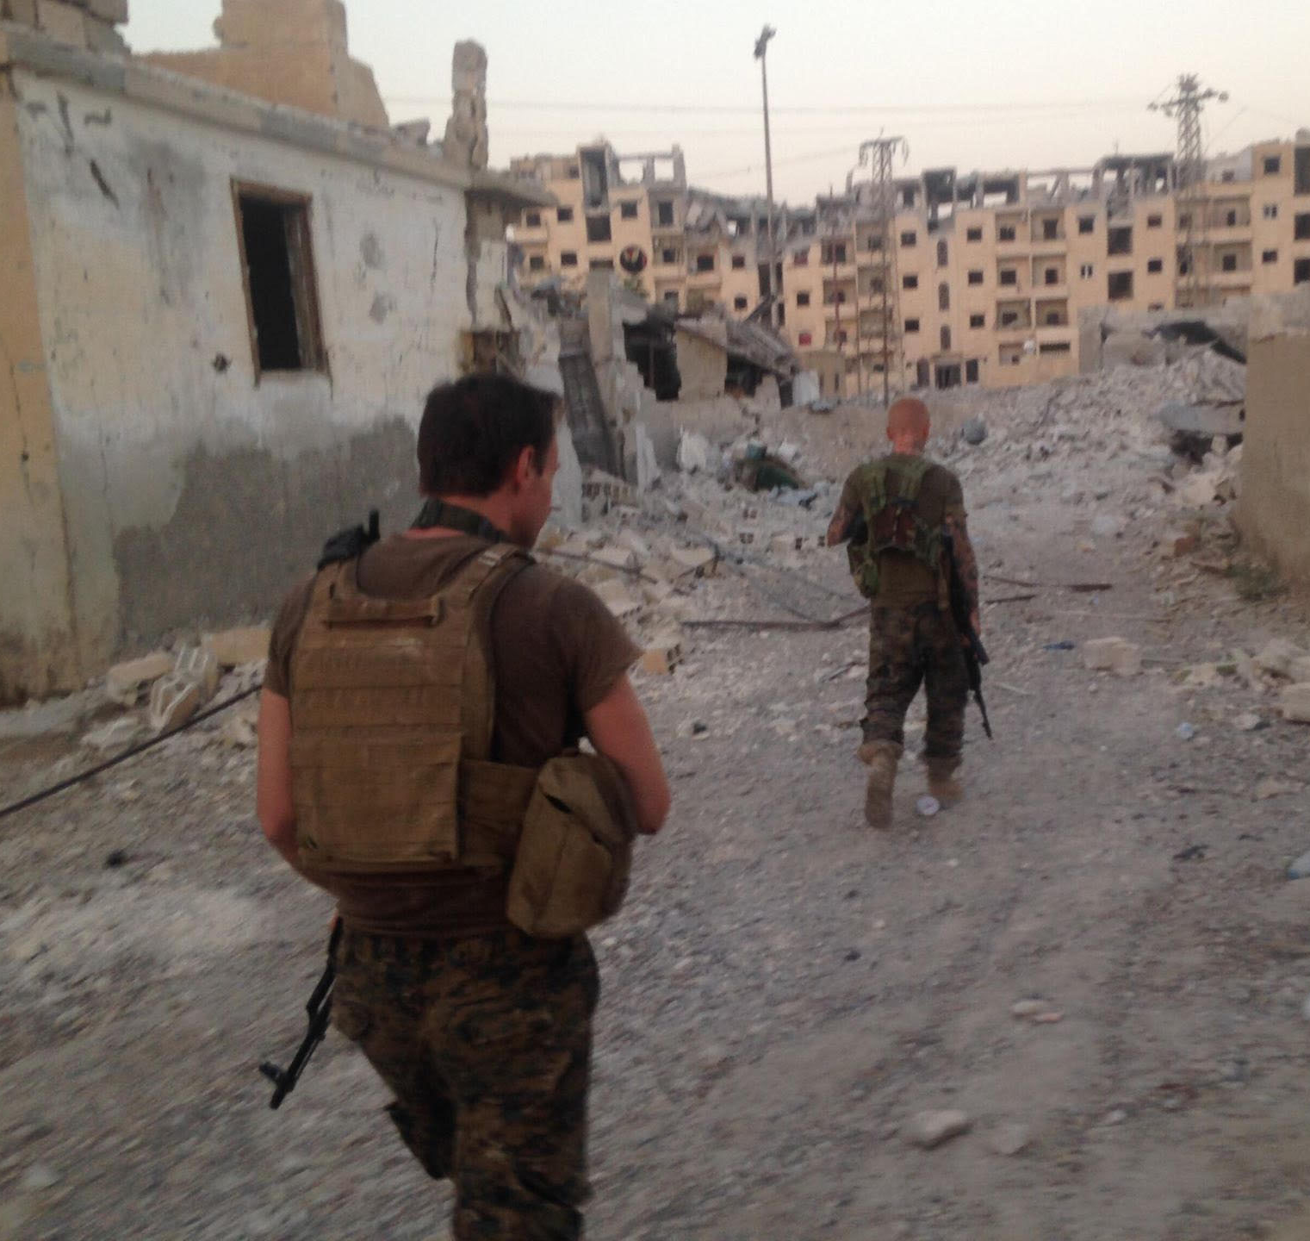
We can even pray for people we don’t know after a storm or an earthquake, or victims from a war.

Slide 28

