Slide 1

DAY 1 –
Rise Up and Hope
Ezekiel 37:1-14
The vision of the valley of dry bones
Notes:
Ezekiel 37:1-14

Slide 2
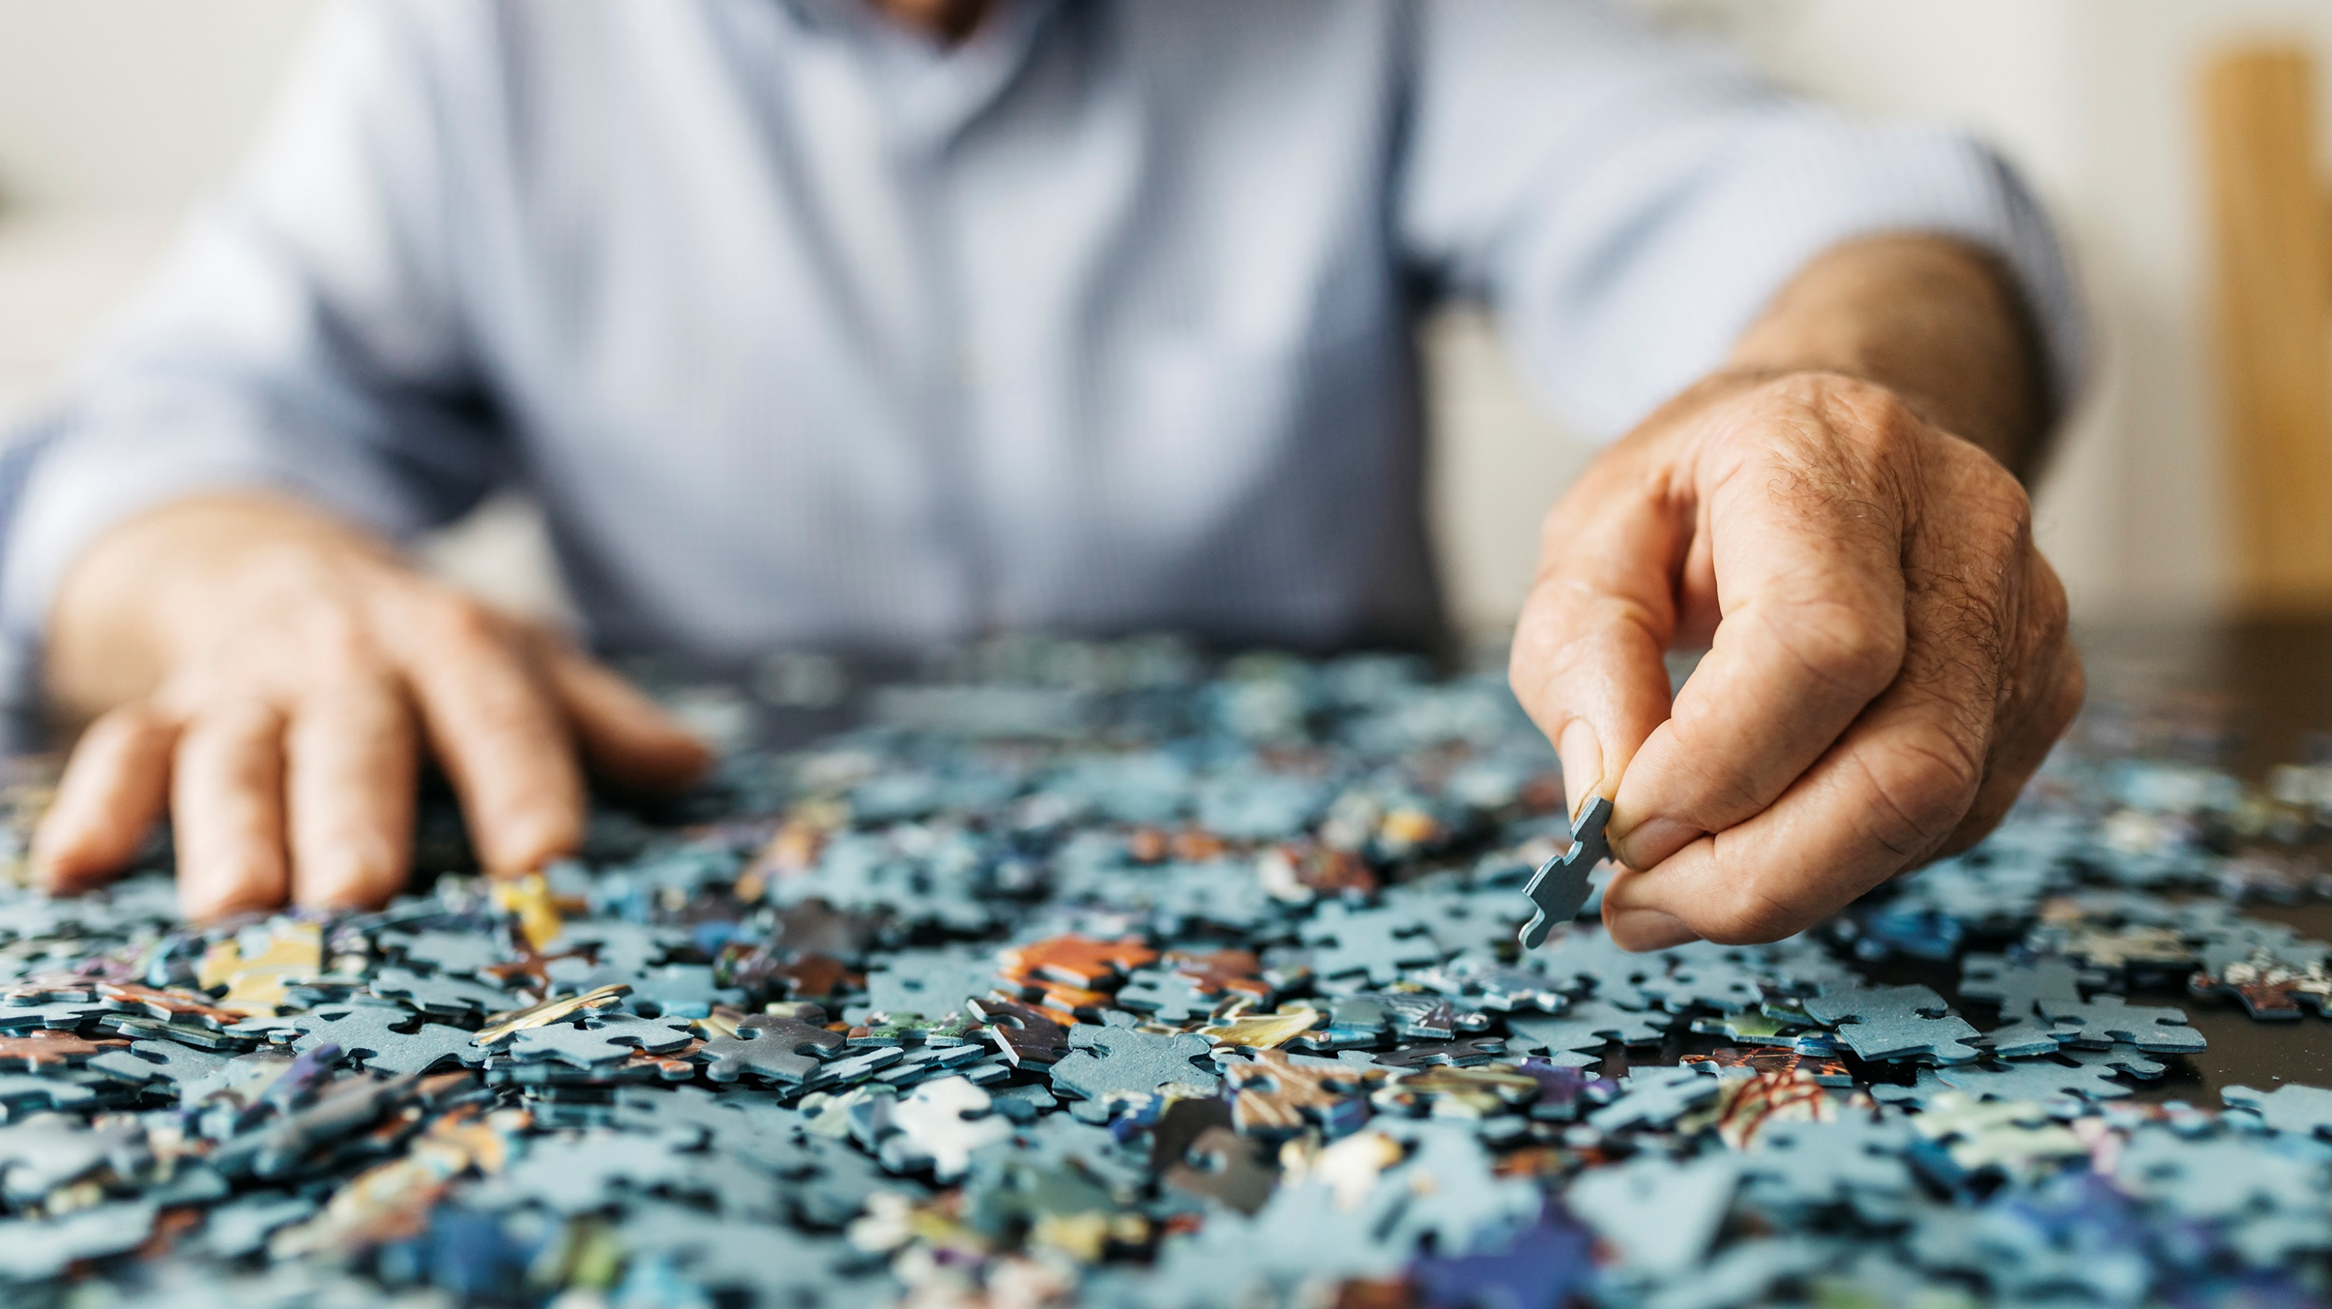
Have you ever tried to create something out of nothing?

Slide 3
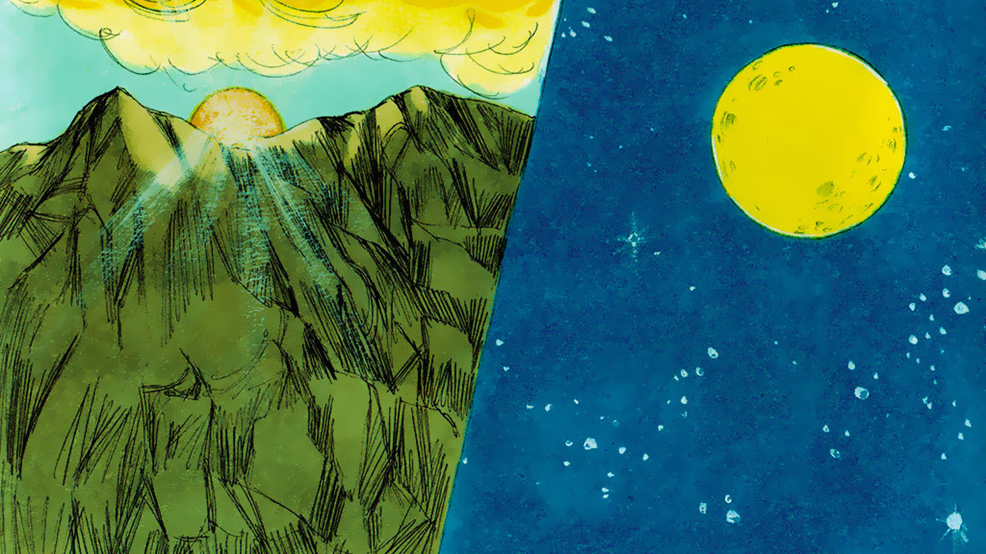
That is what God did when He created the world.
He spoke the Word and it was created.

Slide 4
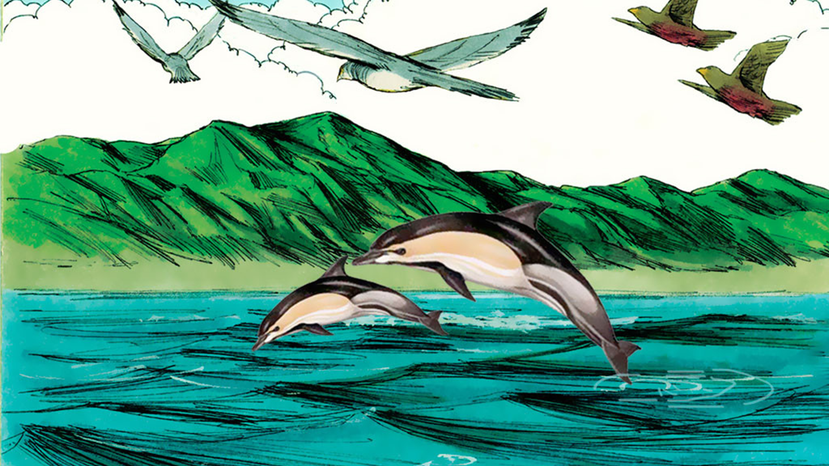
The spoken Word of God, brings with it the power of God.

Slide 5
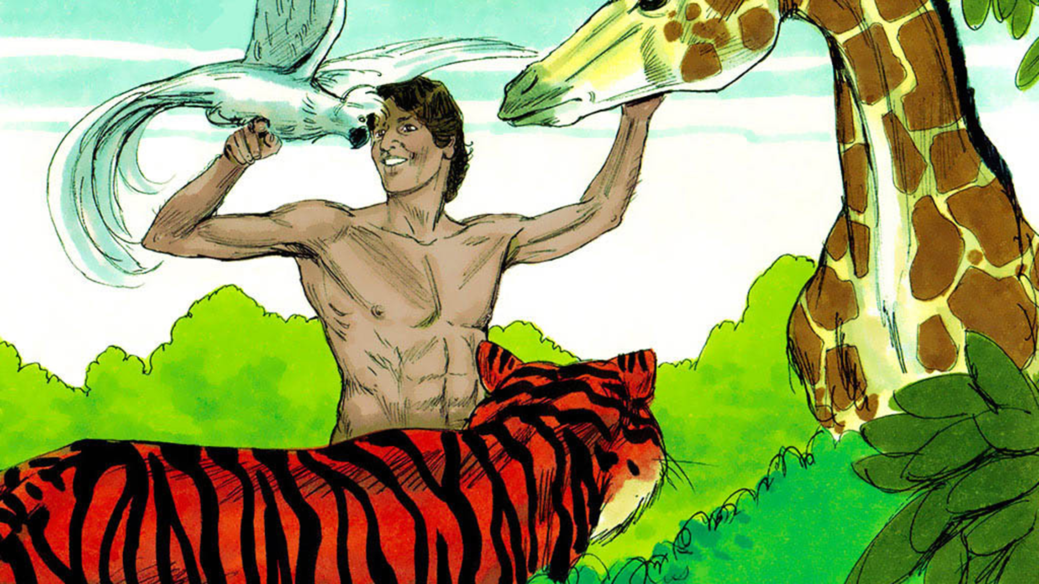
In the beginning God created Adam out of dust.
God breathed life into him, and he became a living person.

Slide 6
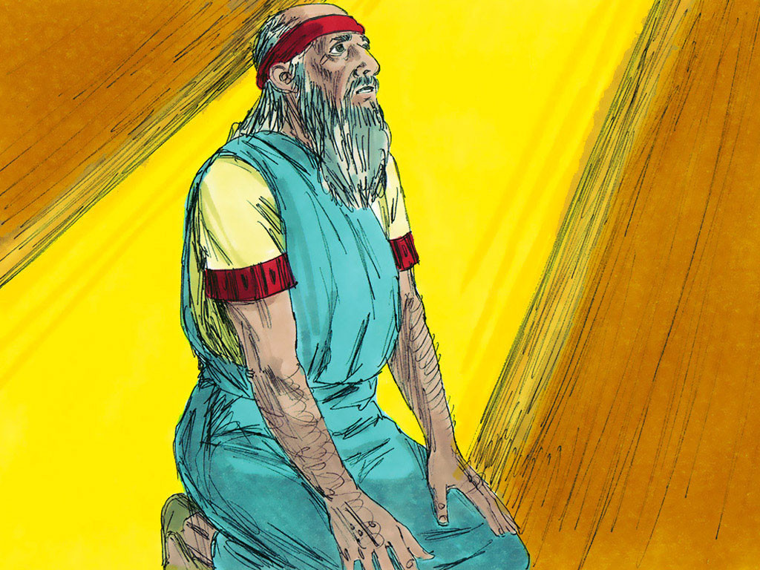
God gave Ezekiel the prophet a vision.

Slide 7
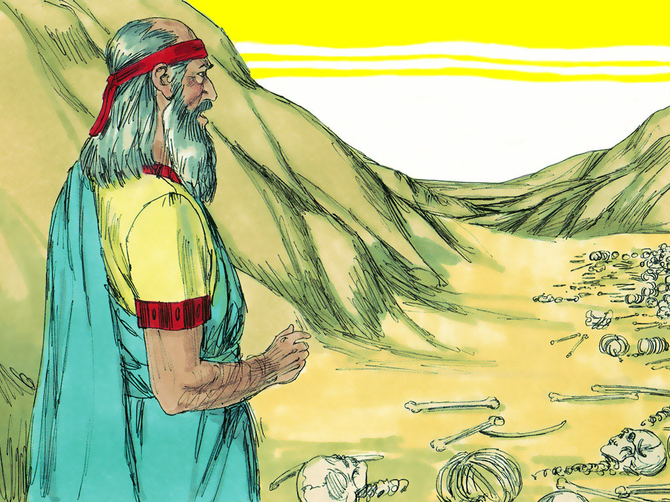
The Spirit of the Lord brought him to a valley of dry bones.

Slide 8
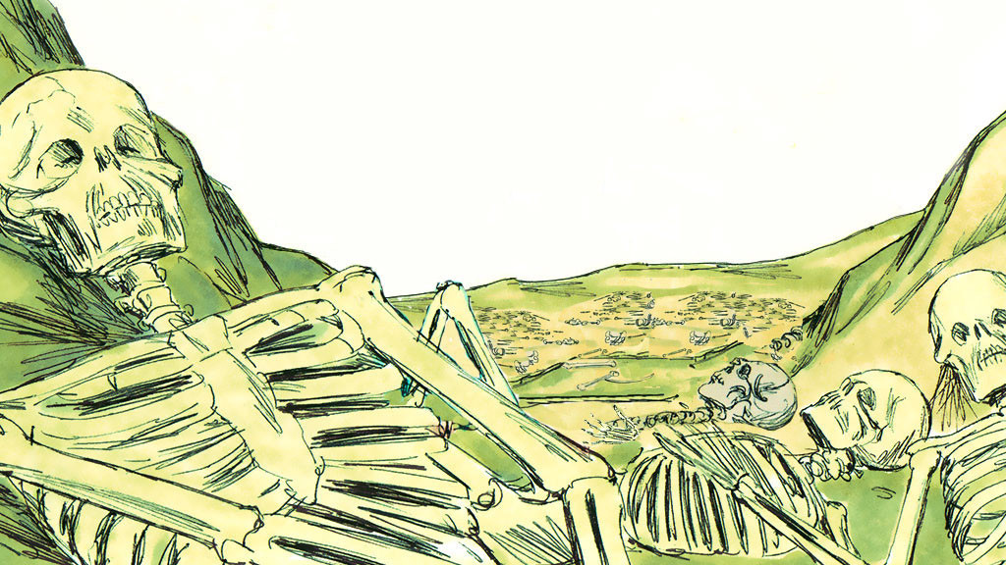
There were a huge number of dry bones. God told Ezekiel to prophesy to the dry bones saying, “I will put flesh on your bones.”

Slide 9
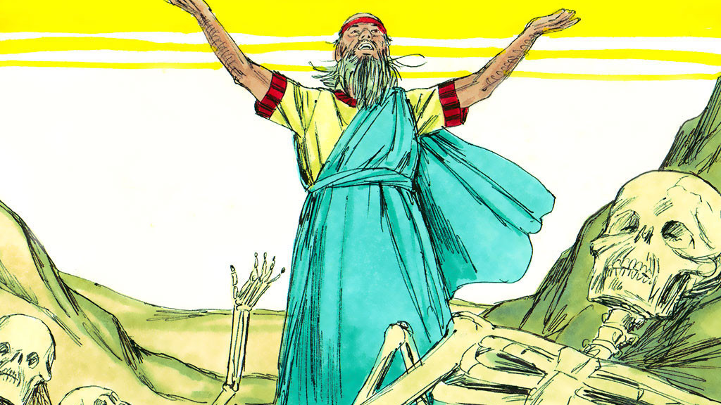
As Ezekiel was prophesying, he heard a rattling sound.

Slide 10
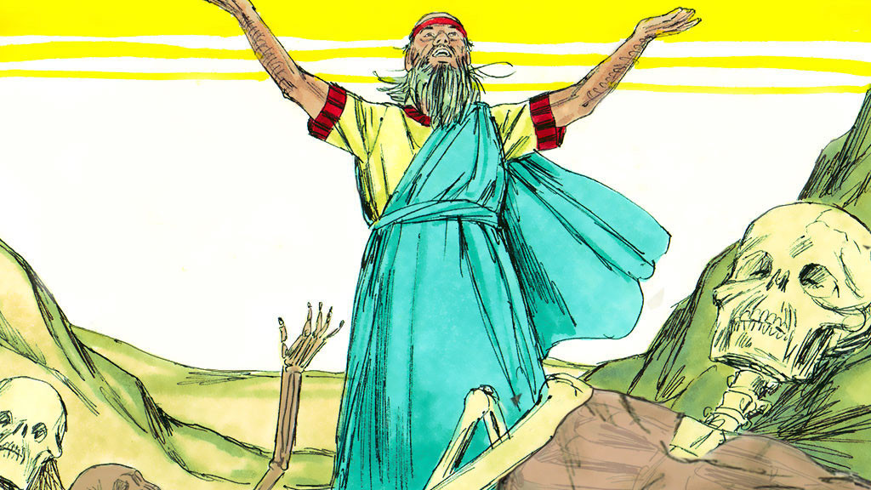
One bone connected to another. Flesh and skin covered them.

Slide 11
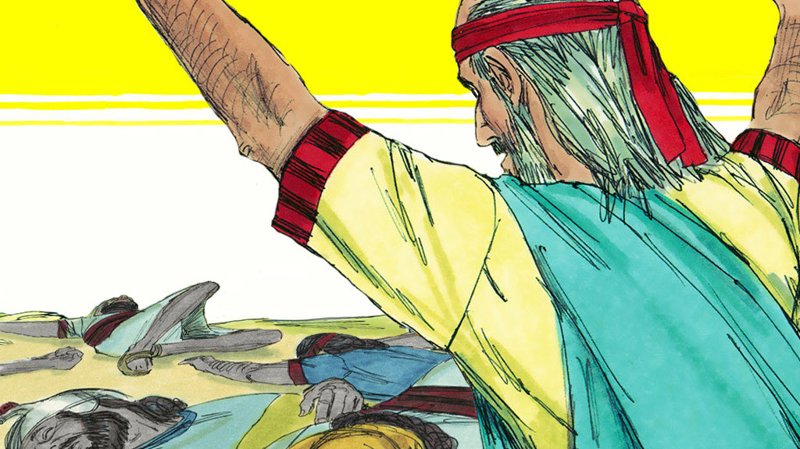
They came to life again! But there was no breath in them.

Slide 12
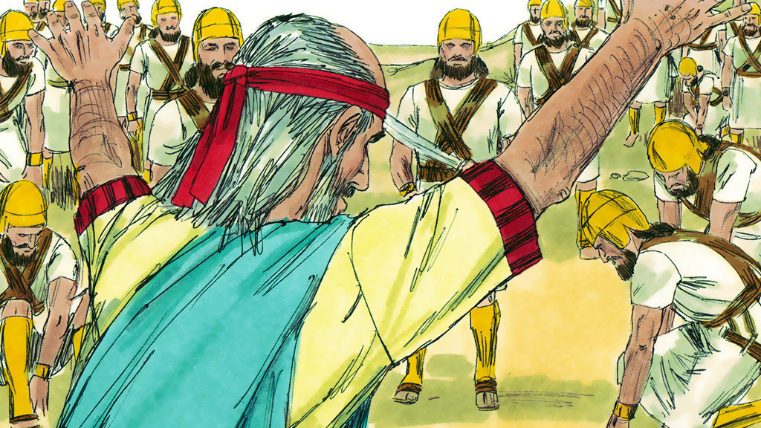
Then God breathed life into them.
They stood on their feet and were like a huge army.

Slide 13
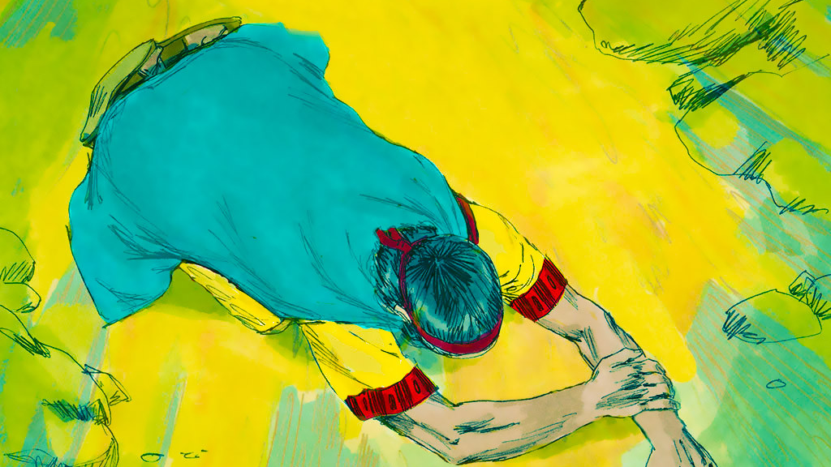
The Lord said to Ezekiel, “These bones stand for the people of Isreal…dried up, destroyed, and with no hope.

Slide 14
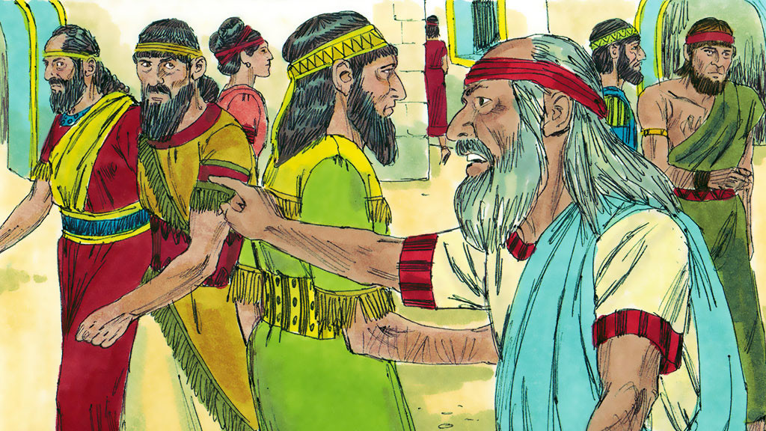
God told Ezekiel to tell the people, “I am going to raise you up again. I will take you back to the land of Israel…. Then you will know that I am the LORD.”

Slide 15
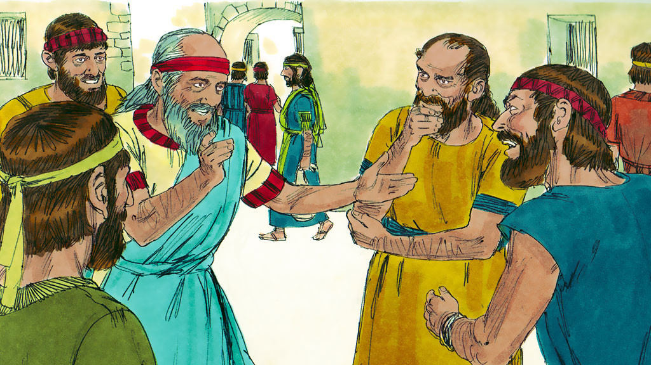
After 70 years in captivity, God made it possible for the Jews to return to their own land. God always keeps his promises.

Slide 16


