Slide 1

DAY 2 –
Rise Up and Believe
John 11:1-44
Jesus raises up Lazarus from the grave

Slide 2
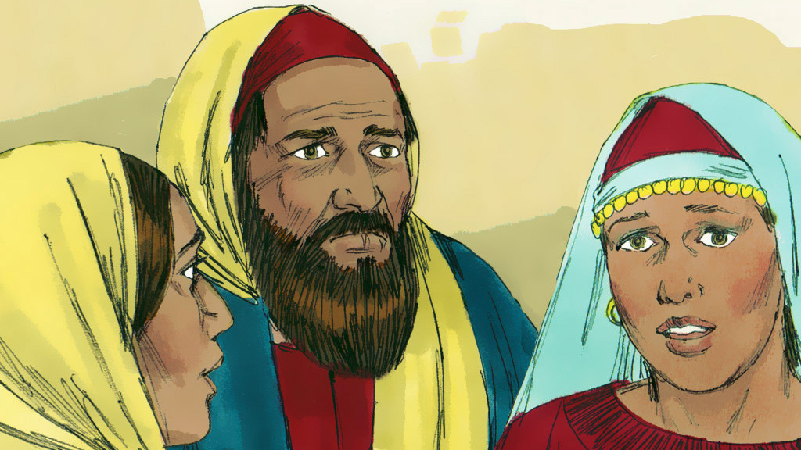
Jesus had close friends that lived in Bethany. Their names were Lazarus, Mary and Martha.
Notes:
Lazarus lived in Bethany with his two sisters Mary and Martha.

Slide 3
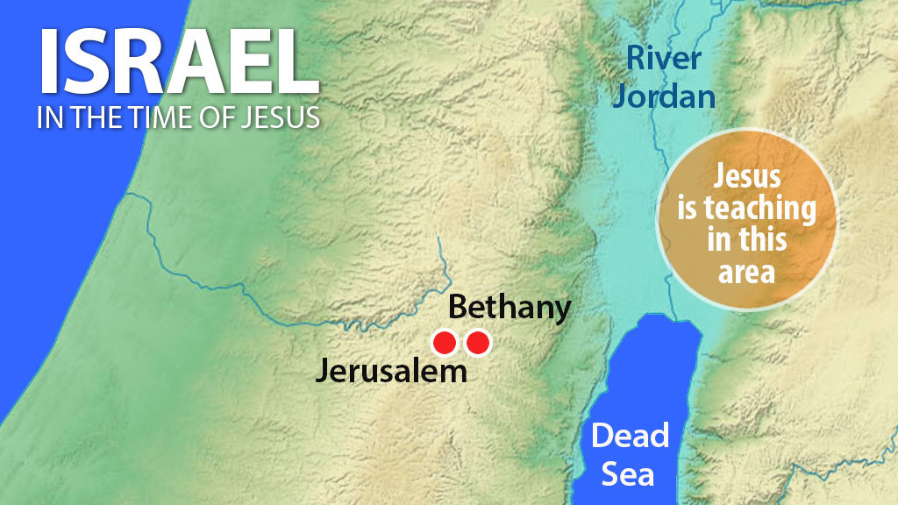
Notes:
One day Lazarus became very seriously ill. Jesus was not near them at the time but teaching in the region on the other side of the River Jordan. So Mary and Martha sent a messenger to fetch Him quickly.

Slide 4
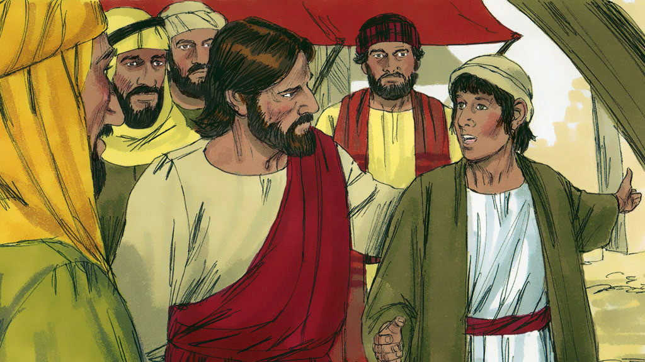
One day Lazarus got very sick. His sisters sent for Jesus to come and heal their brother. His disciples didn't understand
why Jesus didn't go right away.
Notes:
The messenger found Jesus and said, ‘Sir, your good friend Lazarus is very, very sick.’Jesus announced, ‘The purpose of Lazarus’ illness is not death, but for the glory of God. I, the Son of God, will receive glory from this situation.’ Then instead of rushing to Bethany He stayed where He was for the next two days.

Slide 5
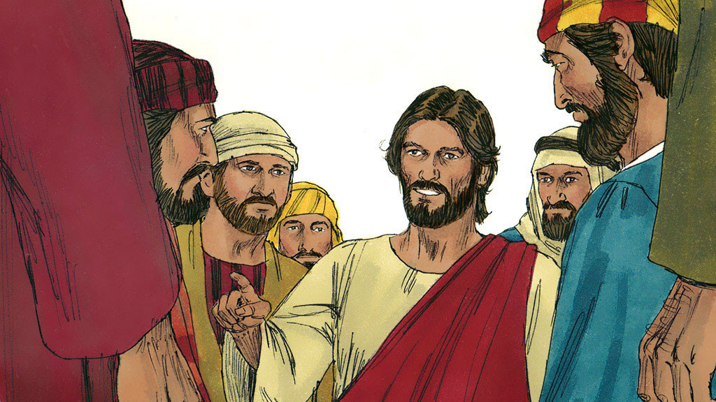
Jesus said, "This sickness will not end in death. It is for God's glory, that God's son may be glorified."
Notes:
Jesus replied, ‘Our friend Lazarus has gone to sleep. I am going to wake him up!’ His disciples thought Lazarus must be resting. So Jesus told them plainly, ‘Lazarus is dead. This will give you another opportunity to believe in me. Come, let’s go to him.’

Slide 6
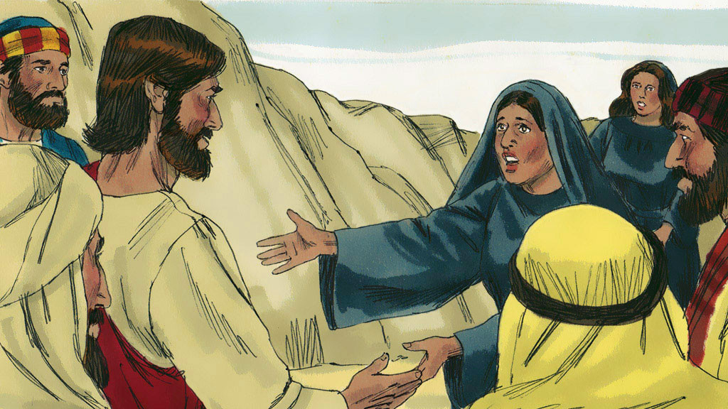
When Jesus arrived at Bethany, Lazarus had been dead for
four days and was already buried.
Notes:
When they arrived at Bethany, they were told that Lazarus had already been in his tomb for four days. When Martha got word that Jesus had arrived, she went to meet Him. But Mary stayed at home.

Slide 7
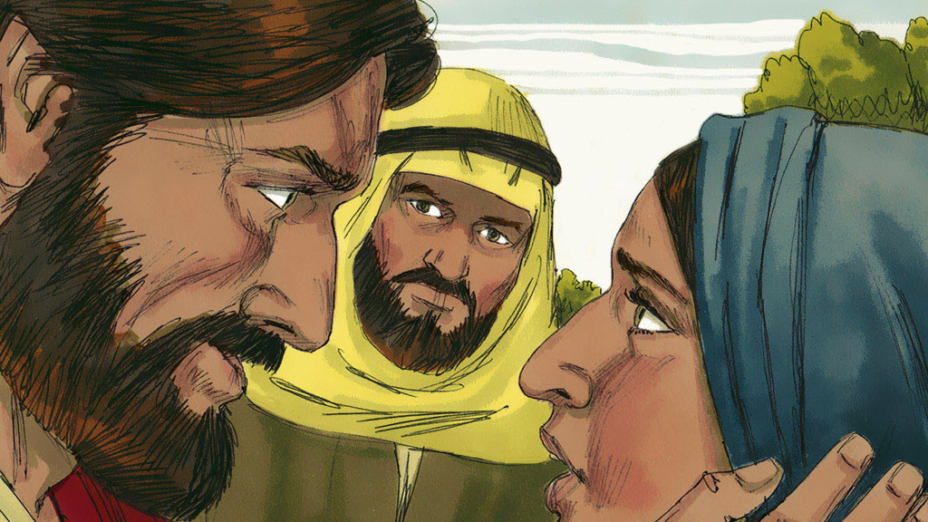
"Lord, I wish you had been here! Then my brother would not have died."
Notes:
‘If you had been here, my brother wouldn’t have died,’ Martha told Jesus. ‘And even now it’s not too late, for I know that God will bring my brother back to life again, if you will only ask Him.’ Jesus told her, ‘Your brother will come back to life again. I am the one who raises the dead and gives them life again. Anyone who believes in me, even though he dies like anyone else, shall live again. He is given eternal life for believing in me and shall never perish. Do you believe this, Martha?’ ‘Yes, Master,’ Martha replied. ‘I believe you are the Messiah, the Son of God.’

Slide 8
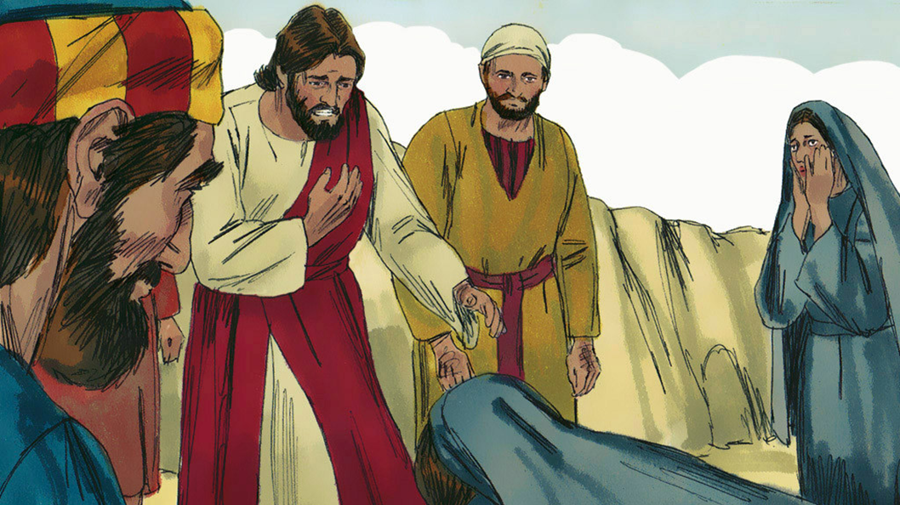
“Jesus said to her, ‘I am the resurrection and the life. Anyone who believes in me will live, even if they die.”

Slide 9
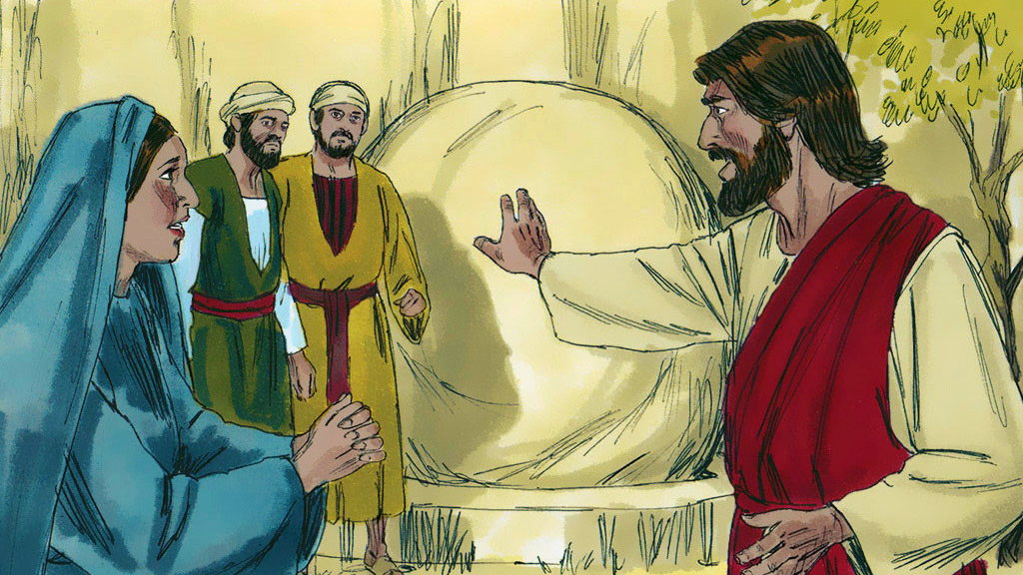
“Take away the stone.” “But, Lord,” said Martha, “by this time there is a bad smell.”
Notes:
Jesus was taken to the tomb. It was a cave with a heavy stone rolled across its door.‘Roll the stone aside,’ Jesus told them.Martha protested, ‘By now the smell will be terrible, for he has been dead four days.’

Slide 10
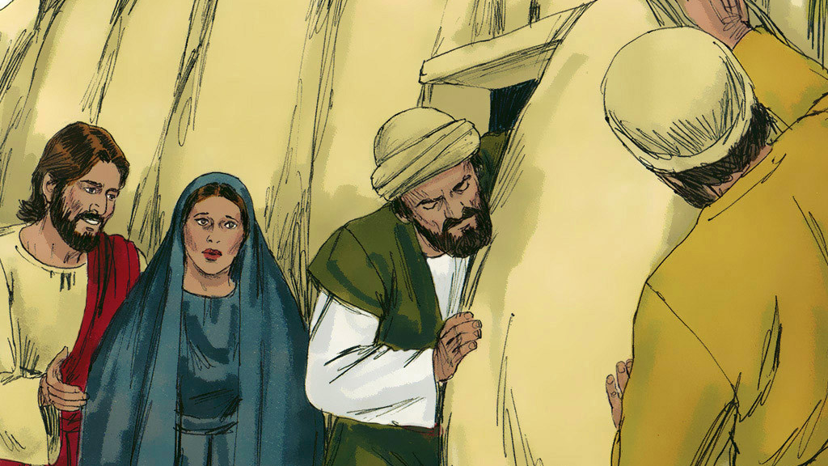
Then Jesus said, “Didn’t I tell you that if you believe, you will see God’s glory?” So, they rolled the stone away.
Notes:
‘But didn’t I tell you that you will see a wonderful miracle from God if you believe?’ Jesus asked her. So they rolled the stone aside.

Slide 11
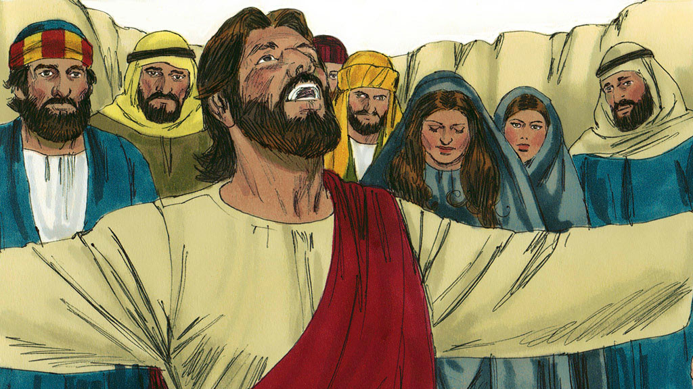
Jesus called out in a loud voice. “Lazarus, come out!”
Notes:
Then Jesus shouted, ’Lazarus, come out!’

Slide 12
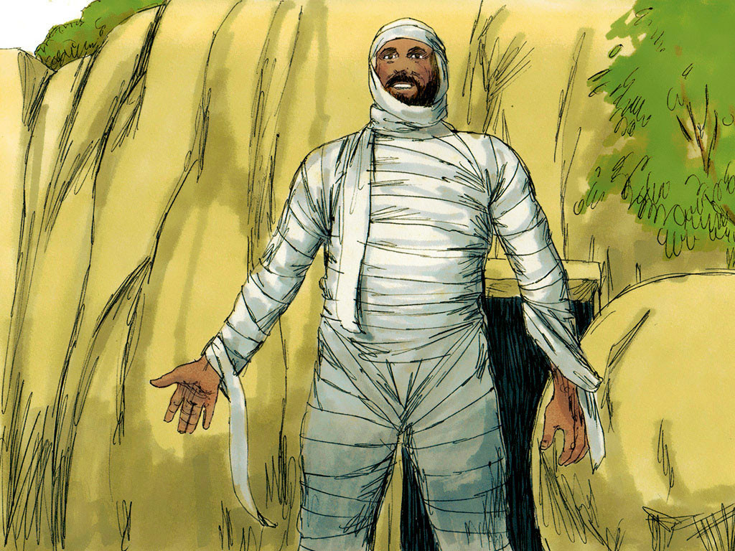
The dead man came out.
His hands and feet were wrapped with strips of linen.
Notes:
Lazarus came out from the tomb still bound up in the grave clothes, his face muffled in a head swath. Jesus told them, ‘Unwrap him and let him go!’

Slide 13


