Slide 1

DAY 3 –
Rise Up and Live
Luke 24:13-35
The risen Lord appears to two men on the road

Slide 2
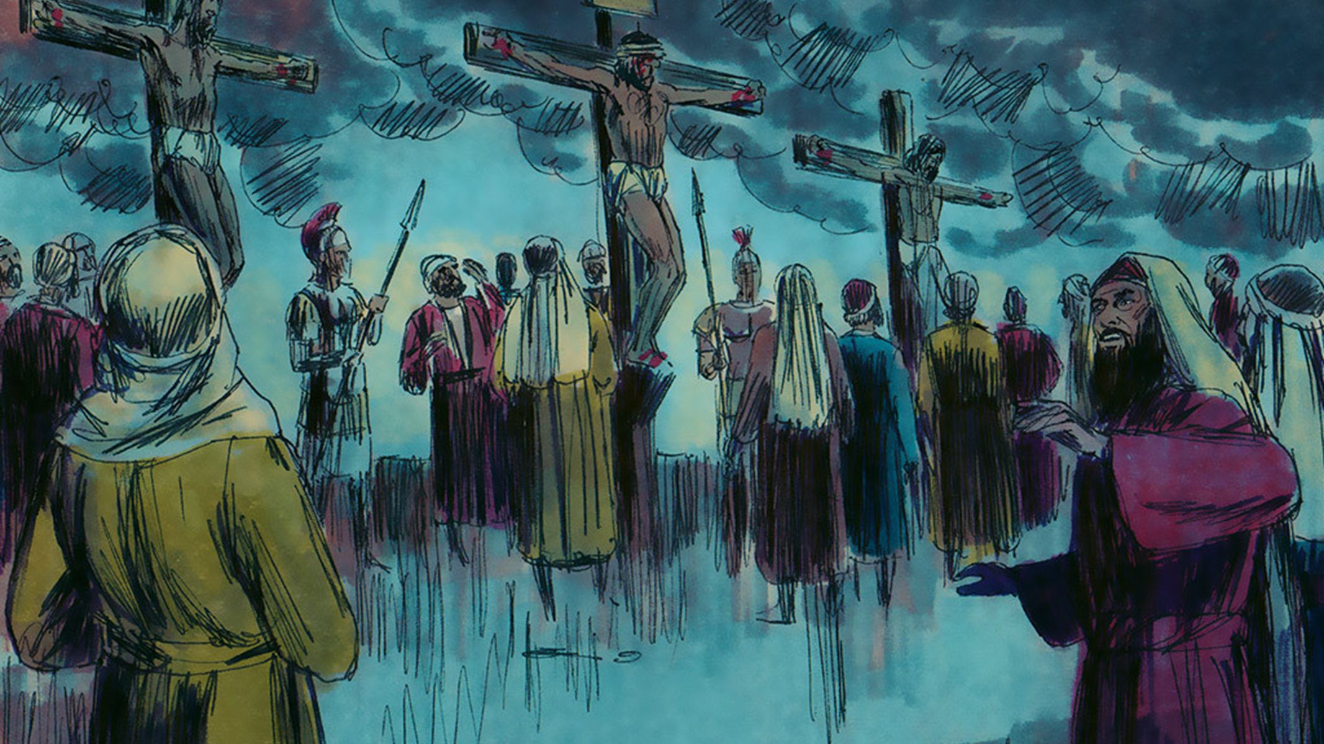
It had been three days since Jesus died and was buried.

Slide 3
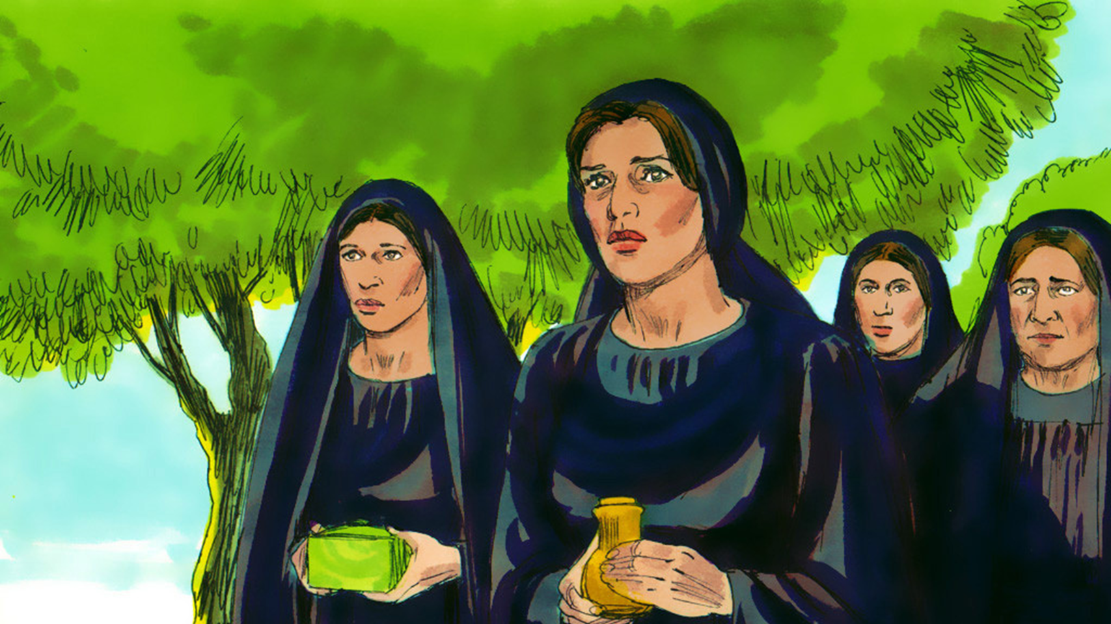
Women went to the tomb with spices to care for Jesus body.

Slide 4
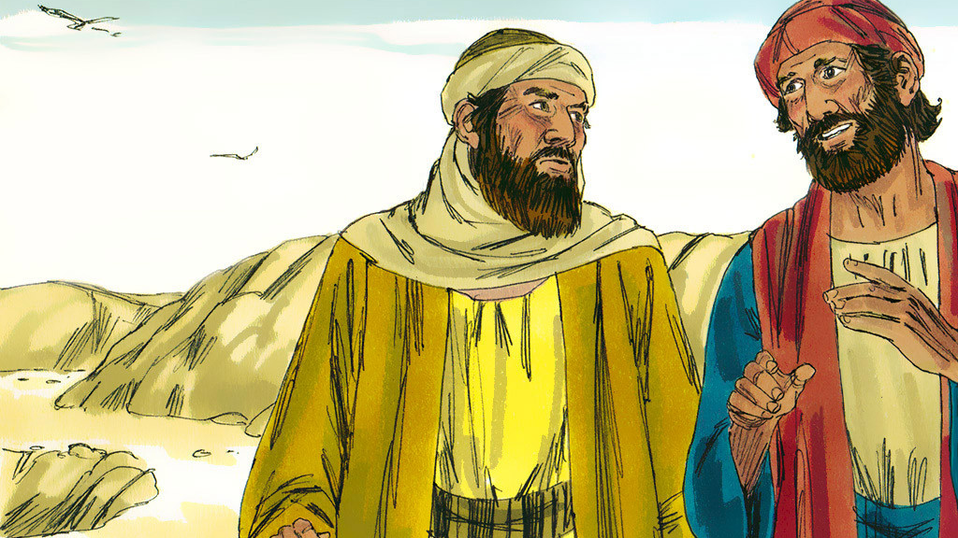
Two of Jesus’ disciples left the group to walk to a village called Emmaus.
Notes:
On the third day after Jesus was crucified and put in the tomb, two of His disciples were walking along a road out of Jerusalem. One of them was Cleopas.

Slide 5
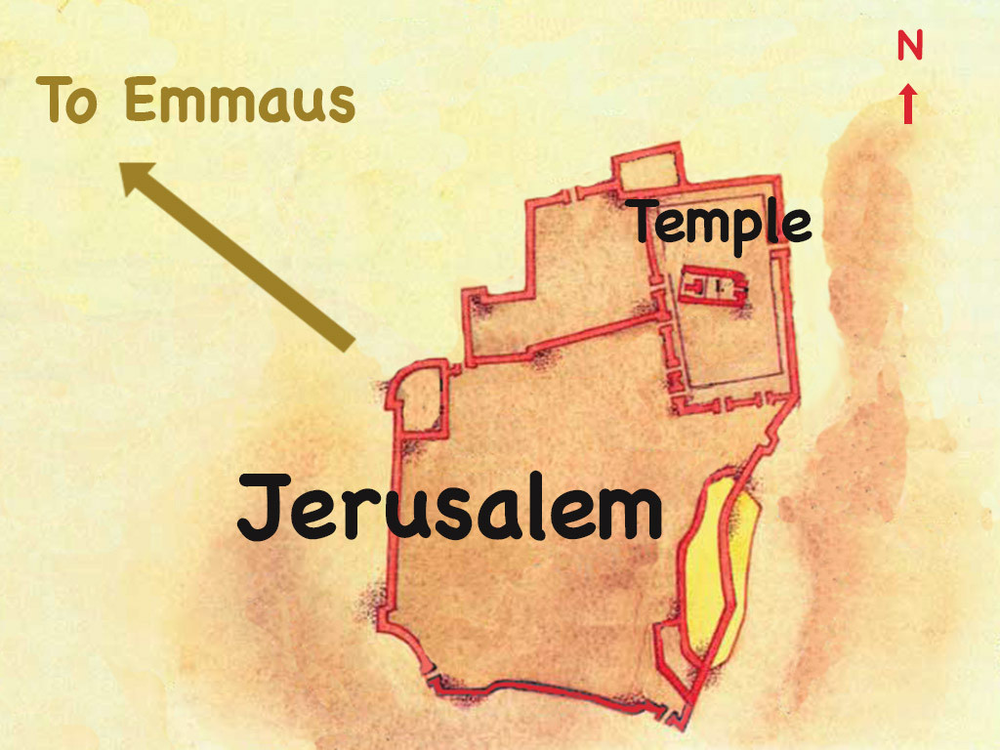
Notes:
They were on their way to a village called Emmaus 7 miles (11 kilometres) out of the city.

Slide 6
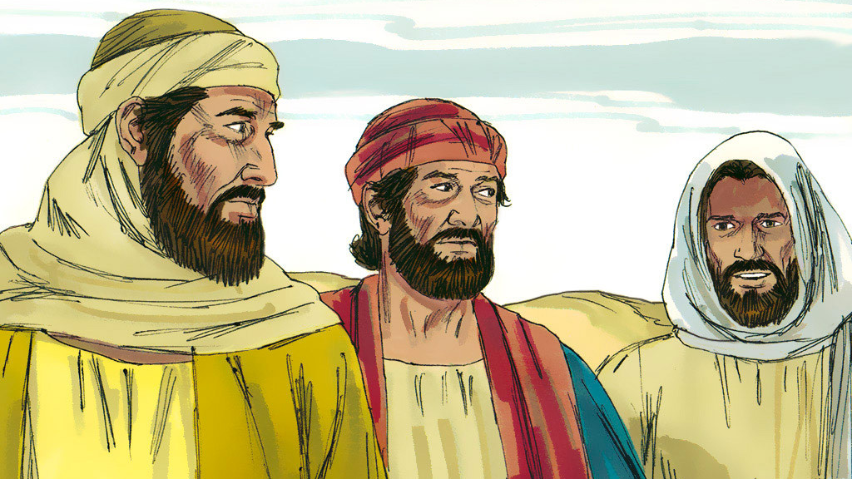
As they walked, Jesus came up and walked along with them. The men were kept from recognizing it was Jesus.
Notes:
They were talking about the events that led to Jesus being put on a cross to die. As they talked, a man came up and walked alongside them. It was Jesus but they were kept from recognising Him.

Slide 7
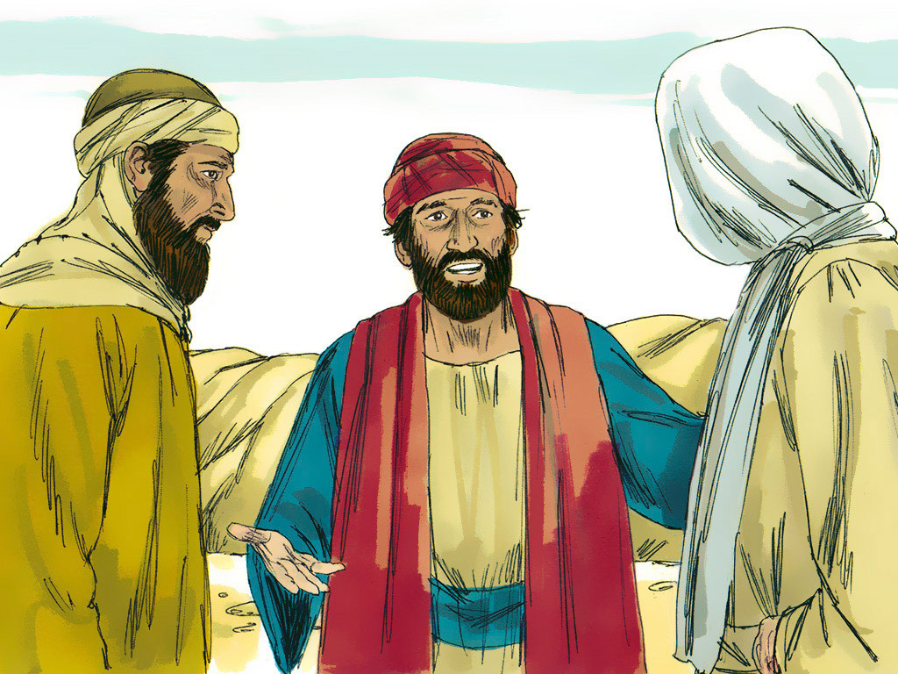
Jesus asked them men what they were talking about. “Don’t you know about the things that have happened the last few days?” The men answered.
Notes:
‘What things?’ asked the stranger.

Slide 8
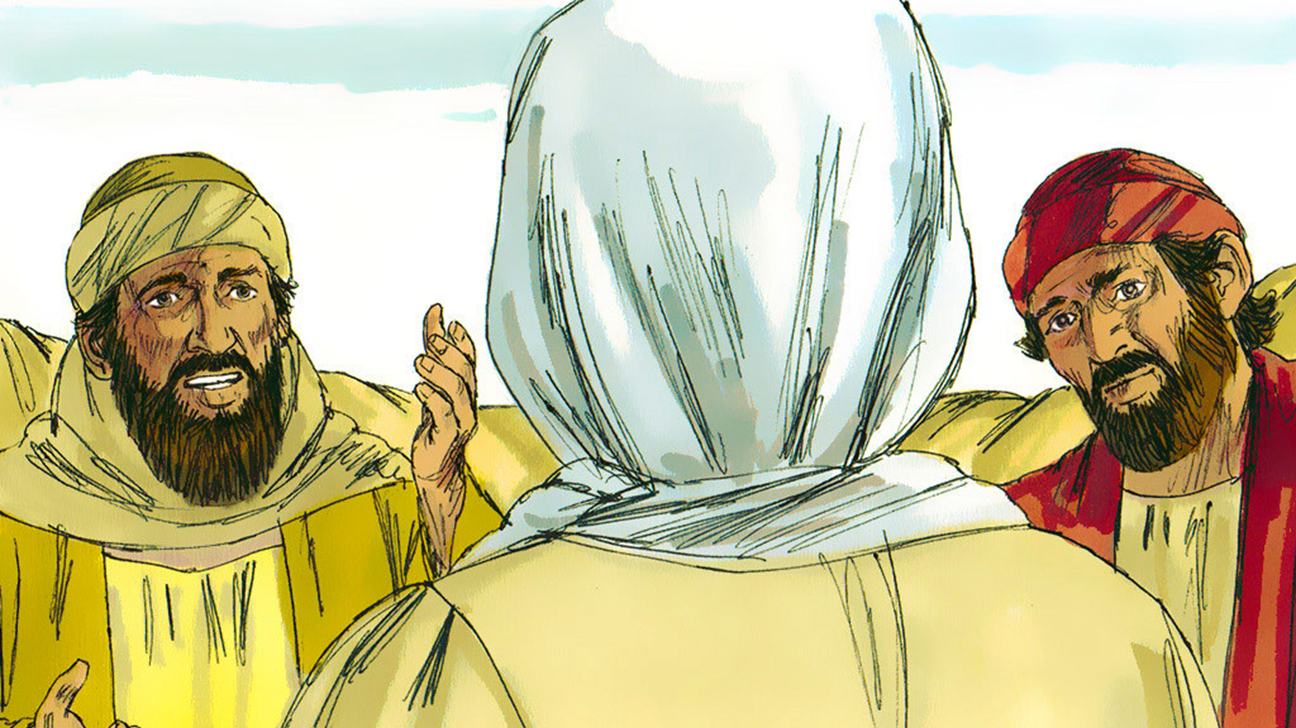
“What things?” Jesus asked. “About Jesus of Nazareth.” They said. The men told Jesus all that had happened.

Slide 9
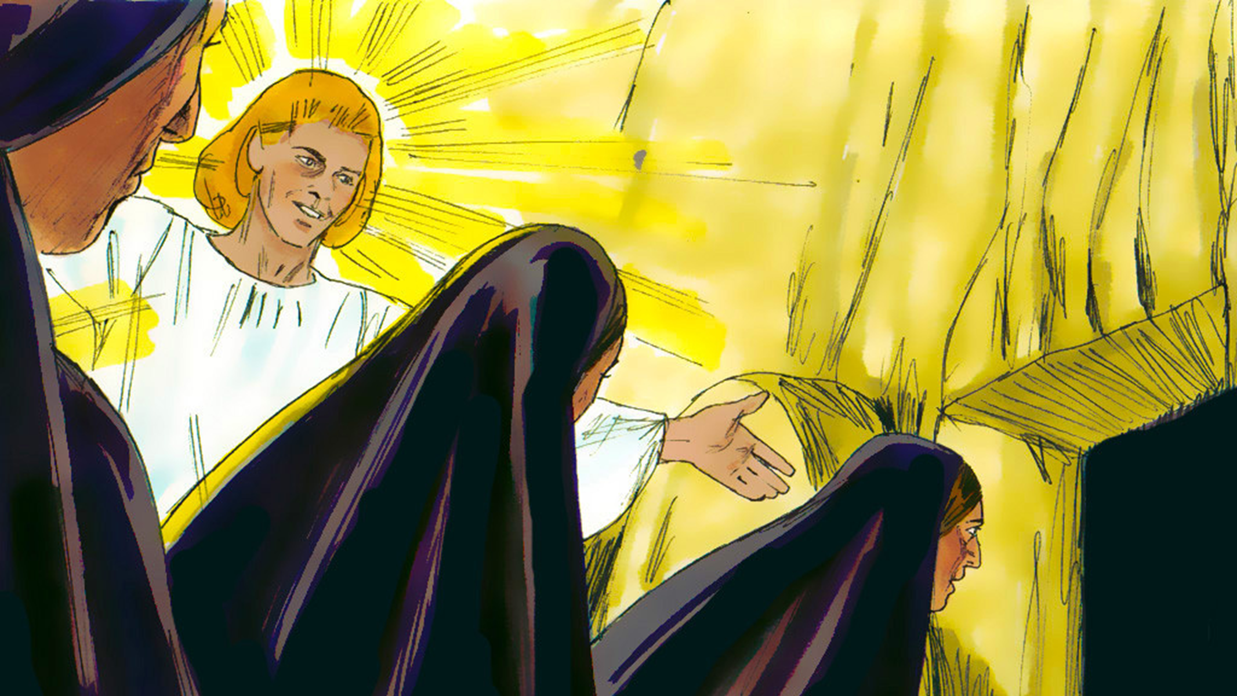
Some of the women in our group even said they saw an angle. He said, “Jesus is alive!”

Slide 10
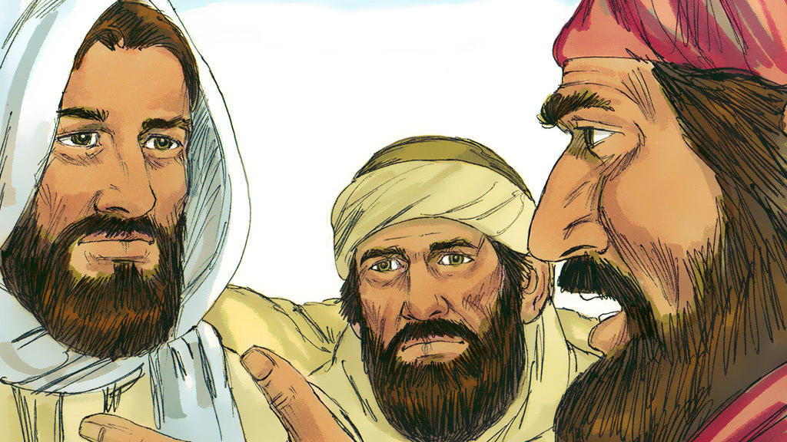
“We had hoped Jesus was the One who was going to set Israel free, and it is the third day.”
Notes:
‘Jesus of Nazareth was handed over by the Chief Priests to be sentenced to death and they crucified Him,’ the disciples explained. ‘We hoped he would save us.’

Slide 11
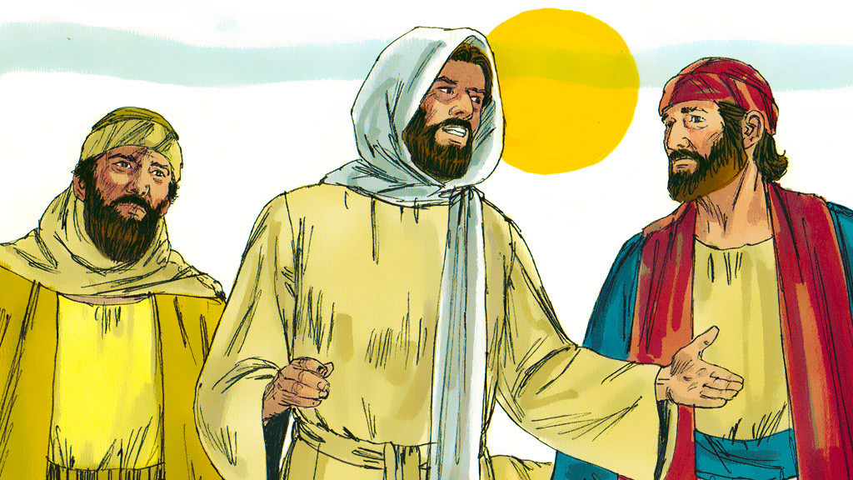
Jesus explained to them what the Bible said about the Messiah having to suffer and die and rise again. He started with Moses and the prophets.
Notes:
‘How foolish you are not to believe what the prophets said would happen many years ago. They told us the Saviour (Messiah) would have to suffer before rising to glory.’

Slide 12
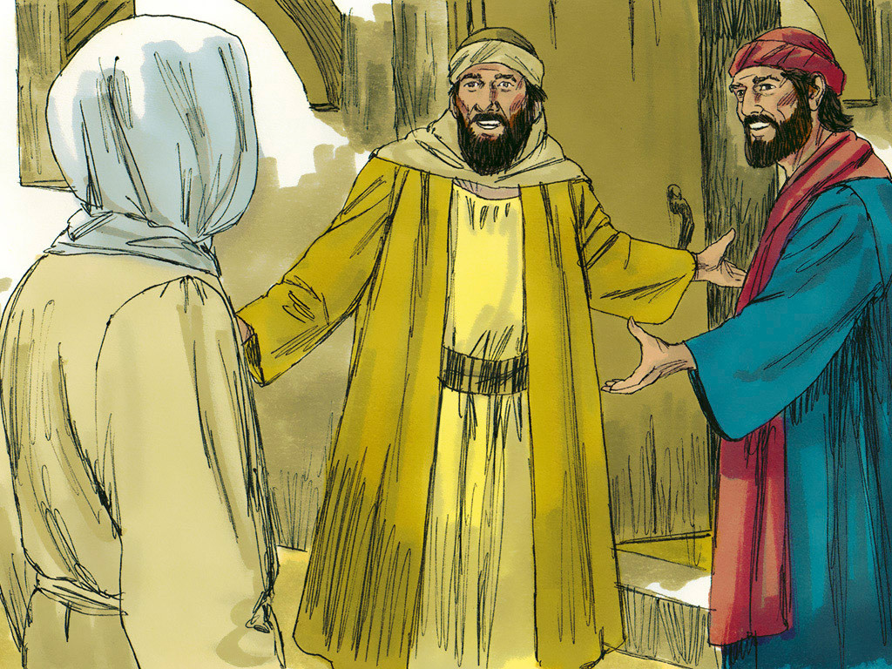
When the men came to the village, they invited him to stay for dinner.
Notes:
As they approached Emmaus the stranger looked as if He was travelling on further. They invited Him to stay with them and He agreed.

Slide 13
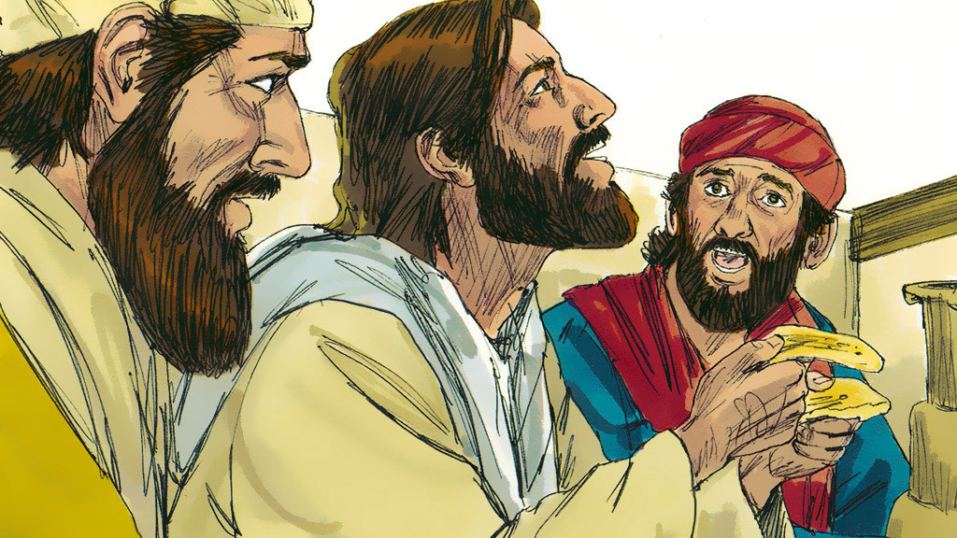
Jesus took the bread and gave thanks to God. As he gave the bread to the men their eyes were opened, and they recognized it was Jesus!
Notes:
As they ate together, the stranger took the bread, broke it and gave it to them. Immediately God allowed the two disciples to see who the stranger was. Jesus!

Slide 14
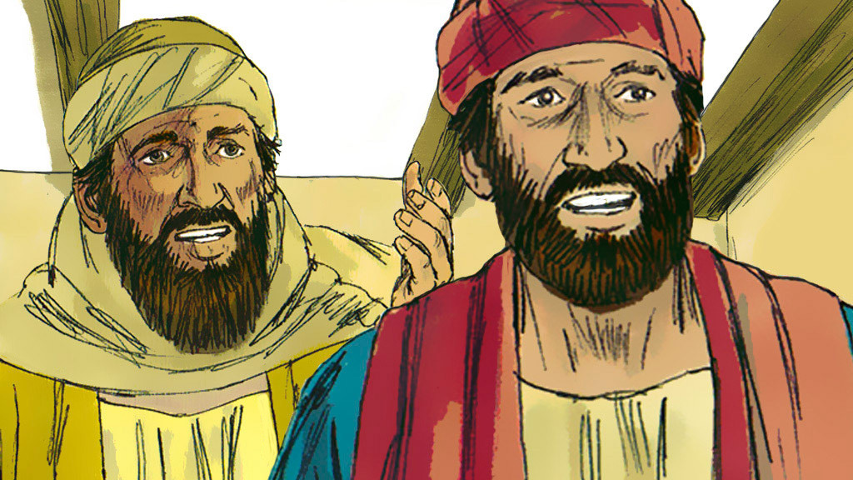
At that moment, Jesus disappeared from their sight. The men said to one another, “Didn’t we feel so strong in our hearts when Jesus explained the scriptures?”
Notes:
At that moment Jesus disappeared from their sight. ‘Weren’t our hearts warmed as He spoke to us and explained what is written about the Saviour?’ they exclaimed.

Slide 15
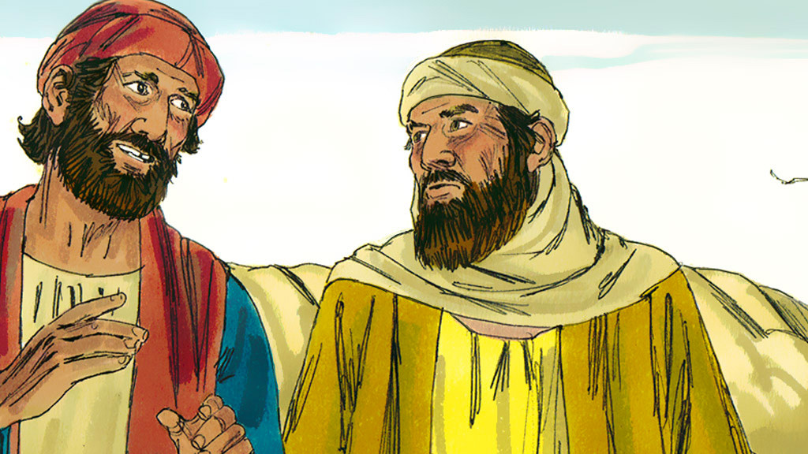
They were filled with joy! Their Savior was alive. Jesus is risen!
Notes:
They got up and rushed back to Jerusalem at once.

Slide 16
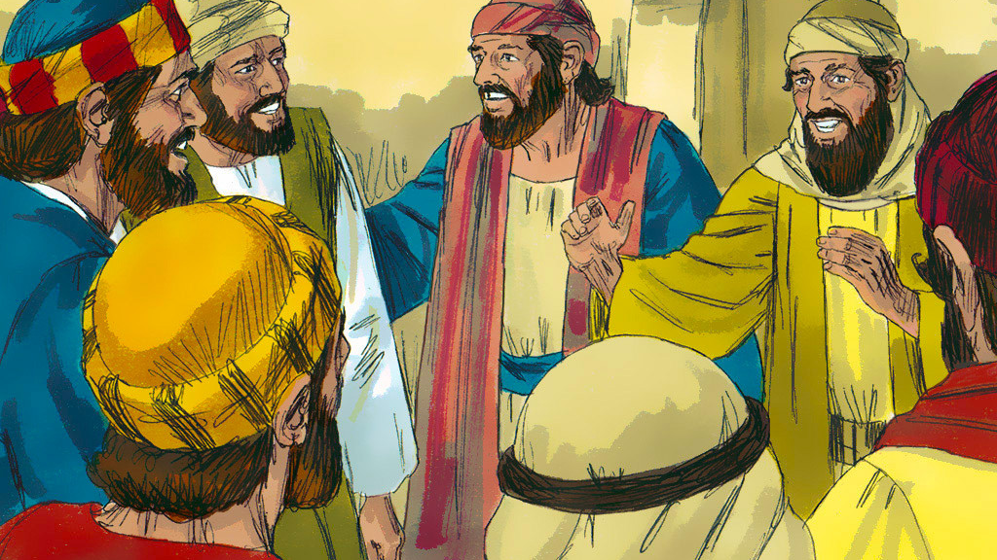
The two men hurried back to tell the rest of the disciples, “It’s true! The Lord is risen!”
Notes:
They found the other disciples and excitedly told them what had happened. The room they were in was locked.

Slide 17


