Slide 1
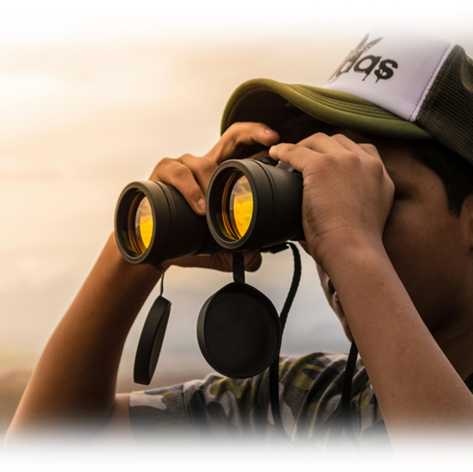
UNSHAKABLE
FOCUS
ACTS 16:16-34

Slide 2

“I keep my eyes always on the Lord.
With him at my right hand,
I will not be shaken.” Psalm 16:8

Slide 3

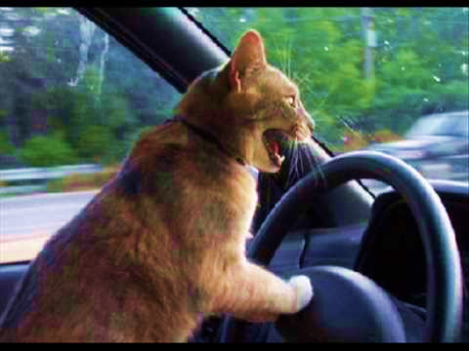
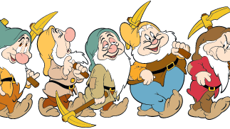
Do you like to sing?
At church or Friendship group?
In the car?
While doing chores?

Slide 4
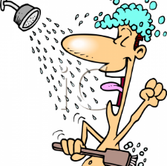
Where is your favorite place to sing?
Maybe in the shower?

Slide 5
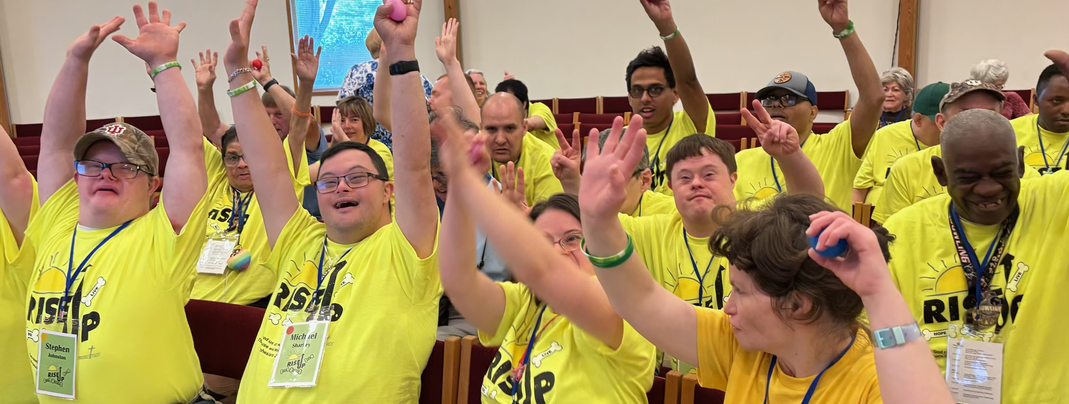
“So, my heart will sing Your praises.
I can’t keep silent.”
Psalm 30:12

Slide 6
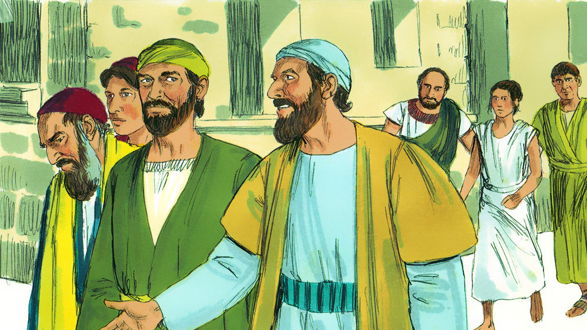
Paul and Silas were missionaries. They were focused on spreading the good news of Jesus Christ in the city of Phillippi.

Slide 7
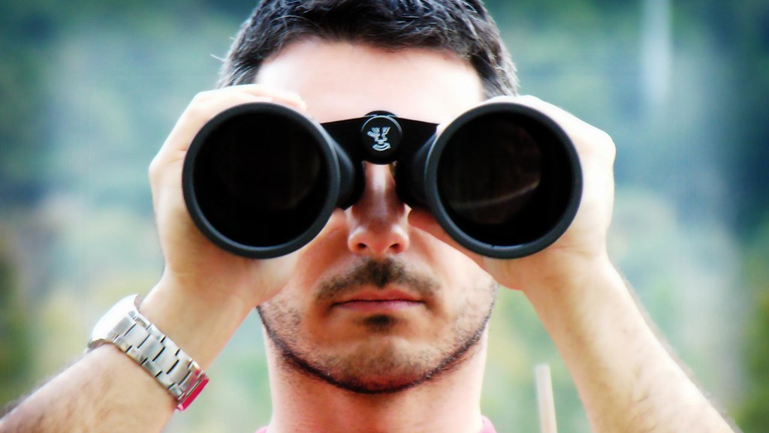
Focus – paying attention on one thing without getting distracted on things around us. Binoculars help us focus on things more clearly.
This Photo by Unknown Author is licensed under CC BY-NC-ND

Slide 8
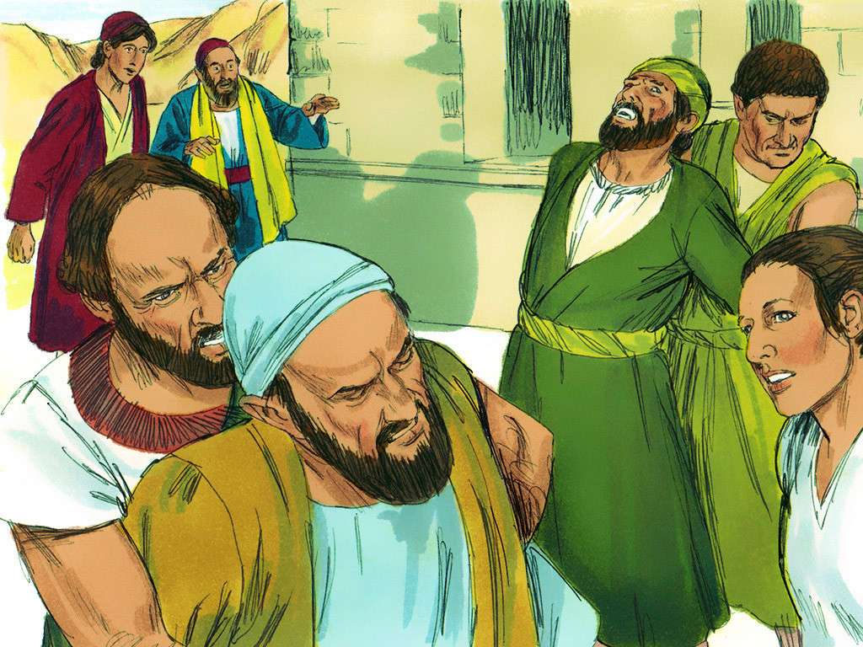
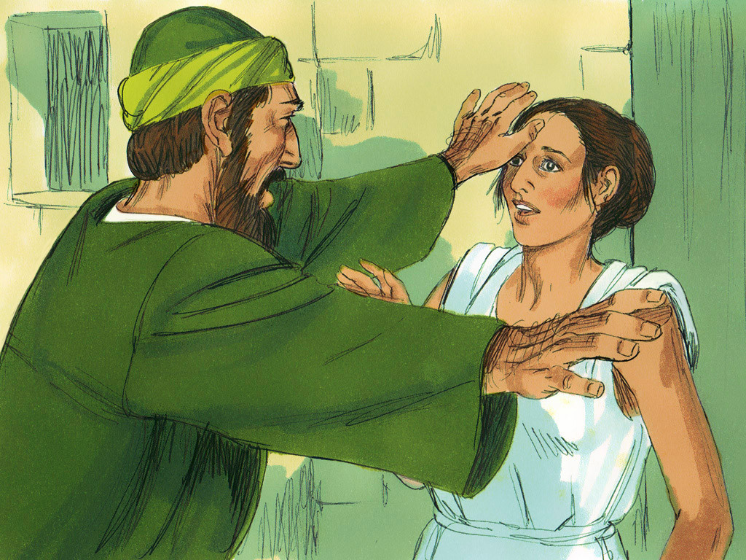
An angry crowd grabbed them on their way to pray.
The did not like Paul and Silas healed a girl with an evil spirit.

Slide 9
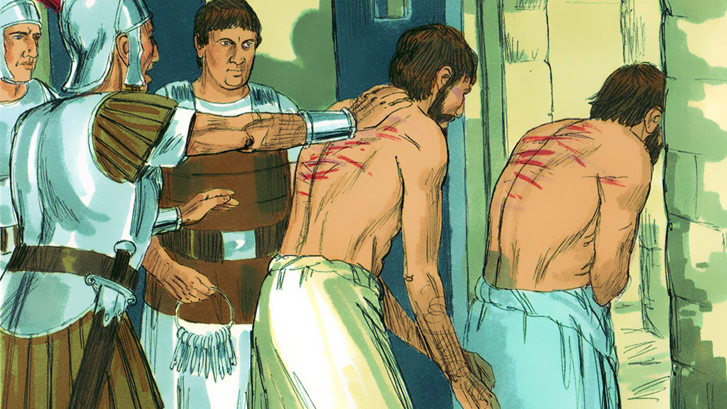
Paul and Silas were arrested and hurt very badly.
The jailer was told to put them in the deepest part of the prison.

Slide 10
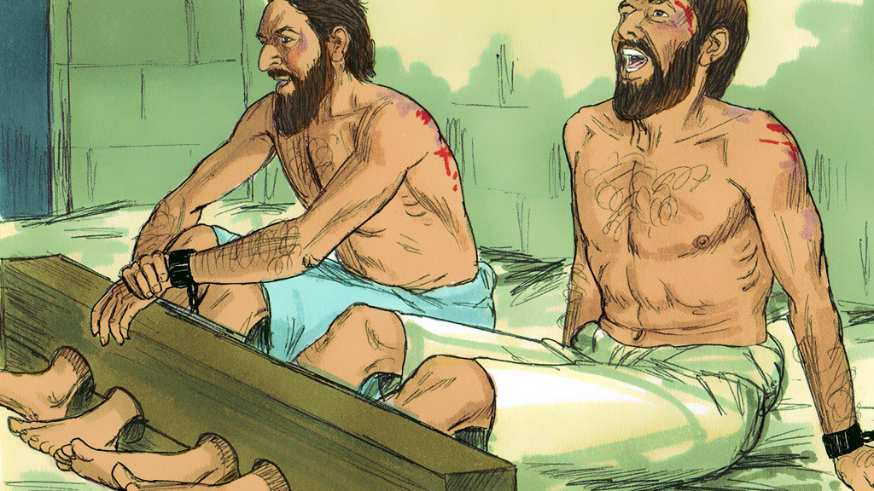
Around midnight Paul and Silas focused on praying and singing hymns to God – the other prisoners were listening!

Slide 11
“God so loved the world that he gave his one and only Son. Anyone who believes in him will not die but will have eternal life.”
John 3:16

Slide 12
Rejoice in the Lord always and again
I say rejoice.
Rejoice in the Lord always and again
I say rejoice.
Rejoice, rejoice and again I say rejoice.
Rejoice, rejoice and again I say rejoice.

Slide 13
Jesus loves me this I know.
For the Bible tells me so.
Little ones to Him belong.
They are weak but He is strong.
Yes, Jesus loves me. Yes, Jesus loves me.
Yes, Jesus loves me, the Bible tells me so.

Slide 14
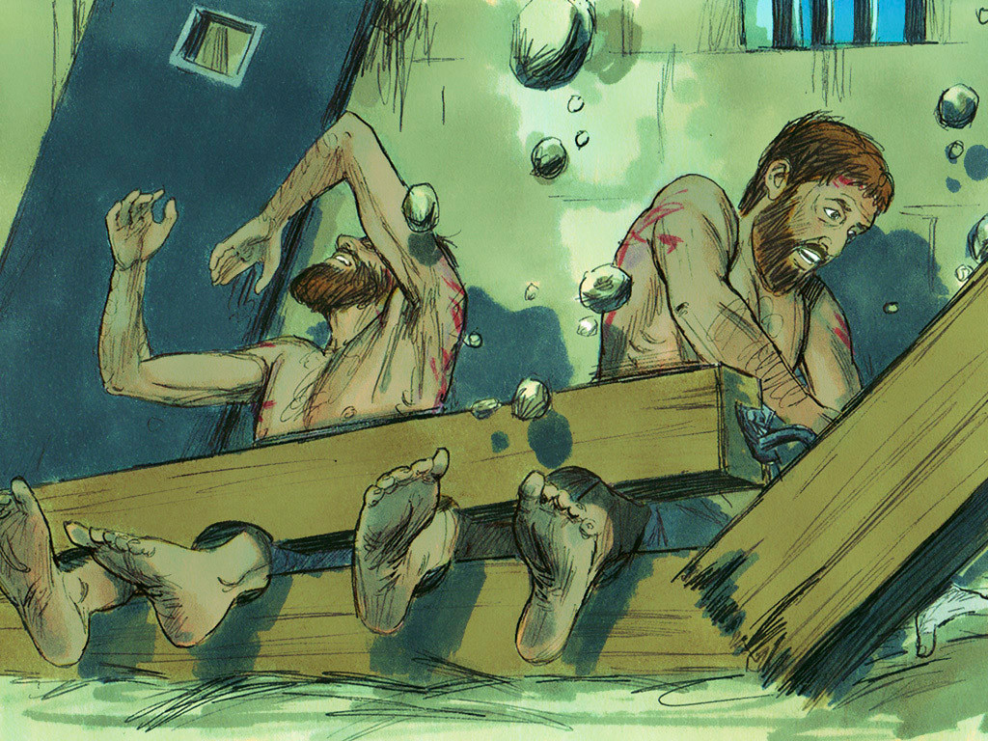
Suddenly, a powerful earthquake shook the prison
from top to bottom.

Slide 15
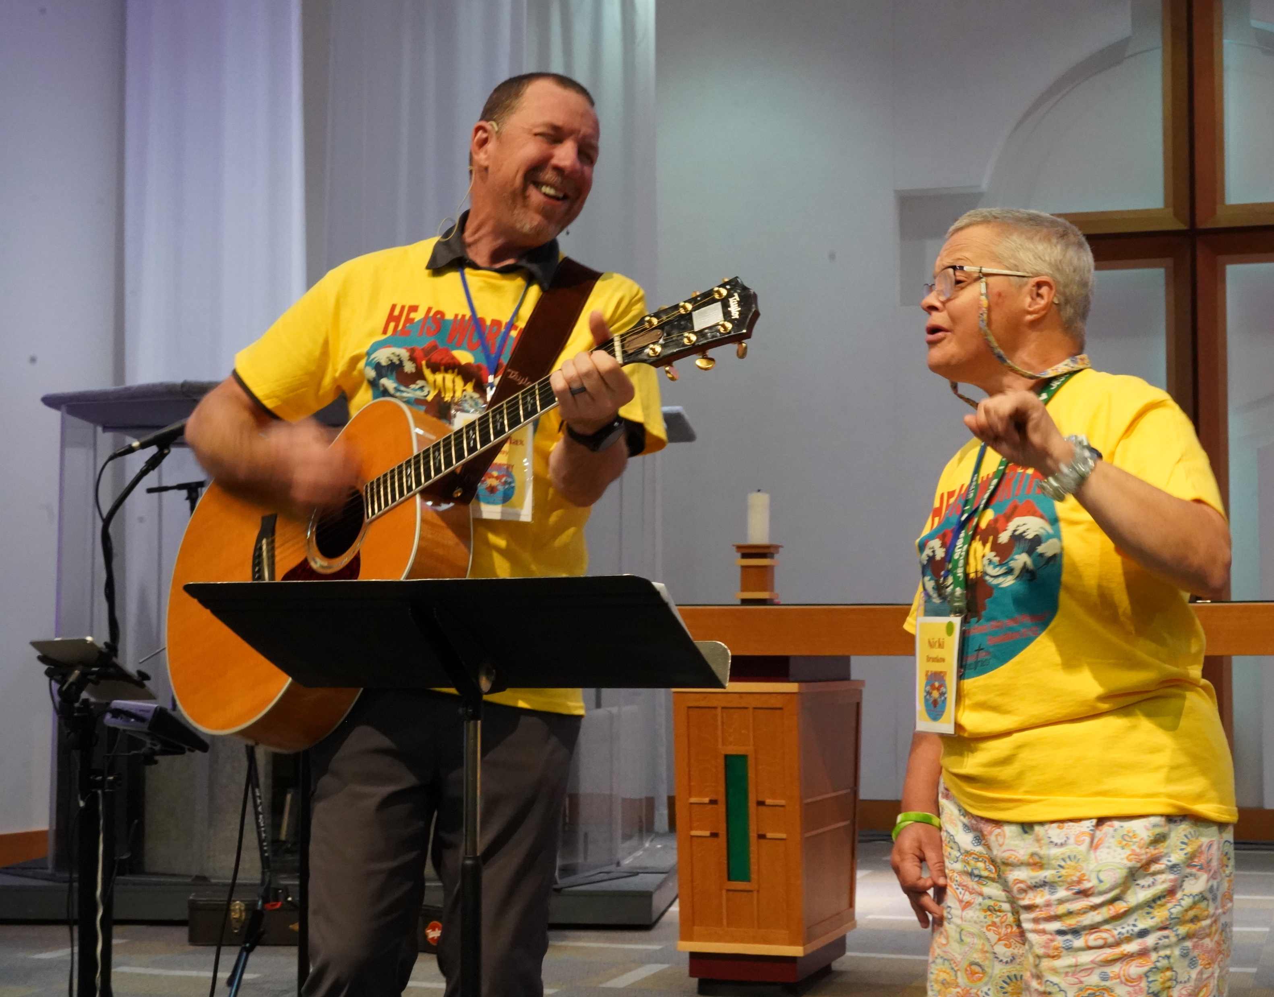
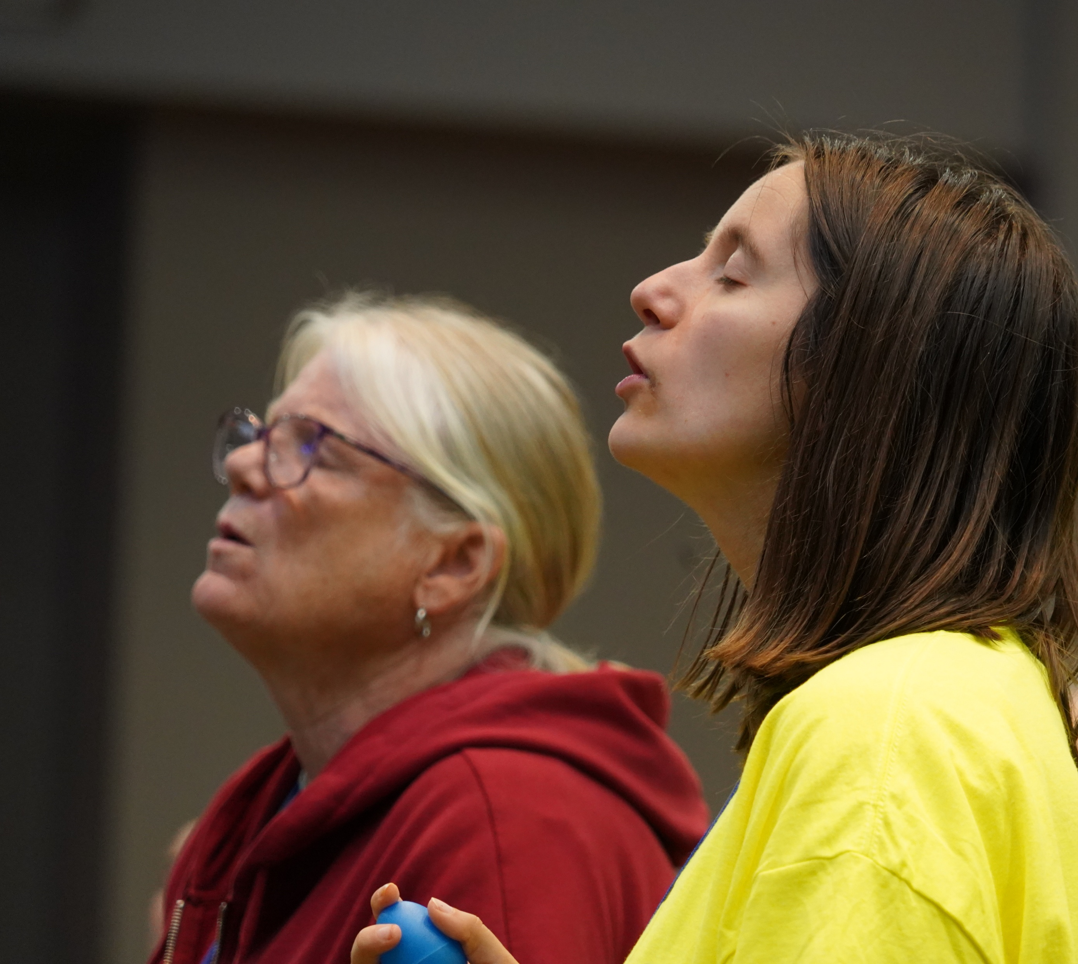
We can praise God and pray anywhere and anytime!

Slide 16
“So, my heart will sing Your praises. I can’t keep silent.”
Psalm 30:12

Slide 17
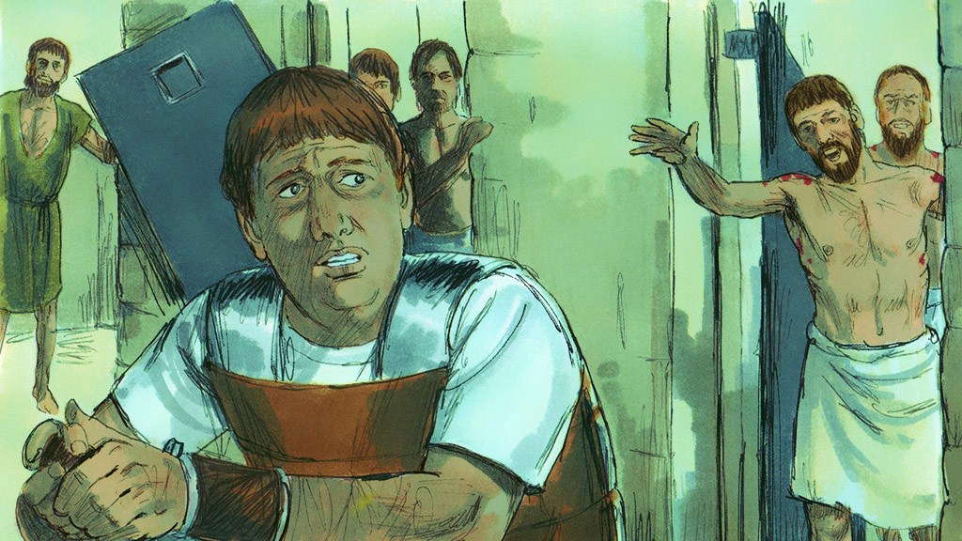
“Paul shouted, ‘Don’t harm yourself! We are all here!’”

Slide 18
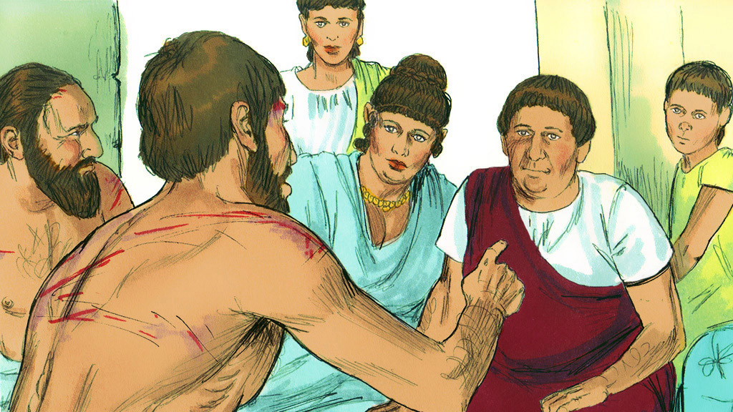
“Believe in the Lord Jesus. Then you and everyone in your house will be saved.” They spoke the word of the Lord to him.

Slide 19
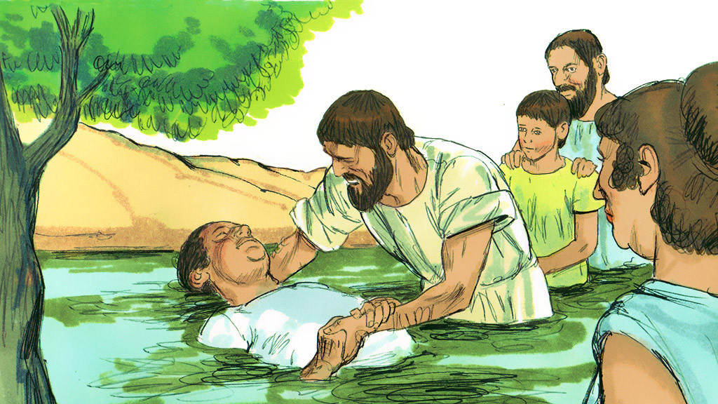
The jailer’s and his family were baptized.
They became believers in Jesus Christ!

Slide 20
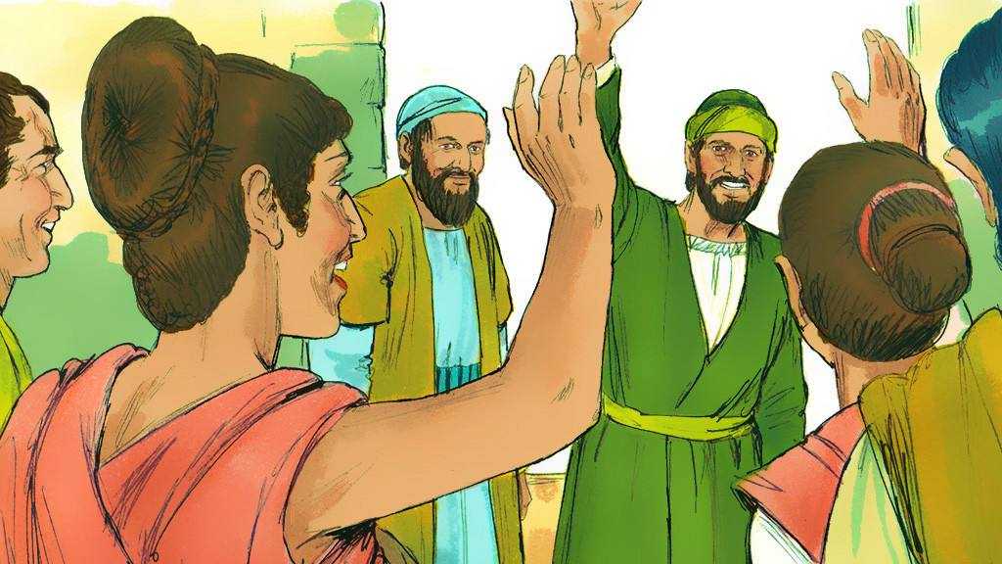
They shared a meal and rejoiced together!

