Slide 1

UNSHAKABLE FAITH
DANIEL 3:1-30

Slide 2
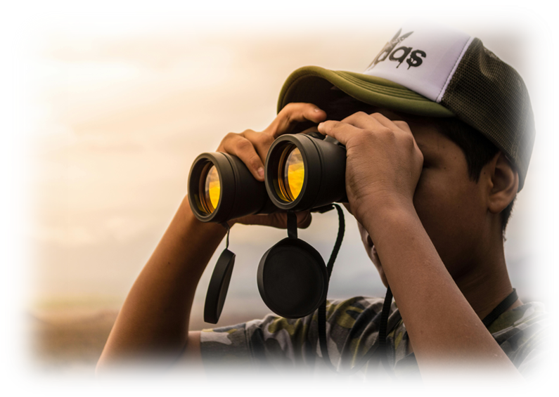
“I keep my eyes always on the Lord.
With him at my right hand,
I will not be shaken.” Psalm 16:8

Slide 3
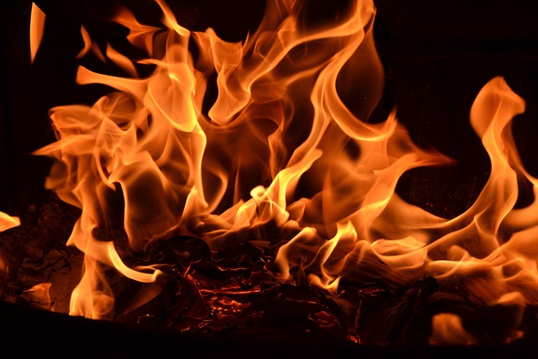
Faith is being sure of what we hope for.
It is being sure of what we do not see.
Hebrews 11:1

Slide 4
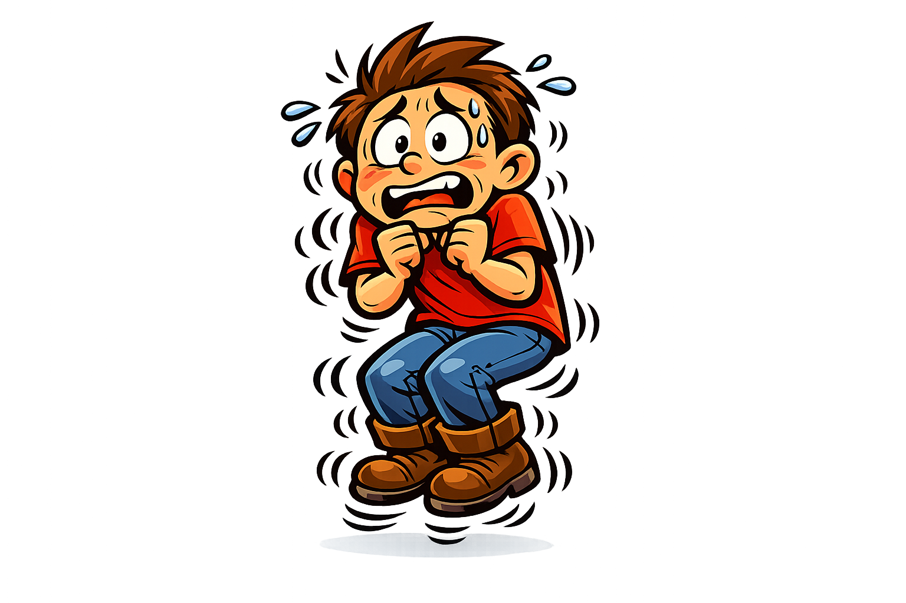
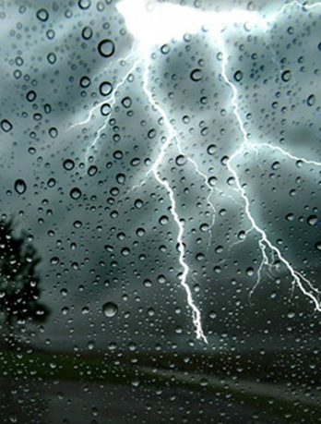
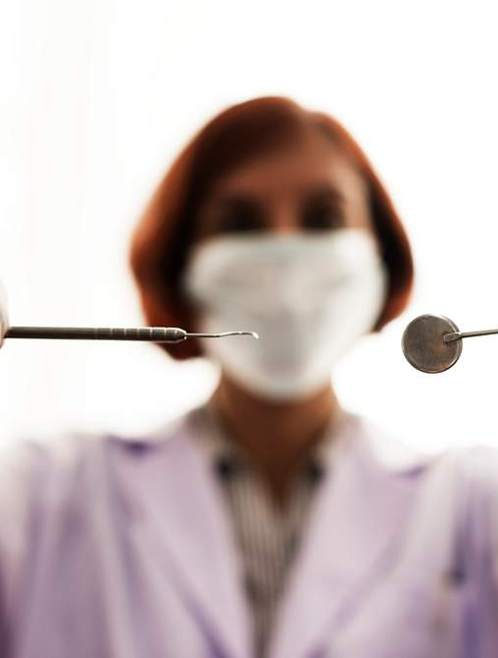
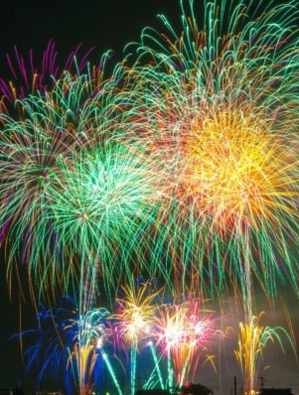
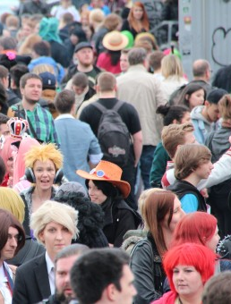
“Shaking in Your Boots!”

Slide 5
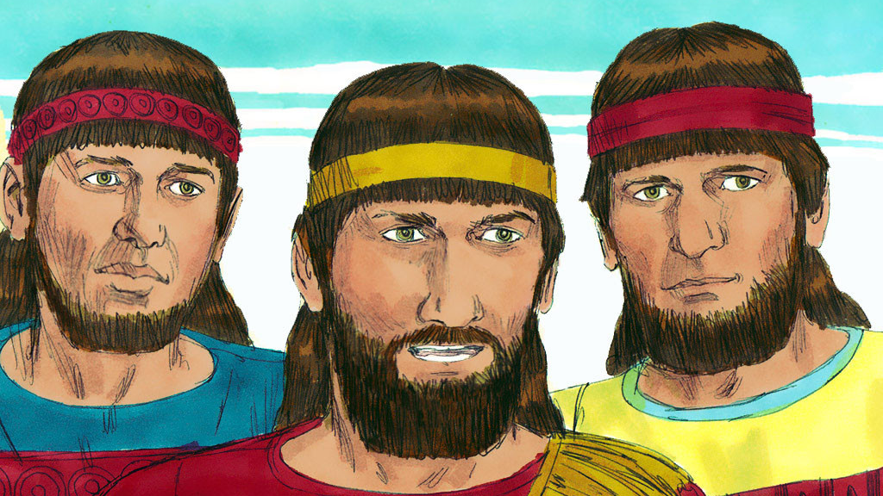
The King captured many young men from Judah including Shadrach, Meshach, and Abednego.

Slide 6
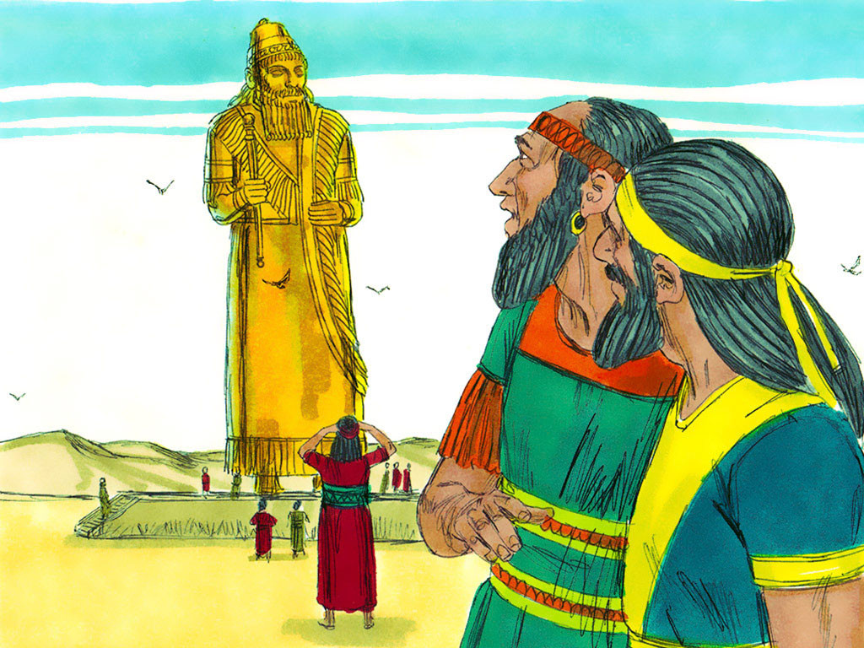
King Nebuchadnezzar built a golden statue 90 feet tall.

Slide 7
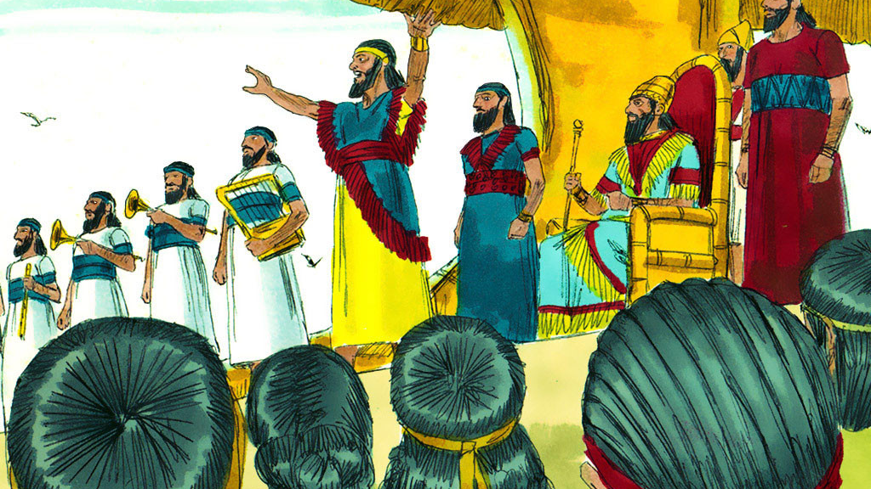
The King commanded people from all the nations to come and bow down to his idol. If they refused, they would be thrown into the fiery furnace.

Slide 8
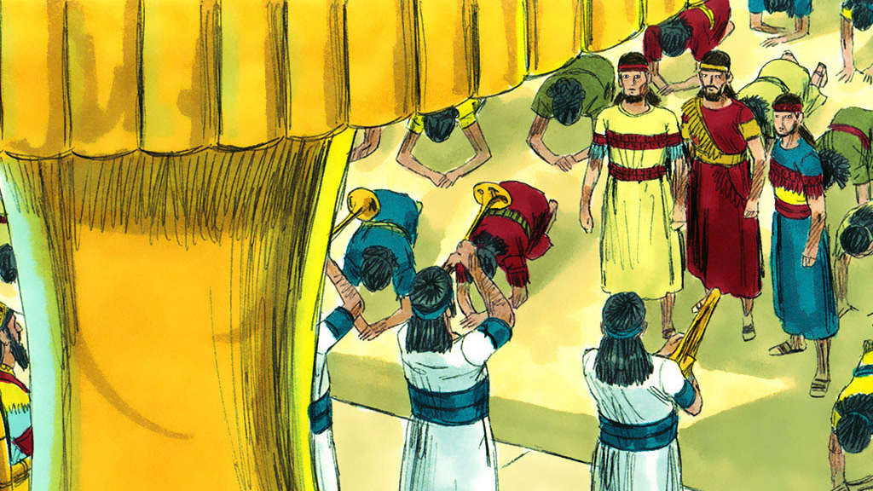
When the music started, everyone bowed and worshipped the idol—except Shadrach, Meshach, and Abednego.

Slide 9
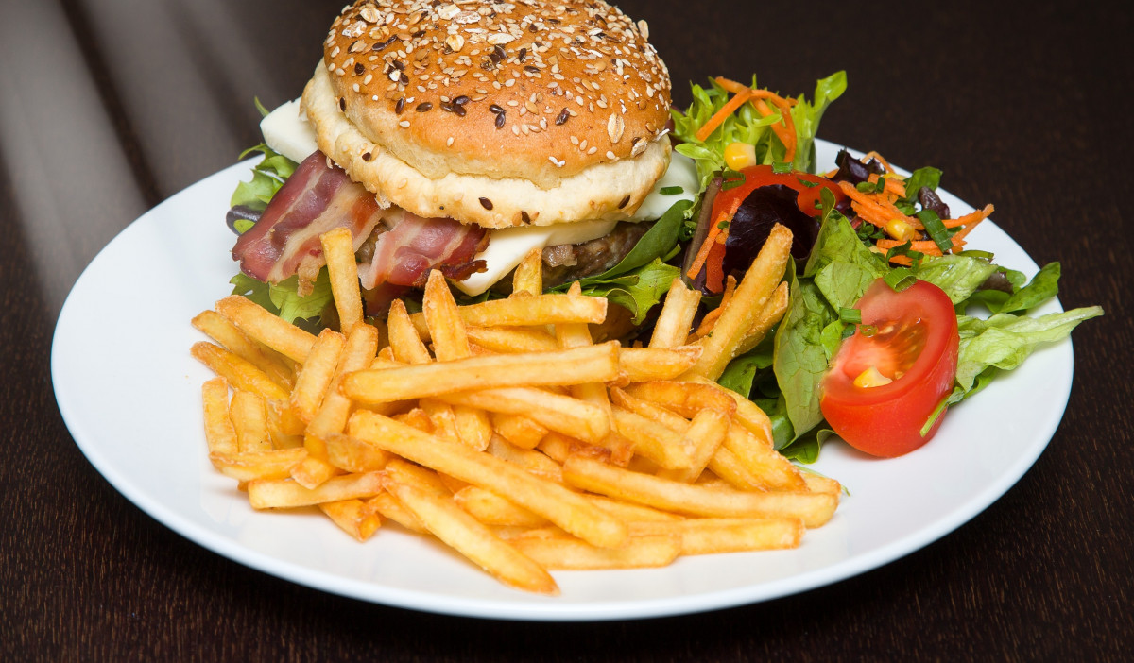


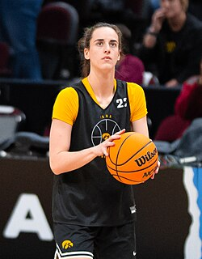

Idols can be things like sport heroes, shopping, money, food, or even your cell phone.

Slide 10
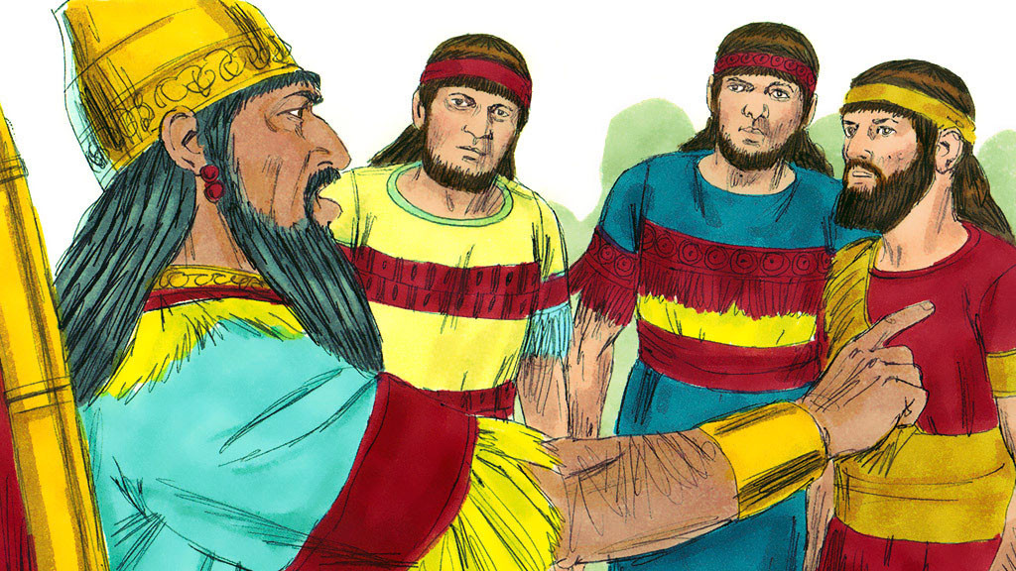
King Nebuchadnezzar was angry that the three young men refused to bow down to his gold statue.

Slide 11
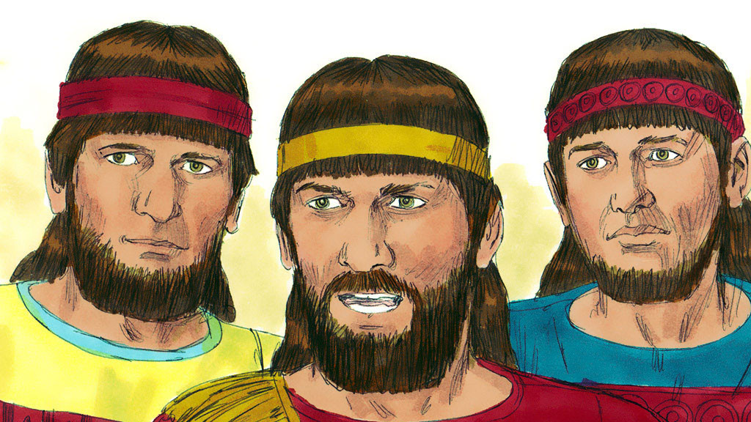
“The God we serve is able to save us from the fire. But even if He doesn’t, we will never worship your gods or bow to your statue.”

Slide 12
Faith is being sure of what we hope for.
It is being sure of what we do not see.
Hebrews 11:1

Slide 13
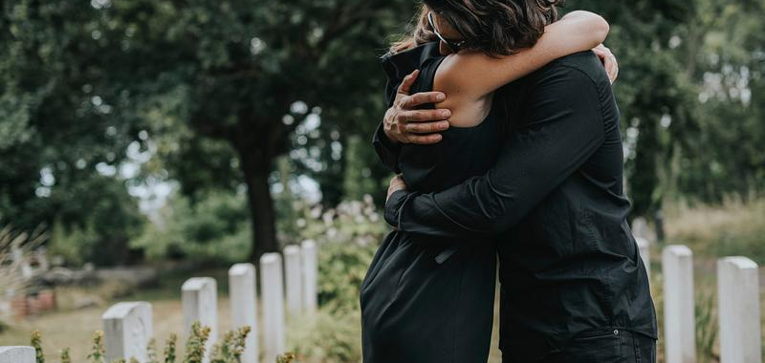

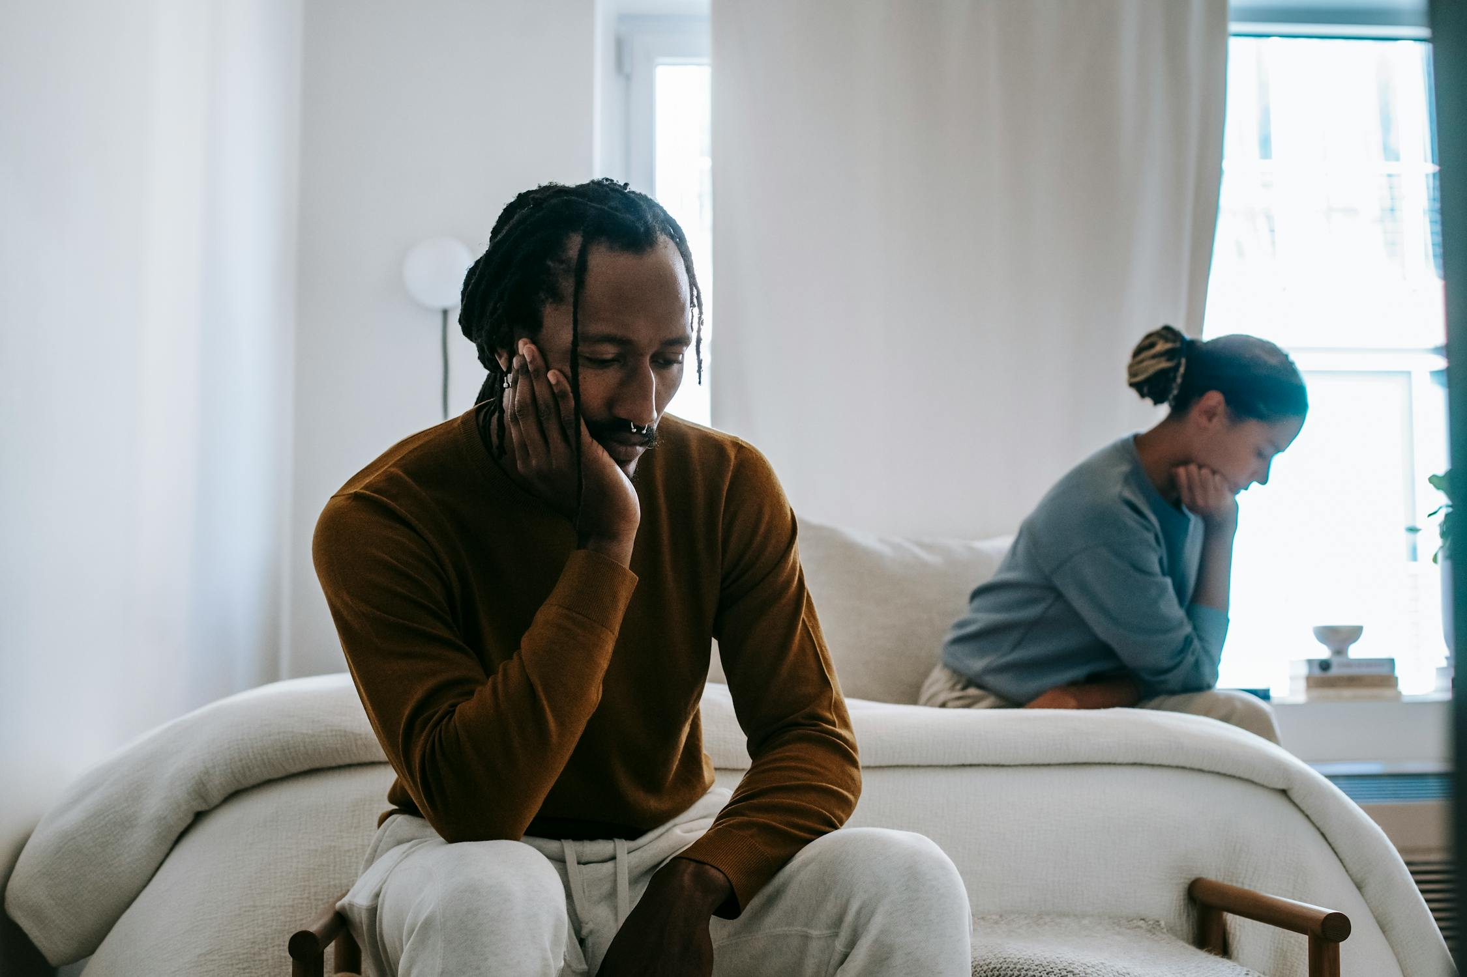
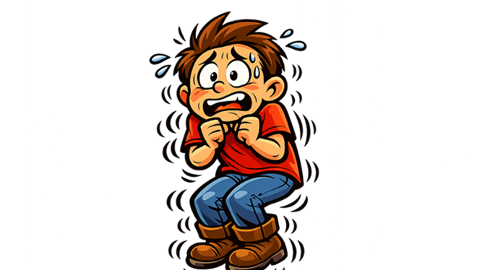
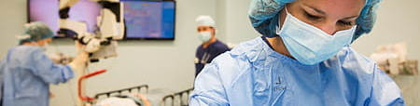
Moving, having surgery, loosing someone you love, or broken friendships can leave us anxious and “shaking in our boots.”

Slide 14
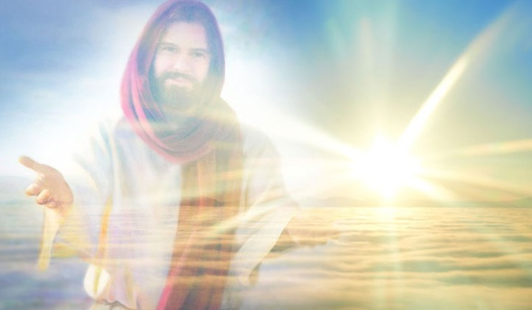
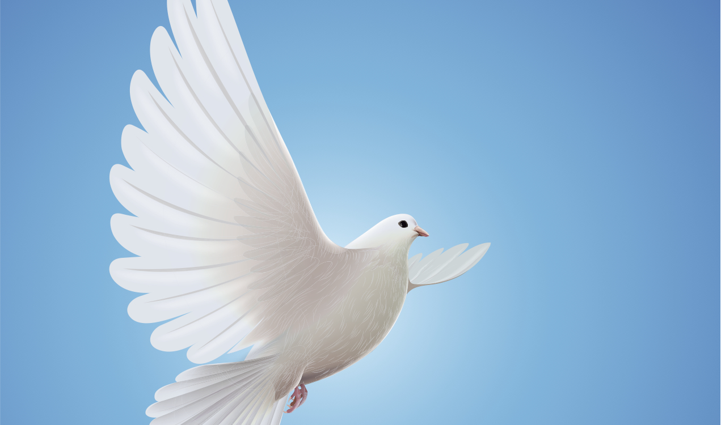
Faith begins by trusting Jesus as our Lord and Savior.
The Holy Spirit lives in us giving us guidance and strength.

Slide 15
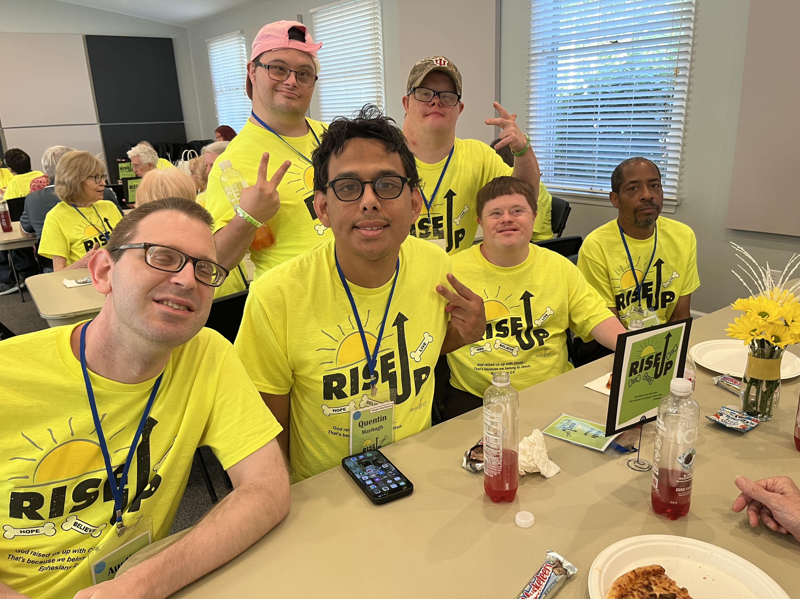

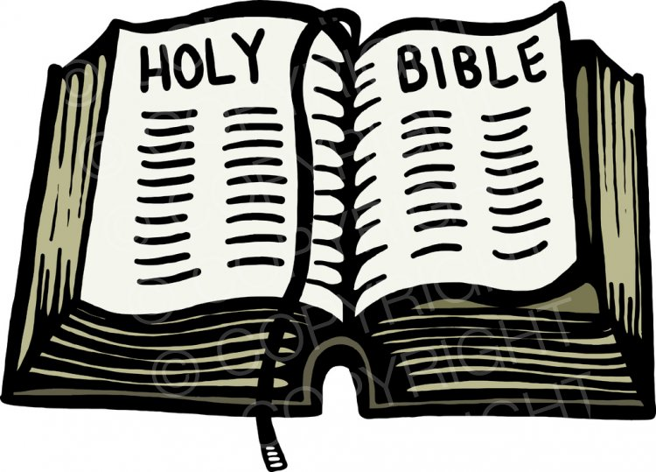
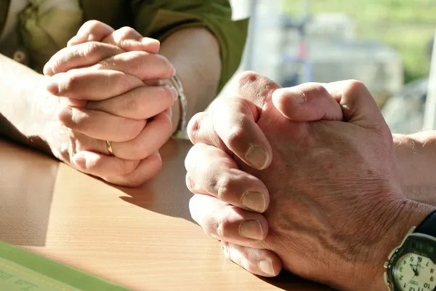
God gives us Christian Community, praying friends, the Bible, and music to encourage and strengthen us.

Slide 16

“He is like a shield to me.
He is the power that saves me. He is my place of safety.”
Psalm 18:2

Slide 17
The King ordered the three men to be thrown into the fiery furnace.

Slide 18
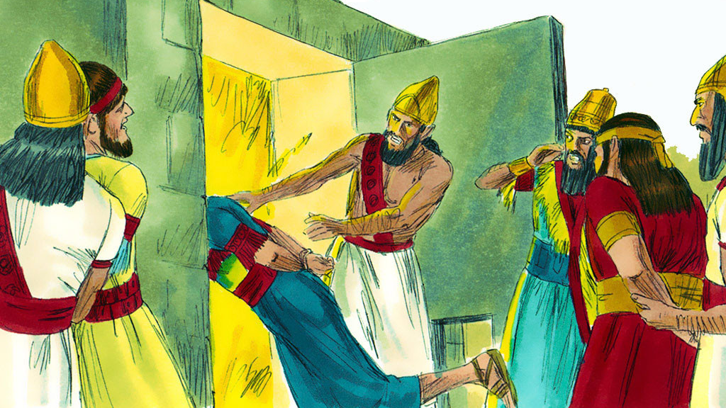
The King was angry and ordered the furnace to be heated hotter than usual and threw Shadrach, Meshach, and Abednego into the fiery furnace.

Slide 19
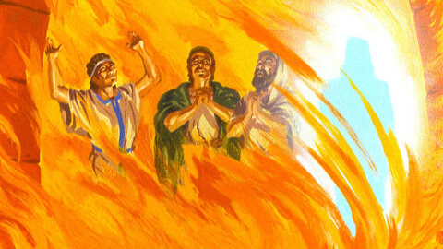
Something incredible happened! The King saw four men untied and unharmed. The fourth looked like a Son of the gods.

Slide 20


When a fiery trial has you “shaking in your boots” refuse to bow down to fear and hold on to UNSHAKABLE FAITH in Jesus Christ, our
King of Kings.

Slide 21
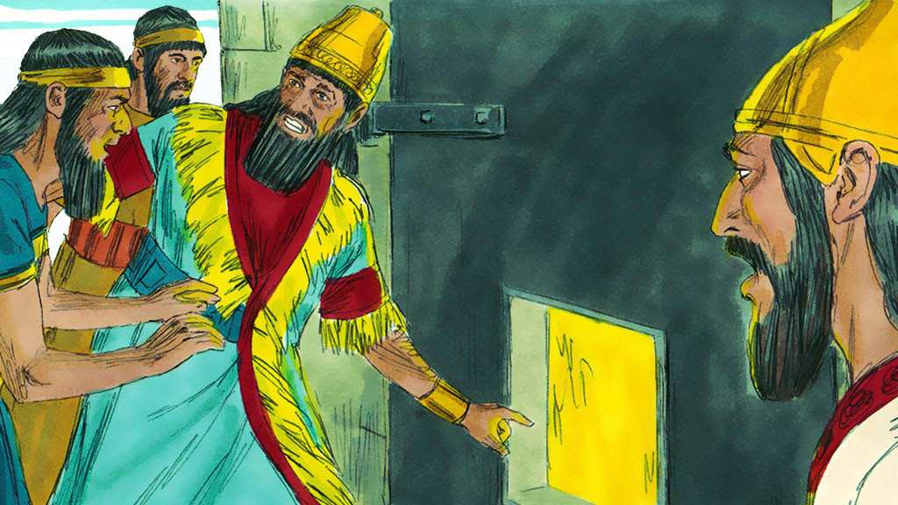
The King came to the opening of the furnace and shouted,
“Come out! You servants of the Most High God.”

Slide 22
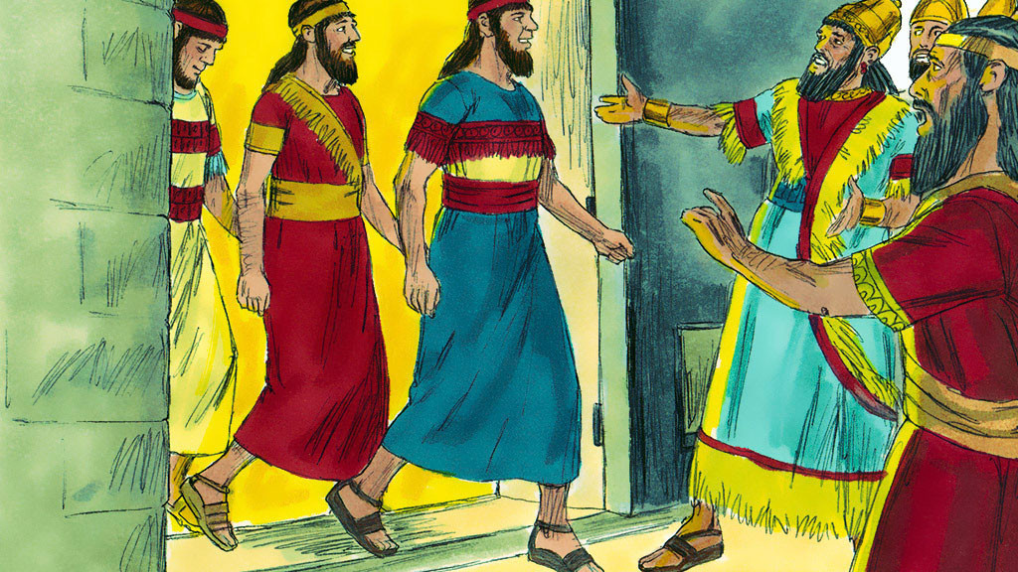
When they came out of the fire not a single hair on their head was burned. They didn’t even smell like smoke. It was a miracle!

Slide 23
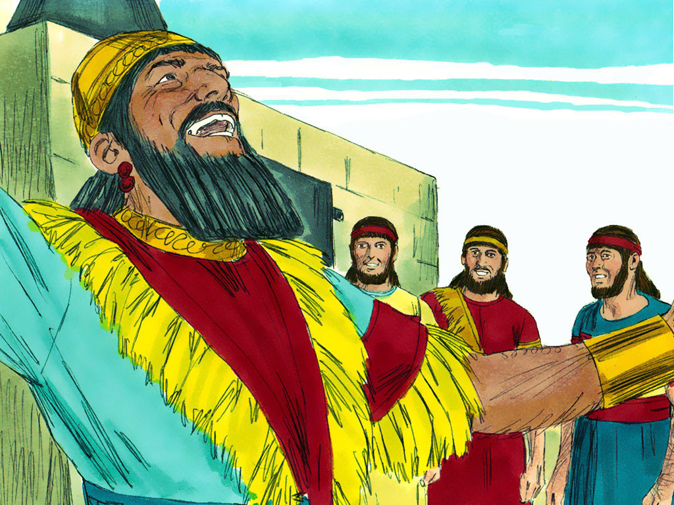
“Praise be to the God of Shadrach, Meshach and Abednego.”

