Slide 1
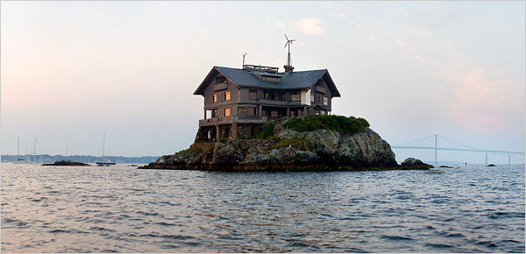

Unshakable Foundation
Matthew 5:1-2, 7:24-27

Slide 2

“I keep my eyes always on the Lord. ​
​
With him at my right hand, ​
​
I will not be shaken.”
Psalm 16:8

Slide 3
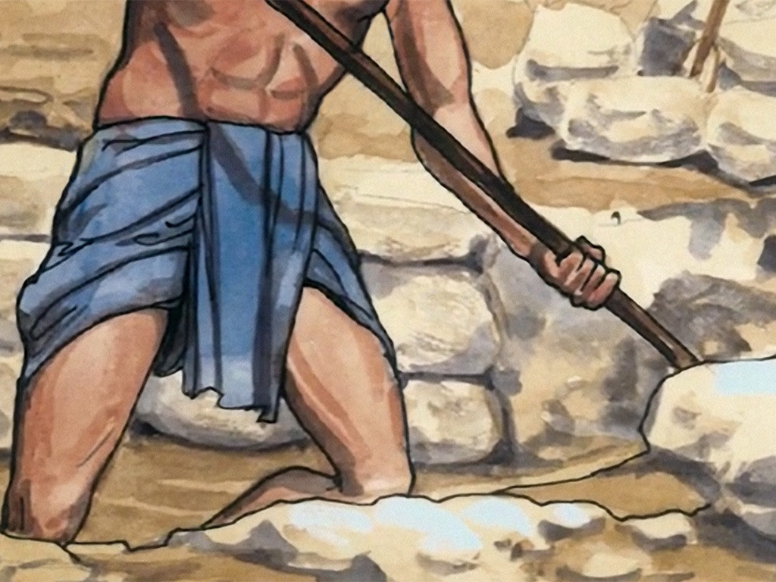
“So then, everyone who hears My words and puts them into practice is like a wise man, He builds his house on the rock.”
Matthew 7:24

Slide 4
A foundation is the solid structure that holds up a building and keeps it steady.
Foundation of rock

Slide 5
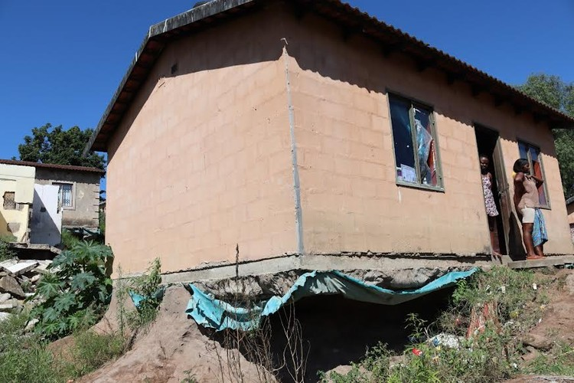
Without a solid foundation, a building can collapse in a big storm or earthquake.
Foundation of sand

Slide 6
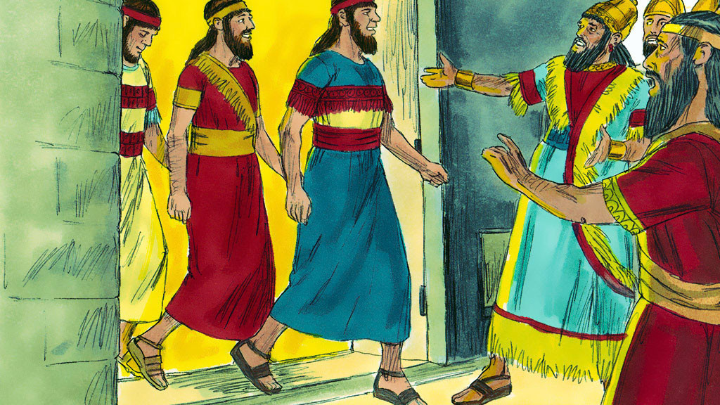
The UNSHAKABLE FAITH in God of Shadrach, Meshach, and Abednego in the fiery furnace.

Slide 7
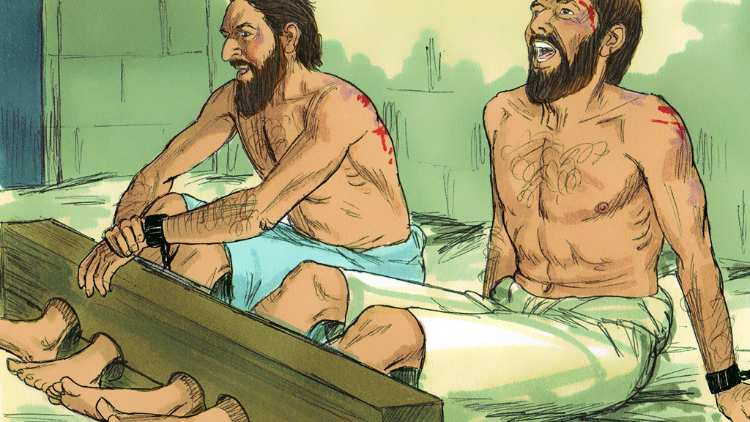
The UNSHAKABLE FOCUS of Paul and Silas praising God in the prison cell.

Slide 8
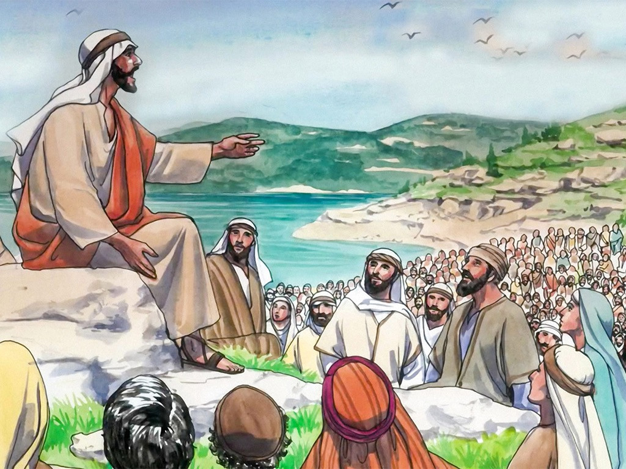
When Jesus saw the large crowds, He went up on a mountainside and sat down…He began to teach.
The Sermon on the Mount

Slide 9
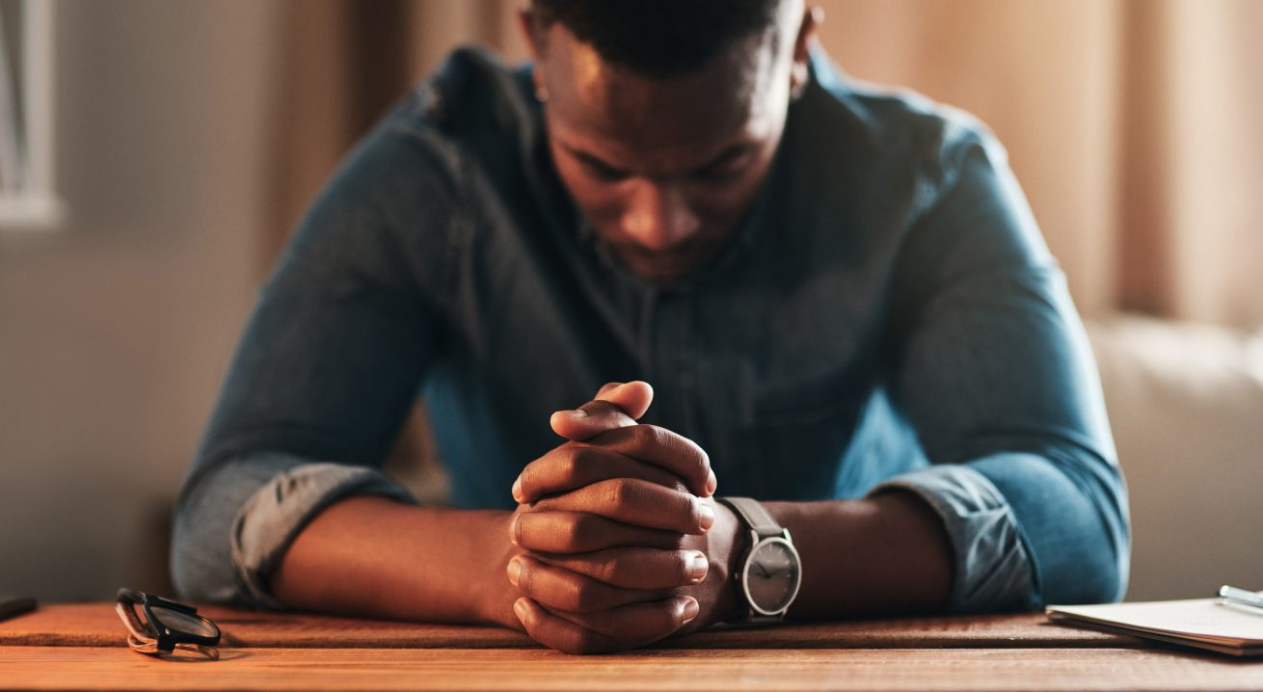
Jesus taught how we are to pray by giving us an example –
“The Lord’s Prayer.”

Slide 10
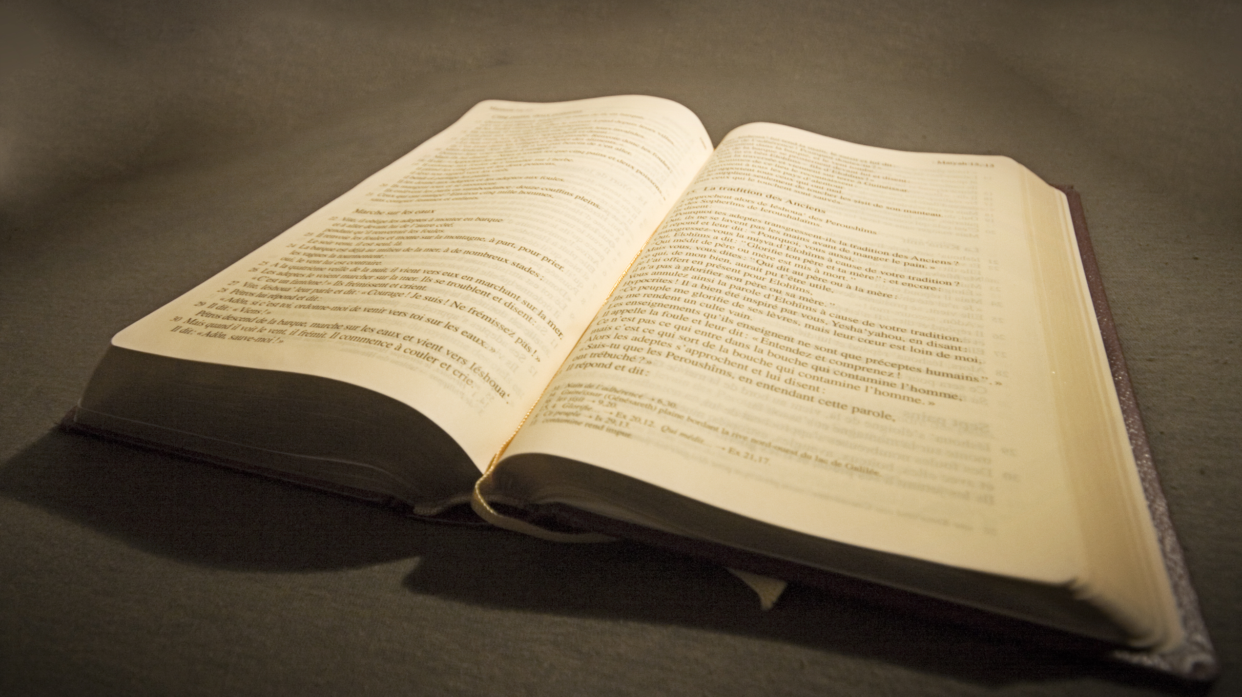
We can seek God rather than worry or be anxious about what we need.
This Photo by Unknown Author is licensed under CC BY-SA

Slide 11

We can love others by treating them as we would want to be treated.

Slide 12
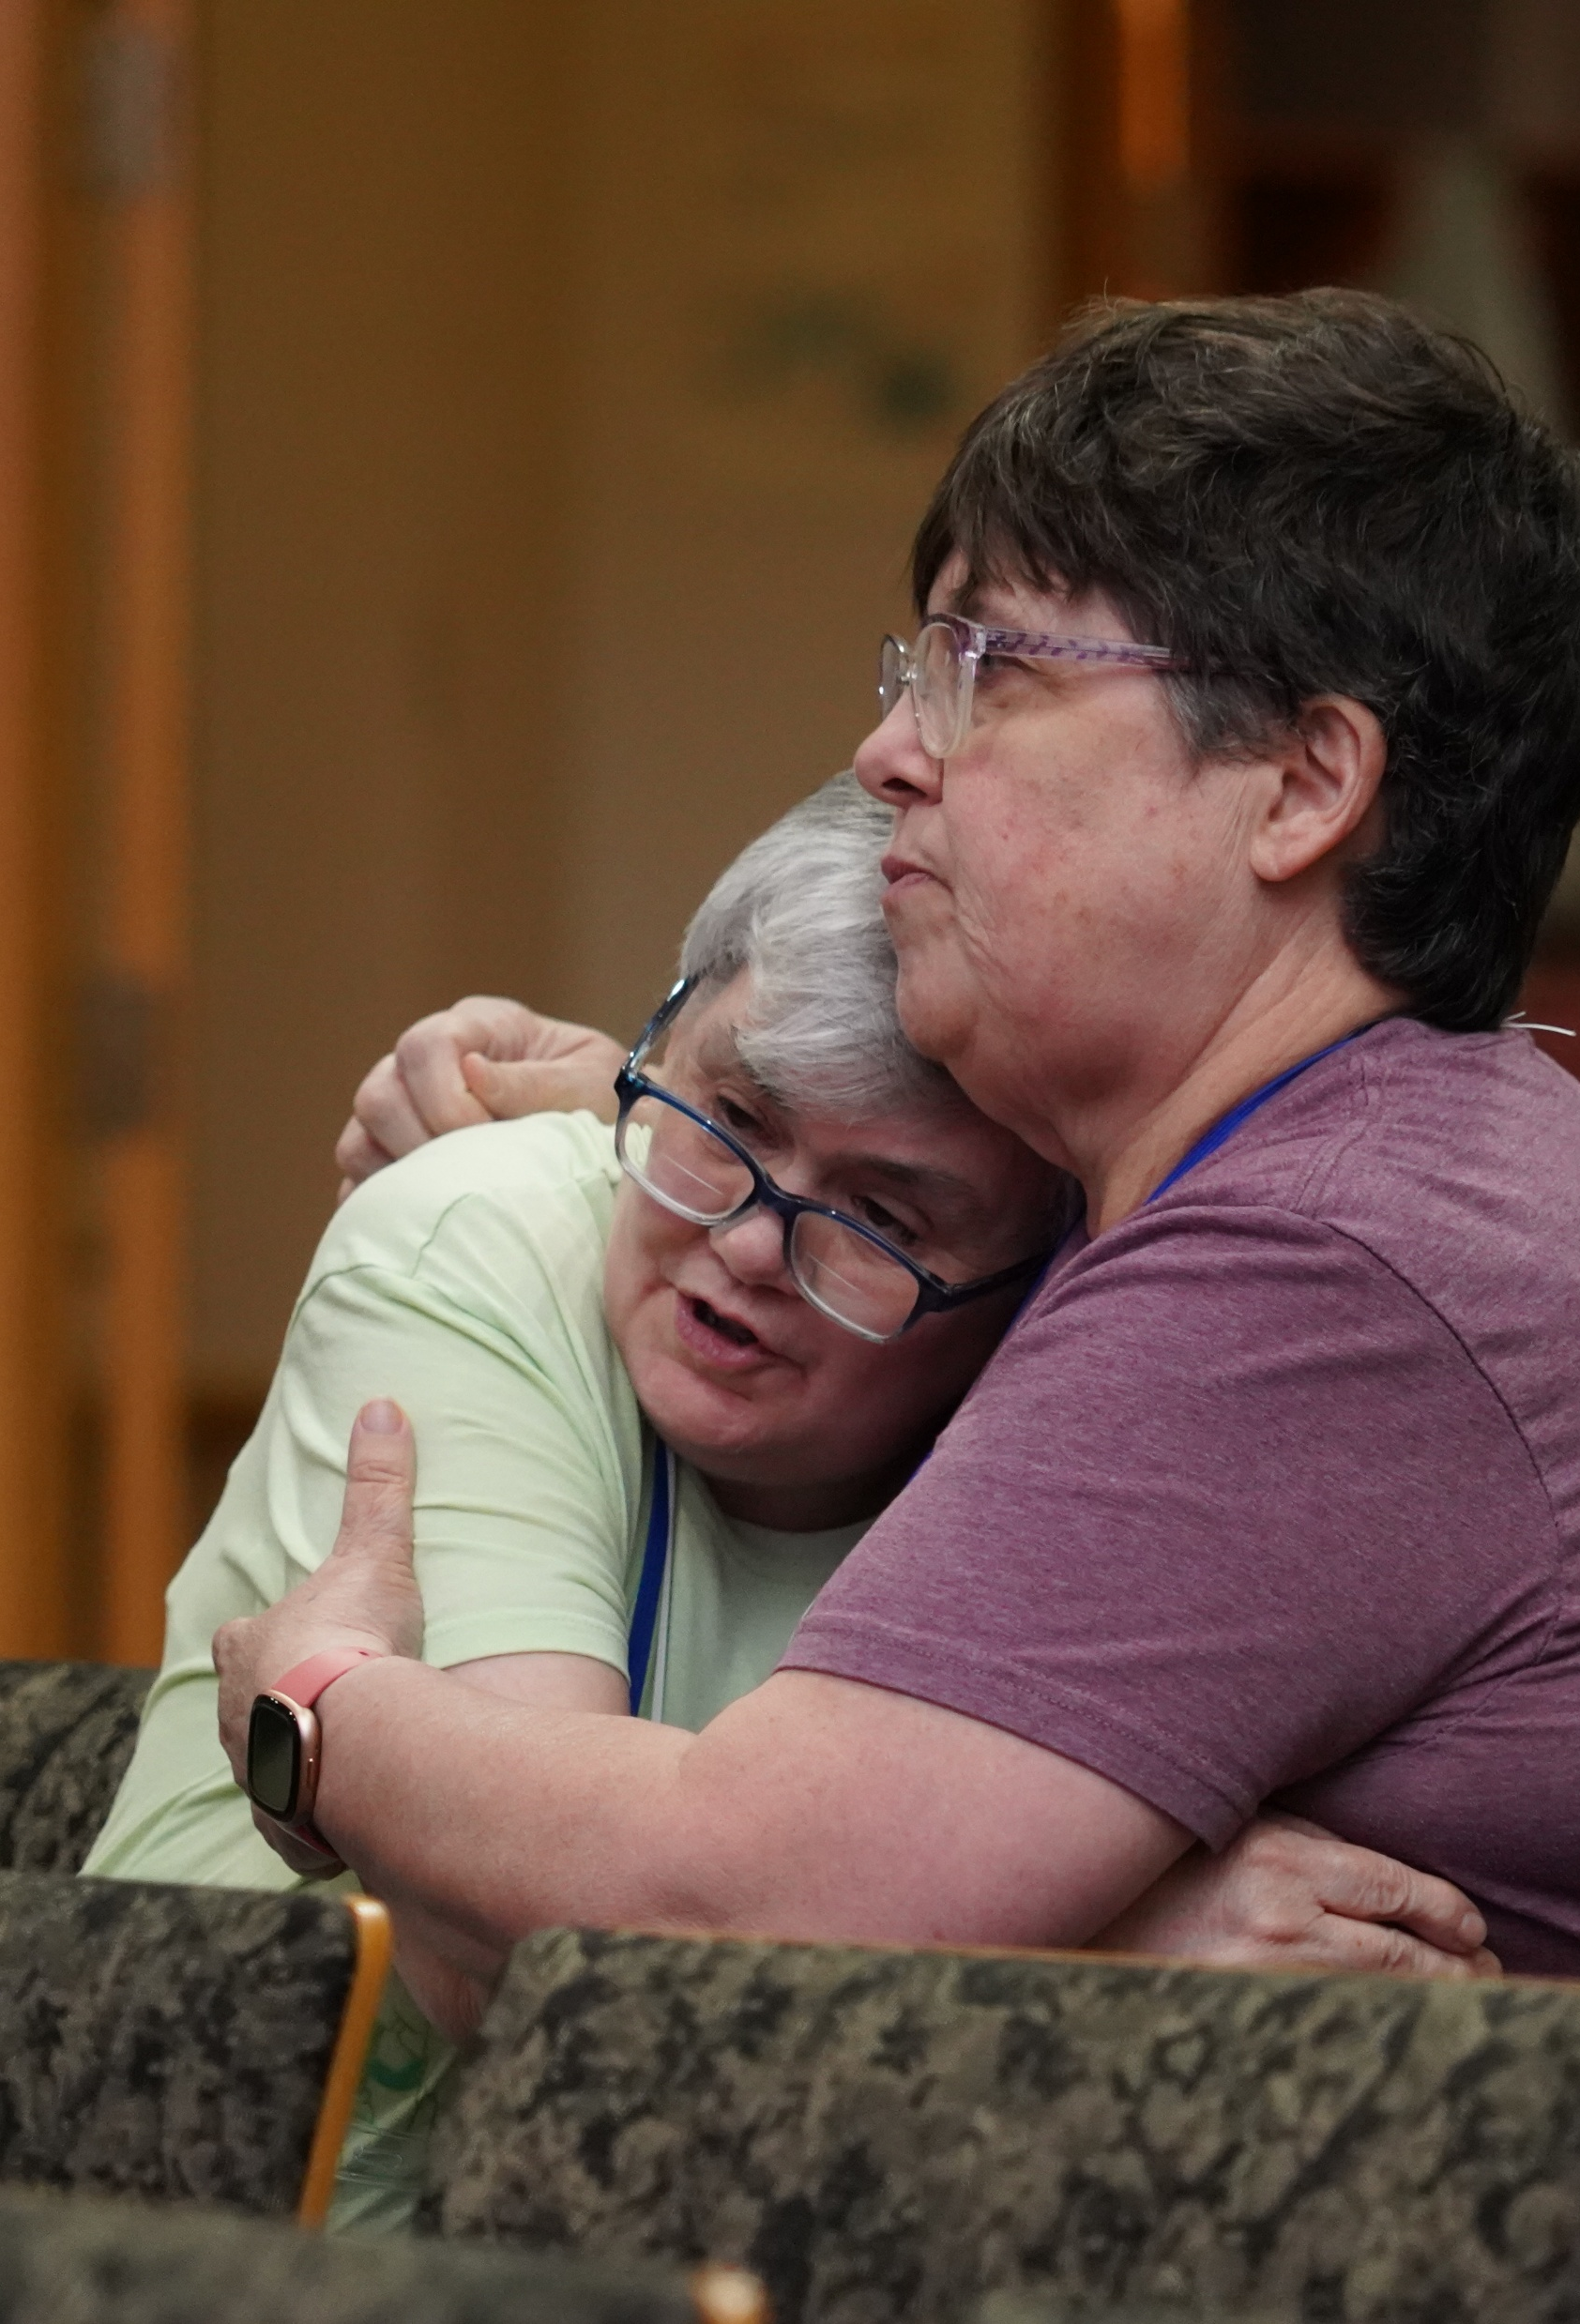
We can let our light shine so others will see Jesus and glorify the Father.

Slide 13
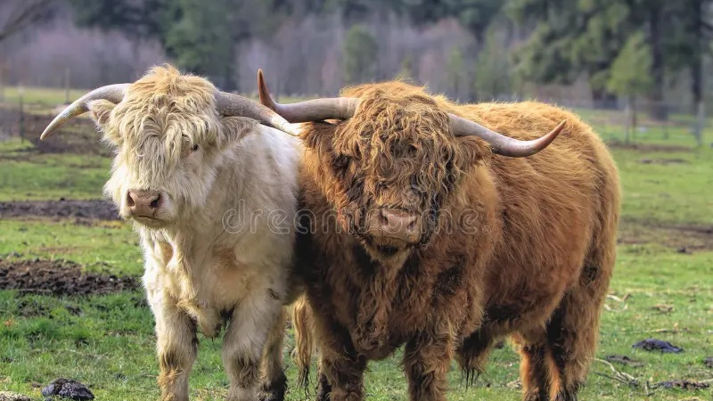
No…Not a pair of bulls!

Slide 14
A parable is a short, everyday story with an important message.

Slide 15
“Therefore, everyone who hears these words of mine and puts them into practice is like a wise man who built his house on the rock.”

Slide 16
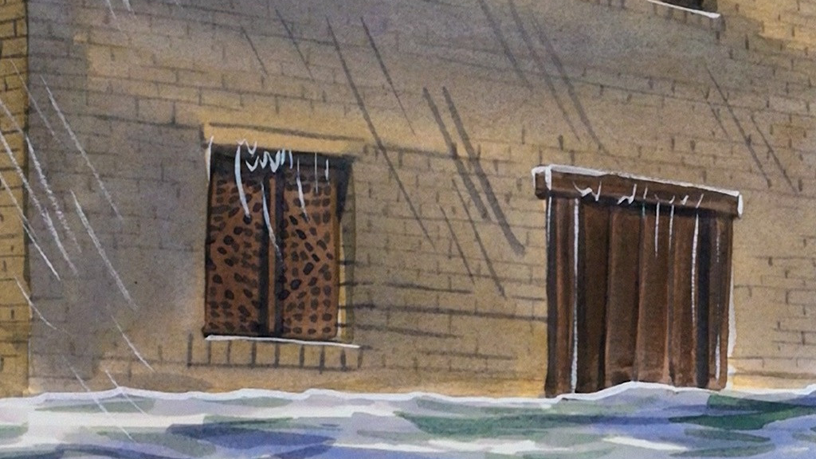
“The rain came down, the winds blew and beat against the house; yet it did not fall, because it had its foundation on the rock.”

Slide 17
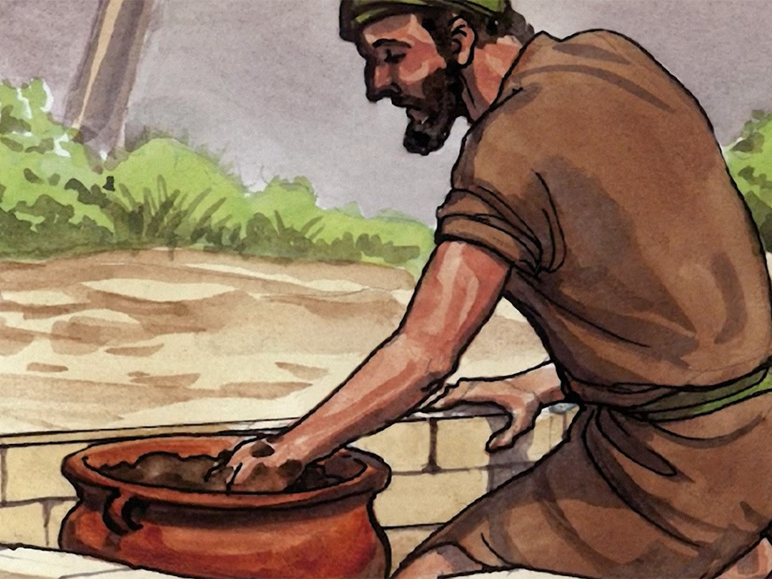
“Everyone who hears my words and does not put them into practice is like a foolish man who built his house on the sand.”

Slide 18
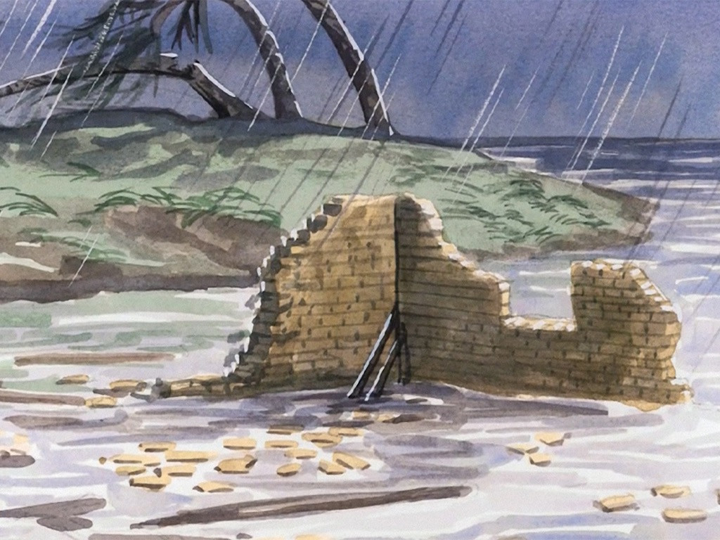
“The rain came down, the winds blew and beat against that house, and it fell with a great crash!”

Slide 19
Jesus is telling us about two kinds builders.
One built on rock, the other on sand.

Slide 20
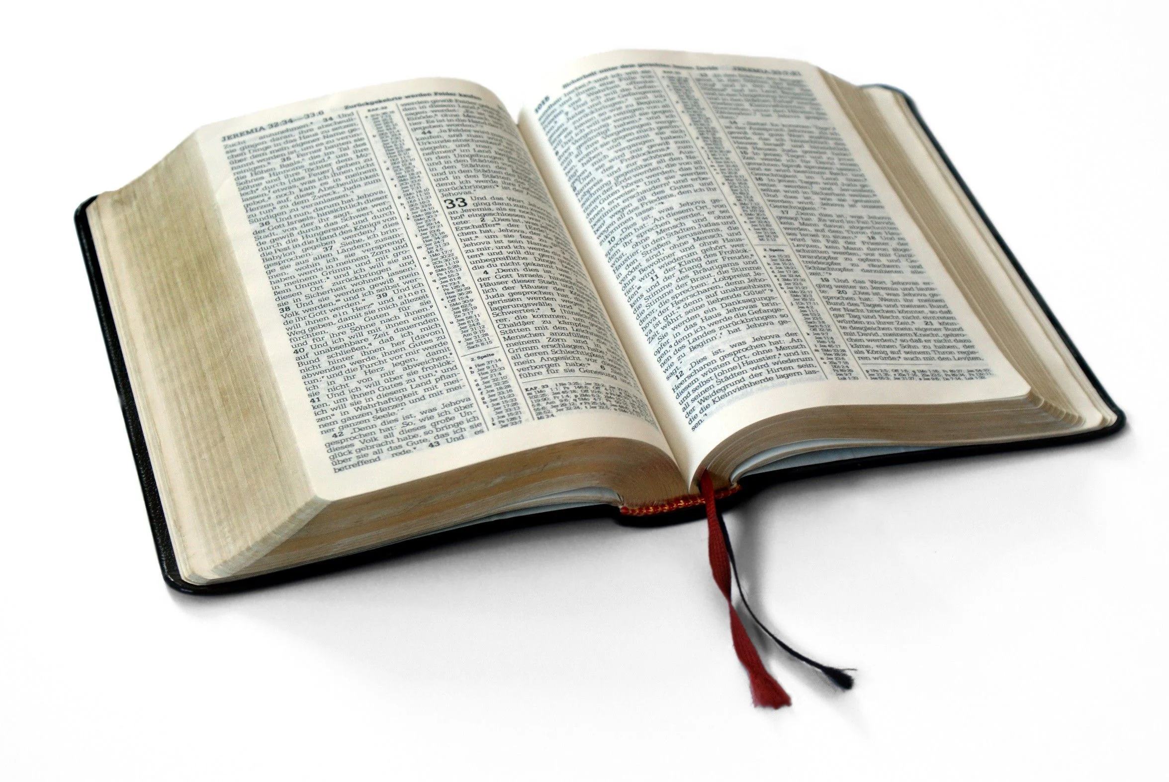
If we build our lives on the solid rock of God’s Word, we will be wise.
Our foundation will be UNSHAKABLE.

Slide 21
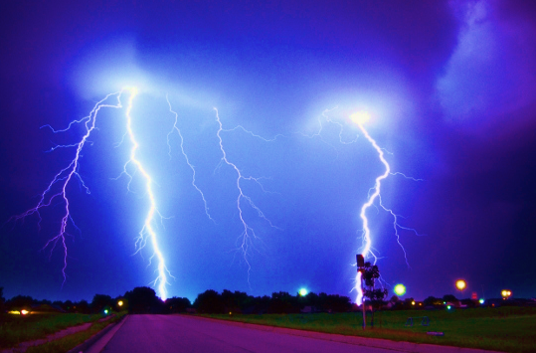



Have you ever gone through a big storm in your life?

Slide 22
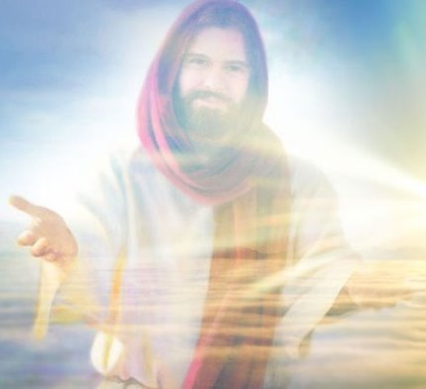

Our most important foundation is trusting Jesus to be our Lord. He will send His Holy Spirit to live in us. He is our guide and comfort through the storms.

Slide 23

The real difference comes down to hearing God’s Word and obeying versus hearing and doing nothing.

Slide 24

When our foundation is on the solid rock of God’s Word, we will be UNSHAKABLE!
Foundation of God’s Word

